Slide 1
APPLYING FISHER’S FUNDAMENTAL THEOREM TO THE CHANGING SCHOLARLY COMMUNICATIONS ECOSYSTEM
CONCERT Meeting
November 8-9, 2017
Taipei, Taiwan
Bruce Heterick
Vice President
ITHAKA
bruce.heterick@ithaka.org
Notes:
Xie Xie (Thank you)
Good afternoon, Friends
My father, who was a wonderful public speaker, once told me that the value of a speaker’s comments are usually inversely proportional to the length of his or hers introduction
I will do my best not to fall into that trap.

Slide 2
JSTOR is a not-for-profit digital library of academic journals, books, and primary sources.
Ithaka S+R is a not-for-profit research and consulting service that helps academic, cultural, and publishing communities thrive in the digital environment.
Portico is a not-for-profit preservation service for digital publications, including electronic journals, books, and historical collections.
Artstor is a not-for-profit providing 2+ million high-quality images and digital asset management software to enhance scholarship and teaching.
Notes:
Before I get started, Let me answer a question that I was asked many times yesterday as I spoke with people during the breaks: What is ITHAKA?
ITHAKA is the umbrella, not-for-profit organization under which sits JSTOR, Artstor, Portico, and ITHAKA Strategy & Research (S&R). ITHAKA’s mission is to preserve and expand access to knowledge and education in affordable and sustainable ways by innovating through technology
Our mission manifests through the work of several services. JSTOR was the first, established in 1997 with the vision of using technology to build a shared, global digital library that the higher education community could invest in and rely upon collectively. It was followed by the others – Artstor with a similar vision for images, Portico founded to address the challenge of preservation of born-digital materials, and Ithaka S+R to look to the future and helping organizations learn, share insights and practices, and successfully navigate change in the digital environment.
My remarks here today will not be about ITHAKA or its services specifically, but rather about the scholarly communications ecosystem in general. In particular, I want to discuss how that ecosystem is struggling to adapt to the transition from print to electronic, and look at some early examples of experiments and exemplar projects that are underway to help find solutions to some of the adaptation issues that libraries, publishers, and scholars are dealing with in this new digital world.

Slide 3
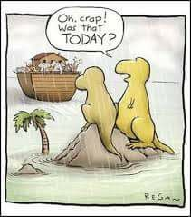
Notes:
I’m not going to predict to what degree we as libraries and content providers will be successful in adapting to this rapidly changing environment, but I do believe it is important for all of us to remember that we operate in a smaller ecosystem that sits inside a much larger ecosystem.

Slide 4
Notes:
And, the rate of change in OUR system has to keep up with the rate of change in the larger system, or run the risk of getting propelled from the system all together.
As the late Robert Oppenheimer, the American physicist who is sometimes known as the “father of the atomic bomb” is reported to have said:
“The optimist thinks this is the best of all possible worlds, and the pessimist knows it”

Slide 5
The more adapted an organism becomes, the less adaptable it is to any new change
Fisher’s fundamental theorem
Fisher, R.A. (1930) The Genetical Theory of Natural Selection, Clarendon Press, Oxford
Notes:
So, let’s talk about Fisher’s fundamental theorem and how I believe it is an interesting analogy for what I see happening in the scholarly communications ecosystem.
Fisher's fundamental theorem of natural selection is an idea about genetic variance^{[1][2]} in population genetics developed by the statistician and evolutionary biologist Ronald Fisher.
For the purposes of our my talk today, I’ll restate Fisher’s Fundamental Theorem for our context. It suggests that the more adapted an organism becomes, the less adaptable it is to any new change

Slide 6
Transition from print (in libraries) to digital (on networks)
Fundamental characteristics are changing from static to mutable and dynamic
The boundaries are expanding to include a wider context
Reconfiguration of stakeholder roles in the process
Scholarly record
Lavoie, Brian, Eric Childress, Ricky Erway, Ixchel Faniel, Constance Malpas, Jennifer Schaffner, and Titia van der Werf. 2014. The Evolving Scholarly Record. Dublin, Ohio: OCLC Research. http://www.oclc.org/research/publications/library/2014/oclcresearch-evolvingscholarly-record-2014.pdf .
Notes:
Libraries and publishers have had centuries to adapt to the changing print ecosystem: from the formation of the first library in Alexandria, to the invention of the printing press in 1440, to the publishing of the first journal in 1665, to the proliferation of science, technology, and medical publishing in the 20th century. Over that period of time, the ORGANISM – scholarly communications – adapted fairly well to its PRINT environment. At the end of the 20th-century, however, the scholarly record began to change dramatically.
From Lavoie, et al.
“First and perhaps most obvious, we have been witnessing a shift from what was traditionally a print-centric scholarly record to one that is increasingly manifested in digital form and resides on the network.
Second, the boundaries of the scholarly record are shifting and blurring. While in the past we might have thought of the scholarly record as consisting primarily of text-based materials like journals and monographs, today the cohort of materials over which the scholarly record can potentially extend has expanded dramatically, to include research data sets, computer models, interactive programs, complex visualizations, lab notebooks, and a host of other materials. Some of the fundamental characteristics of the scholarly record are changing. At the risk of oversimplifying an admittedly nuanced point, one might characterize the scholarly record of the past as largely static, in that much of it was manifested in fixed formats like print; it was made available primarily through formal publication channels like books or journals; and its focus was on the documentation of final outcomes, rather than the entire process of scholarly inquiry. Currently, however, these characteristics are being turned on their heads: the scholarly record, by virtue of its transition to digital formats, is now much more mutable and dynamic than in the past; it is made available through a blend of both formal and informal publication channels.
Thirdly, the scholarly record’s boundaries are expanding to include a much wider context surrounding the publication of a scholarly outcome. This point is driven in part by an increased emphasis on replicability of scholarly outcomes, as well as higher expectations around what Lavoie et al. termed “leverageability”: that is, the ability to take previously published work and integrate it seamlessly into new work.
Finally, another trend of note is the reconfiguration of the stakeholder roles associated with the scholarly record. The pathways by which materials comprising the scholarly record are created, managed, and consumed are changing in a variety of ways, with traditional stakeholders taking on new roles, and new stakeholders taking on traditional roles. The scholarly communication “supply chain” is evolving in concert with the scholarly record itself. These trends, as well as others, are hastening the scholarly record along an evolutionary path that promises to transform our view of the nature and scope of the scholarly record, as well as the configuration of stakeholders roles associated with it. However, this is not to suggest that the scholarly record was previously in some kind of stationary equilibrium, and has only recently been subject to transformative forces. The scholarly record is always evolving, and while we are not experiencing a sudden revolution in the development of the scholarly record, we are experiencing a particularly emphatic confluence of trends that are accelerating the evolutionary process that is changing the boundaries of the scholarly record, as well as the configurations of the stakeholder roles associated with it. “

Slide 7
Content businesses are impacted by lack of library funding, open access, social networks, and piracy
Content providers want to reposition themselves beyond the content business
CONSOLIDATION in traditional scholarly
PUBLishing
Schonfeld, Roger. February 2, 2017. The Strategic Investments of Content Providers, http://www.sr.ithaka.org/blog/the-strategic-investments-of-content-providers/
Notes:
As Jose noted yesterday, publishers – content businesses – are being impacted by a number of variables. Some of those variables are within their control, and some are not.
From Schonfeld:
“From Elsevier and Springer to EBSCO and ProQuest, these publishers and content providers are reducing their reliance on their content businesses as engines of growth. While these businesses remain strong, they are pursuing one of two newer directions for greater growth. Aggregators like EBSCO and ProQuest are investing substantially in content support businesses, while scientific publishers are investing substantially in research management and analytics businesses.
EBSCO and ProQuest alike are building up an impressive array of content support businesses, which are intended to be sold principally to libraries but are outside of the materials budget. Elsevier and Springer (through its related Digital Science businesses) are building portfolios in research management and analytics businesses, which are intended to be sold to universities (beyond the library budget altogether) and to scholars themselves.”

Slide 8
Notes:
“In recent years, ProQuest has continued to bolster its core content platform with ebrary, EBL, MyiLibrary, and more recently Alexander Street Press, yielding a growing suite of licensed content products that support undergraduate teaching and learning. But of even greater importance have been the major investments in content support businesses, including Serials Solutions, Ex Libris, Coutts, and SIPX. These new businesses, which are believed to be collectively profitable, position ProQuest as the foremost provider of library management systems, with substantial strengths in acquisition, discovery, and permissions as well.”

Slide 9
Content businesses are impacted by lack of library funding, open access, social networks, and piracy
Content providers want to reposition themselves beyond the content business
Revenue diversification is one key consideration
CONSOLIDATION in traditional scholarly
PUBLishing
Schonfeld, Roger. February 2, 2017. The Strategic Investments of Content Providers, http://www.sr.ithaka.org/blog/the-strategic-investments-of-content-providers/
Notes:
As Ingrid described in her talk yesterday morning, there is some concern in the library community as to how much of the scholarly communications infrastructure is potentially being ceded to commercial interests.
Looking at the macro level at what is happening, we can see common patterns.
Per Schonfeld,
“Today, each has pivoted substantially to reduce its overall exposure to content licensing to academic libraries. It may be too early to know if these strategies will succeed in providing a new source of growth to substitute for licensed content products in the long term. But, it is notable that each has pursued a fundamentally similar strategy of adding businesses that do not rely on the library materials budget; in the case of EBSCO and ProQuest mostly in the library technology budget and in the case of Elsevier mostly outside the library altogether. ”

Slide 10
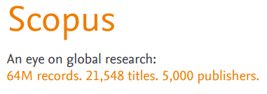
Notes:
Per Schonfeld,
“If we take a look at Elsevier for instance, some of Elsevier’s new businesses in recent years include: building its Scopus discovery and analytics platform; buying and building research management and analytics businesses such as Pure, SciVal, CiteScore, and now Plum; and acquiring and expanding laboratory management, social networking, and open content products such as Hivebench, Mendeley, and SSRN. Even while it clearly remains in investment mode for these new businesses, Elsevier is already positioned as a foremost provider of laboratory management, researcher workflow, and research analytics for the higher education and scientific communities. When you add in the most recent acquisition of Bepress – and their Digital Commons institutional repository service – you can see that Elsevier is truly building an end-to-end solution for the scholarly workflow. One of the most interesting aspects of these new directions is that they are mutually reinforcing with Elsevier’s content businesses. This is an impressive strategic pivot.”

Slide 11
Content businesses are impacted by lack of library funding, open access, social networks, and piracy
Content providers want to reposition themselves beyond the content business
Revenue diversification is one key consideration
The boundaries between content, analytics, discovery, workflow, and compliance may be collapsing
CONSOLIDATION in traditional scholarly
PUBLishing
Schonfeld, Roger. February 2, 2017. The Strategic Investments of Content Providers, http://www.sr.ithaka.org/blog/the-strategic-investments-of-content-providers/

Slide 12
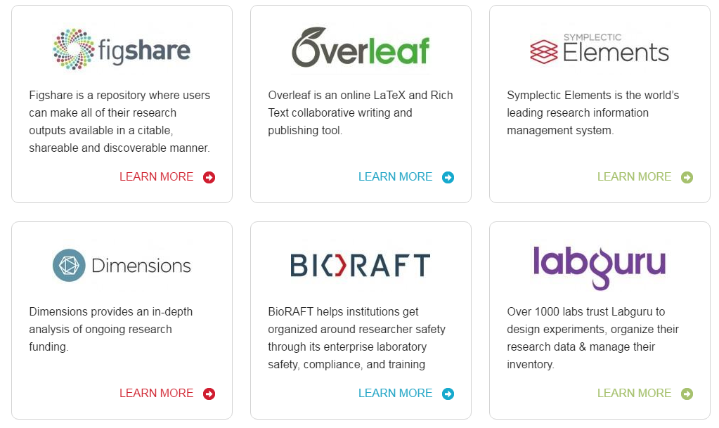
Notes:
Recently, news broke that Springer Nature is preparing for a 2018 stock market listing, with an anticipated valuation of approximately €4 billion.
Per Schonfeld:
“Other publishers — and libraries and universities — that are working in collaboration with, or customers of, various Digital Science businesses might wish to give greater attention to the implications. First, Digital Science itself may soon become an operating unit of Springer Nature. Second, this could well yield changes to the Digital Science strategy, if its current model as an investor were to give way to the operating integrations that have been a hallmark of Elsevier’s strategy. Universities, libraries, and other publishers should have contingencies in place today that will position them appropriately should these developments occur.”

Slide 13
Repositories
Library Publishing
Research Data Management
Text and Data Mining Services
Student Success
Libraries putting more focus on services
Dempsey, Lorcan. January 31, 2016. The Facilitated Collection, http://orweblog.oclc.org/towards-the-facilitated-collection/
Notes:
The network environment is very different in several important ways. The emergence of the facilitated collection is one element of this changing picture. The facilitated collection is organized according to a network logic, where a coordinated mix of local, external and collaborative services are assembled around user needs. This aims to meet research and learning needs in the best ways available, and not just by assembling material locally. This is actually a significant shift in how the library thinks about what it collects and how that is managed

Slide 14
Seamless integration with their workflows
No access barriers
Access to everything
Preservation of all research outputs
Platforms that facilitate engagement
Faculty and student expectations expanding
Wolff-Eisenberg, C., Rod, A. B., & Schonfeld, R. C. (2016, April 4). Ithaka S+R US Faculty Survey 2015. https://doi.org/10.18665/sr.277685
Notes:
Executive summary of key findings
The Ithaka S+R US Faculty Survey has tracked the changing research, teaching, and information usage practices of faculty members since the early days of the digital transformation. In this sixth triennial cycle, we survey a random sample of US higher education faculty members,
Key findings
Discovery starting points remain in flux.
Interest in supporting students and their competencies and learning outcomes shows signs of surging.
Faculty members prefer to be self-reliant in their data management and preservation processes.
There is no observable trend towards a format transition for monographs.
Traditional scholarly incentives continue to motivate behaviors around research and its dissemination.

Slide 15
Collection Development
Research Data Services
Seeking
collaboration

Slide 16
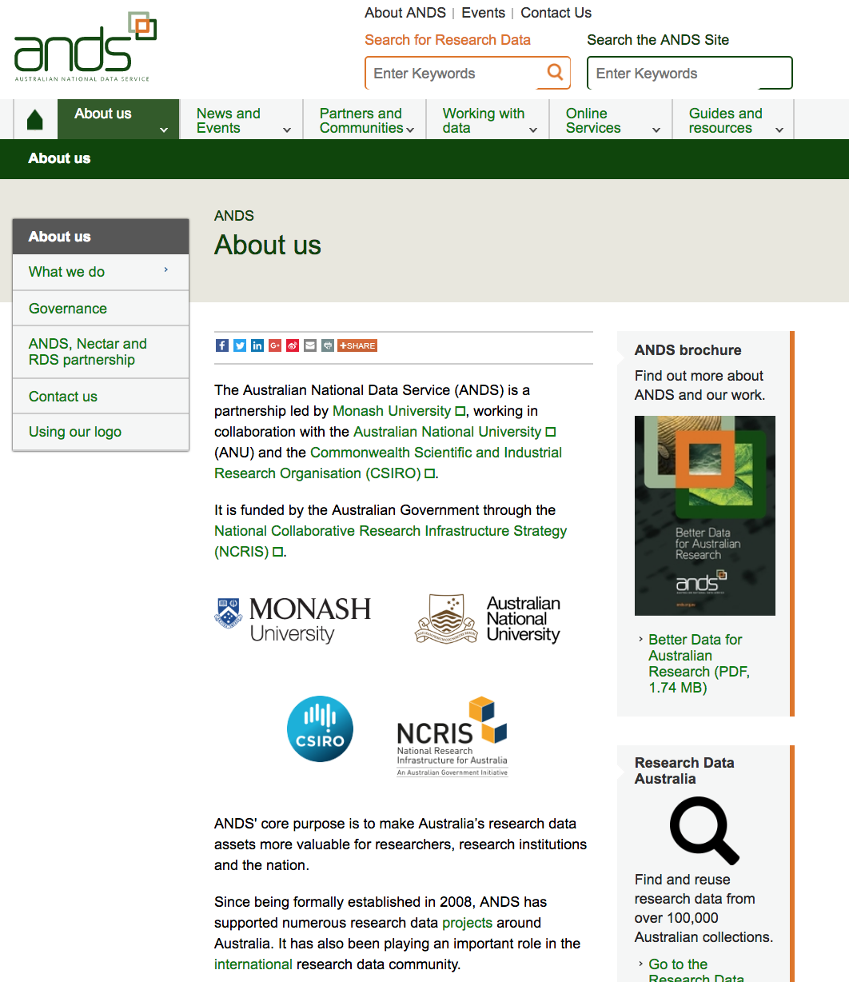
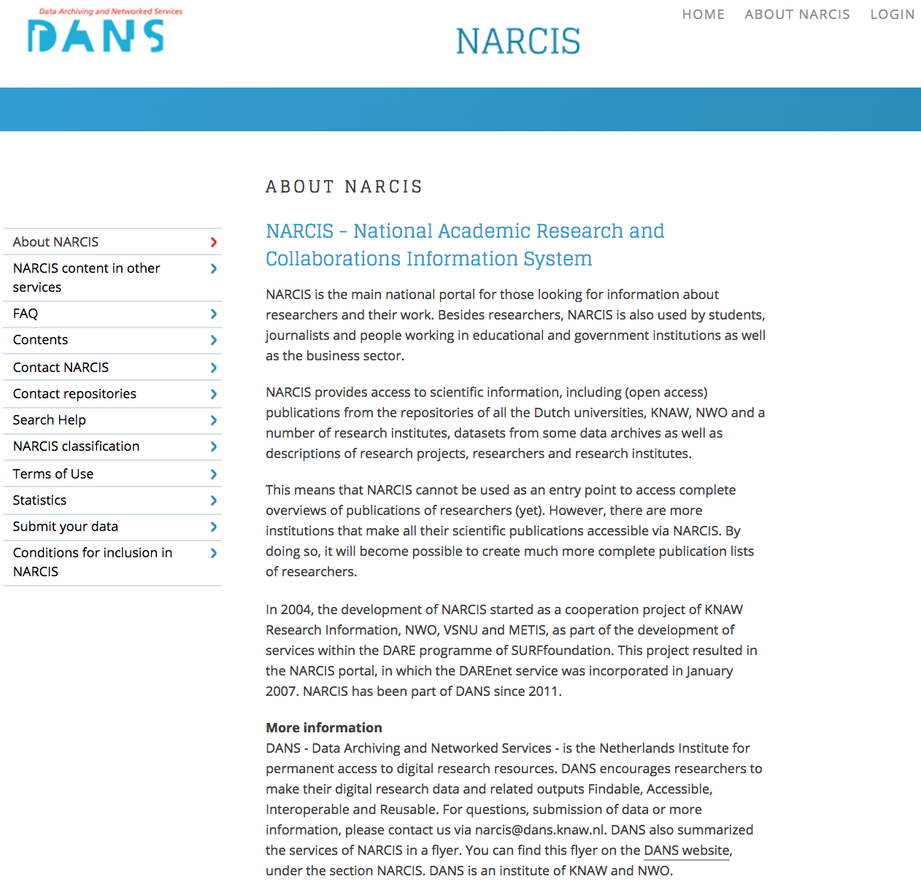
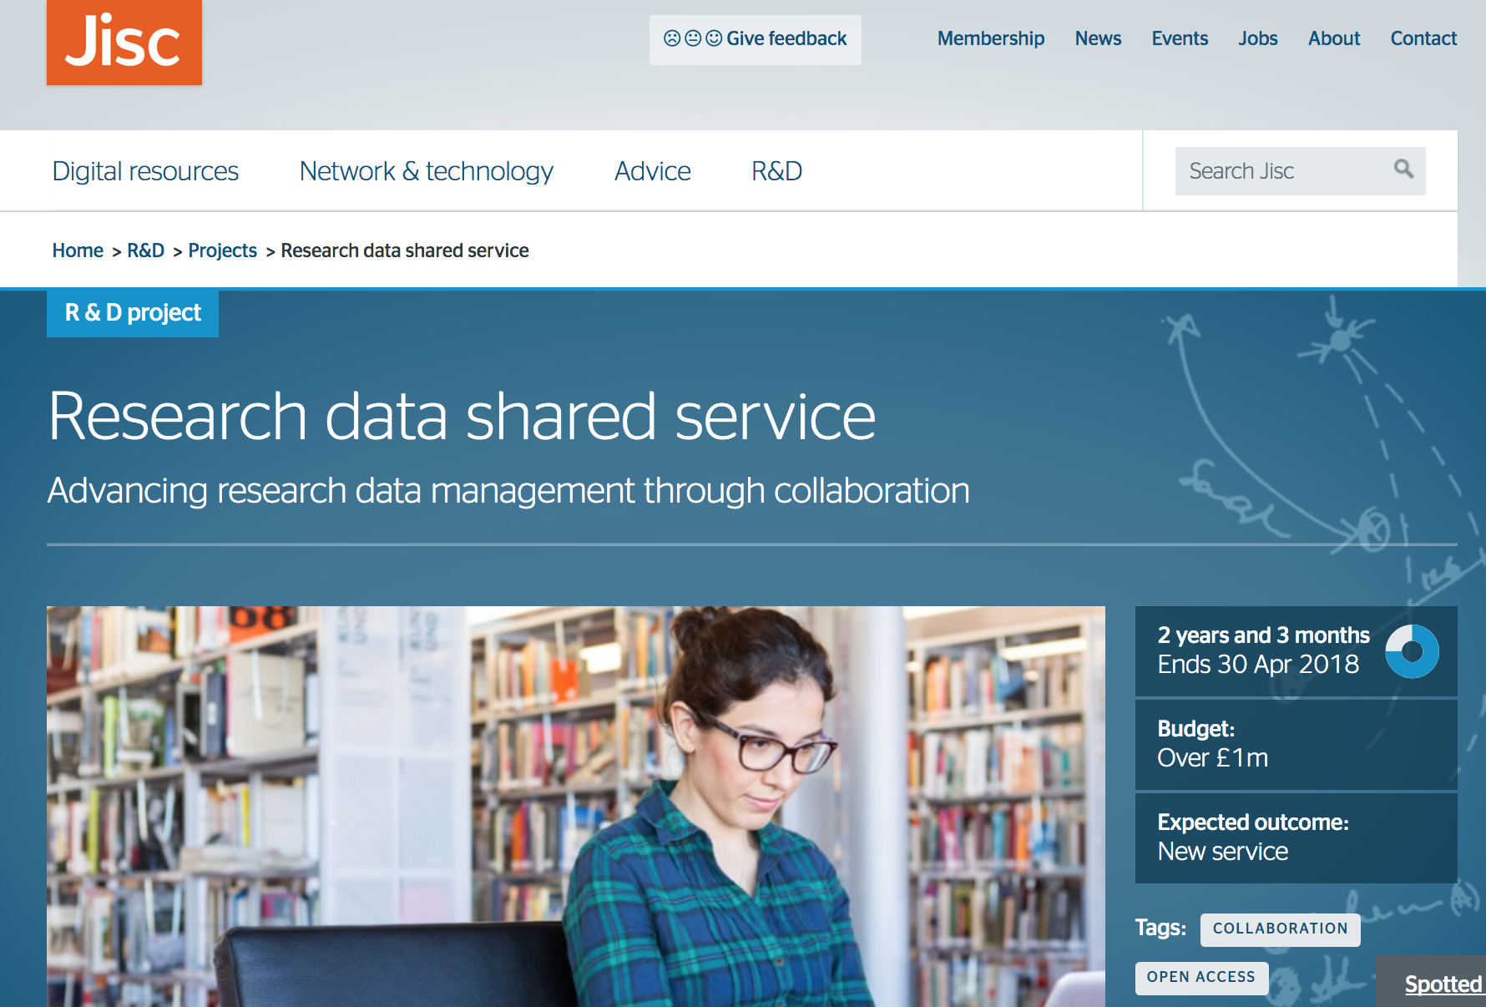

Slide 17
Collection Development
Research Data Services
Contributed Collections
Open Access Publishing
Seeking
collaboration

Slide 18
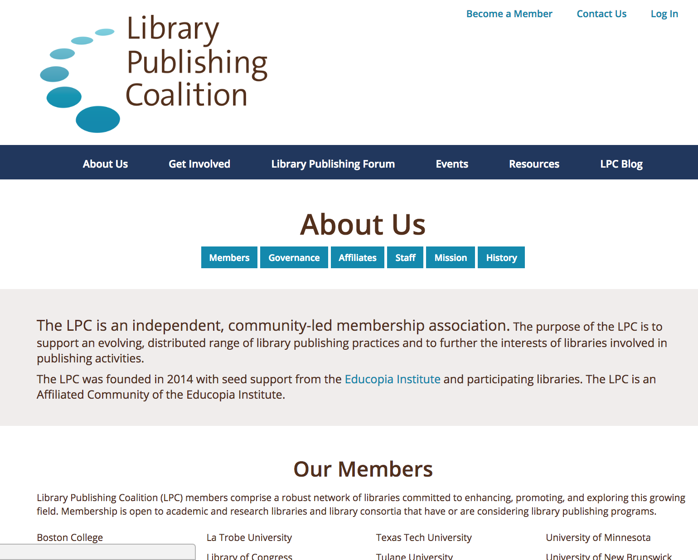
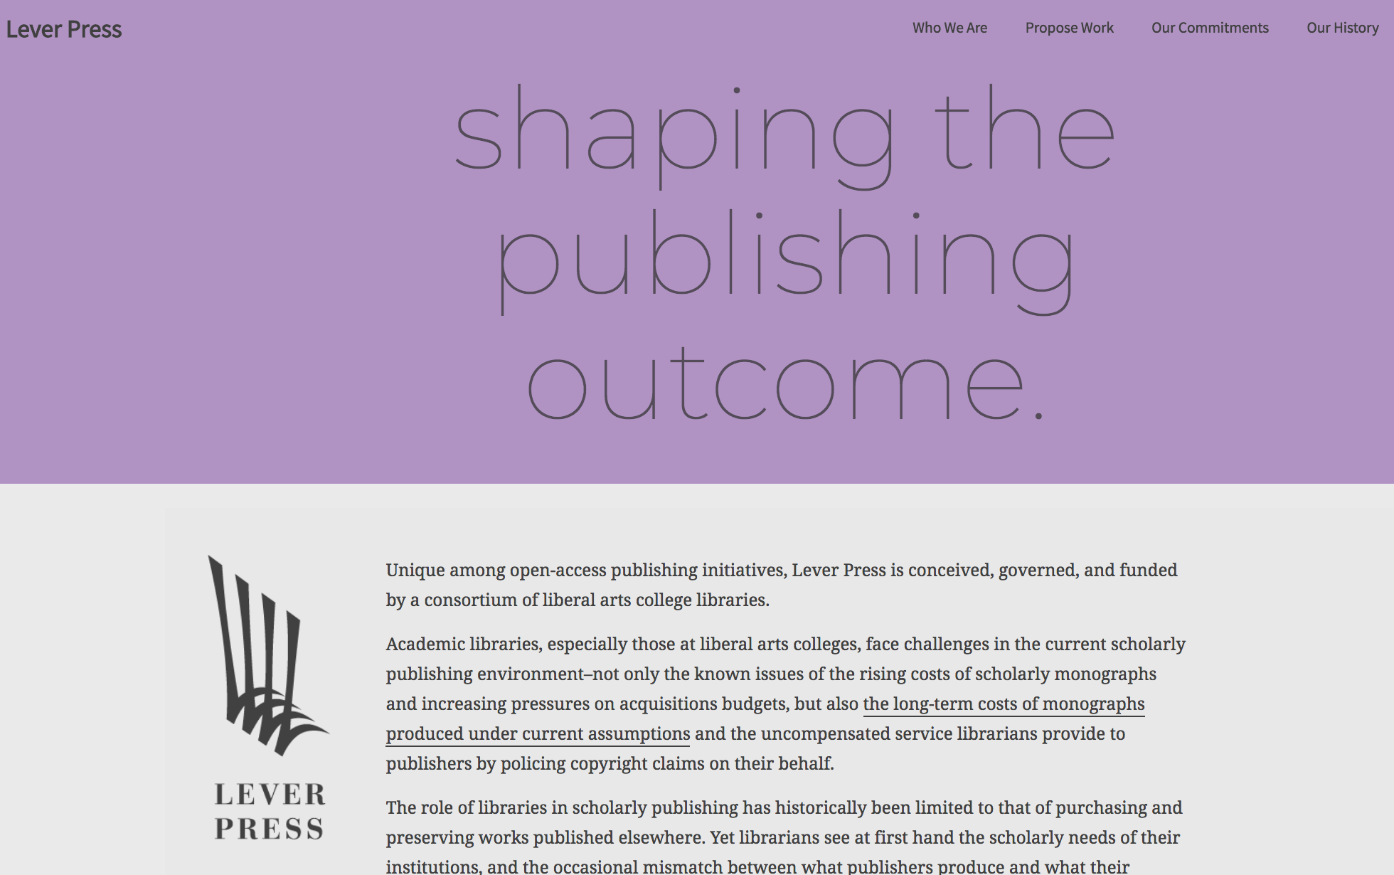
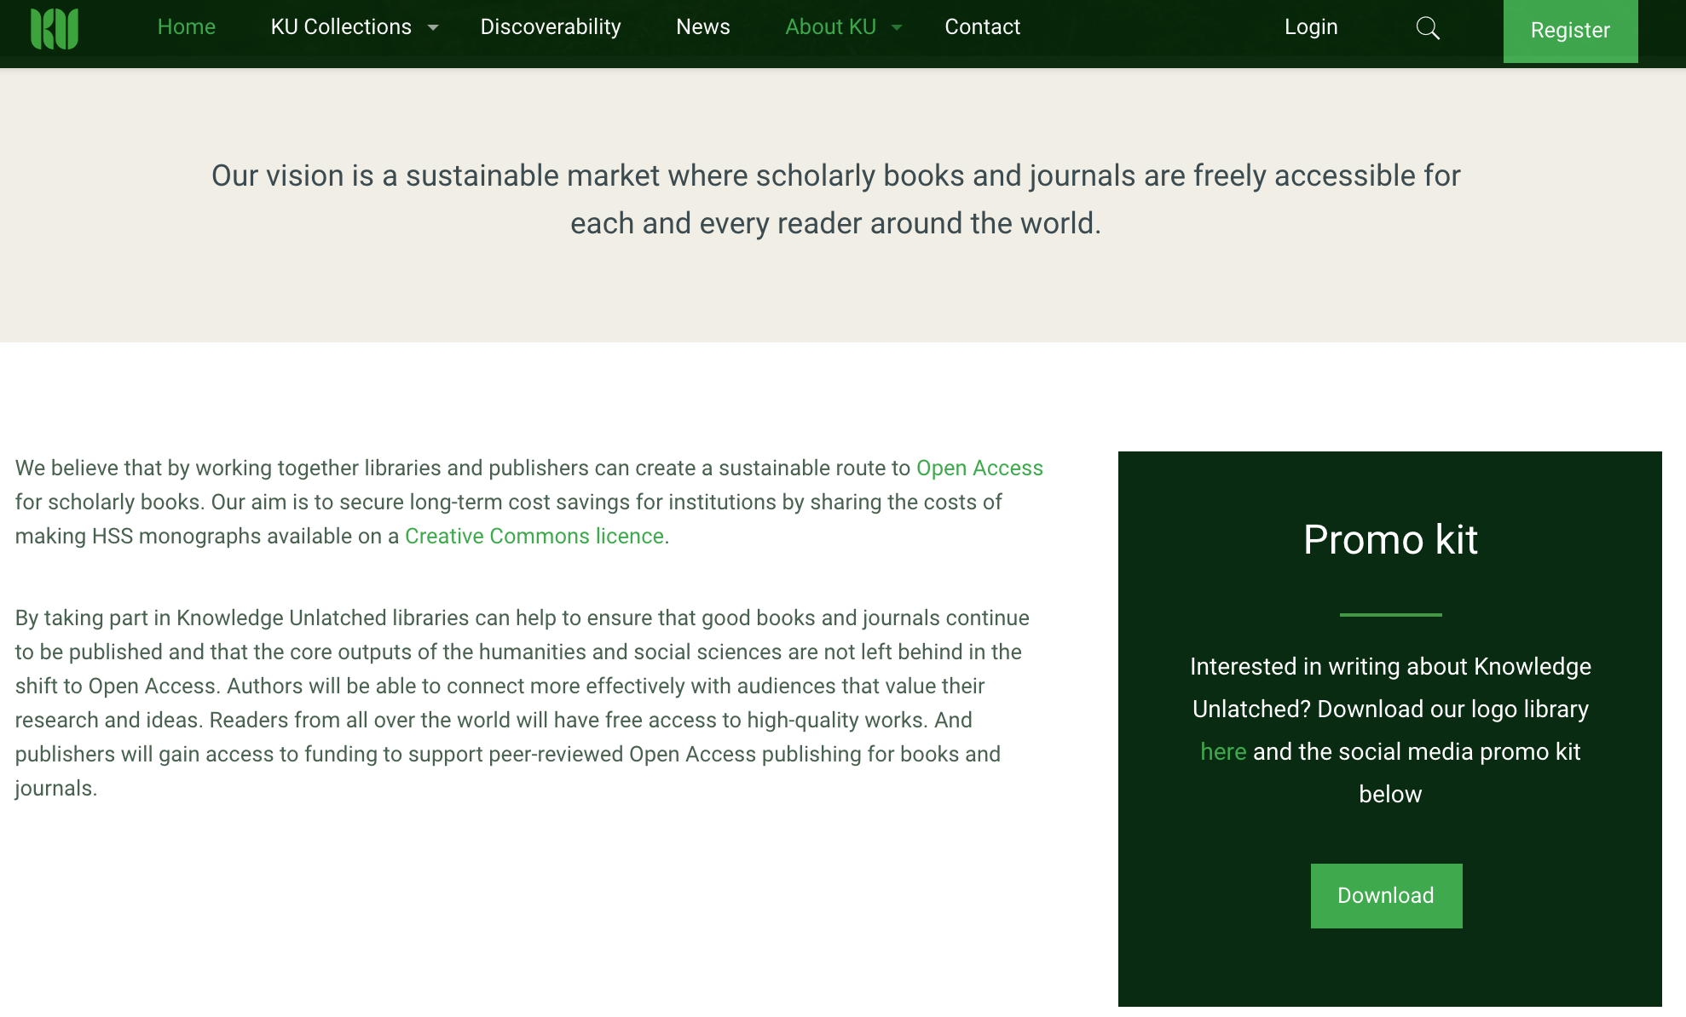

Slide 19
Collection Development
Research Data Services
Contributed Collections
Open Access Publishing
Shared Preservation
Seeking
collaboration

Slide 21
Text and Data Mining Services
Leveraging technology

Slide 22
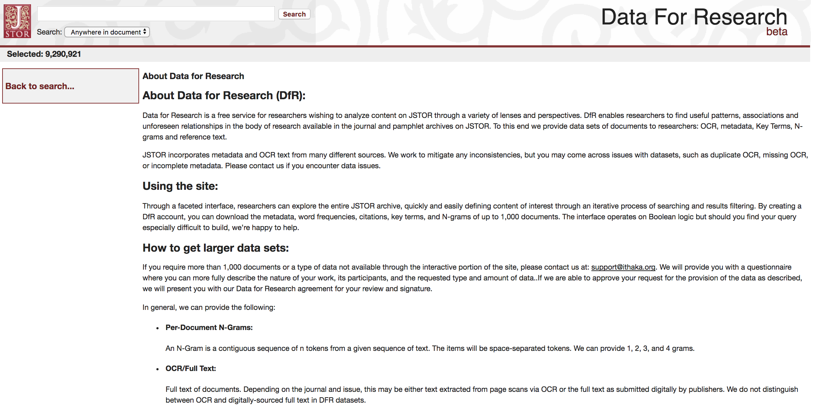
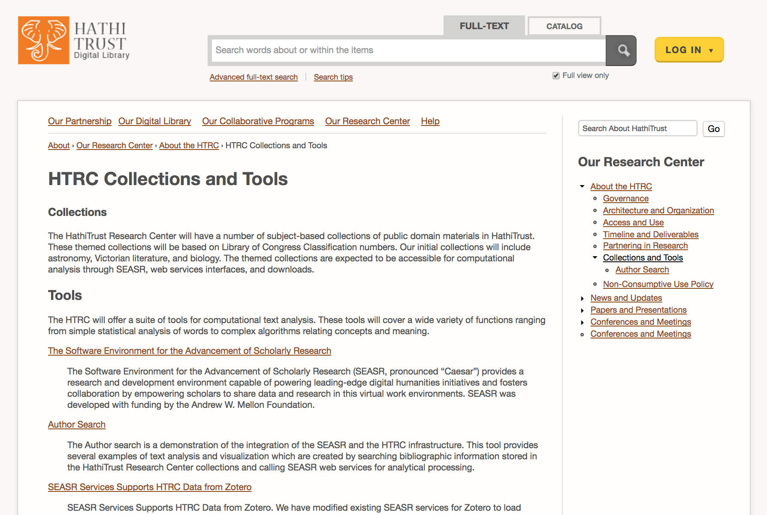

Slide 23
Text and Data Mining Services
Digital Humanities Toolkits
Leveraging technology

Slide 24
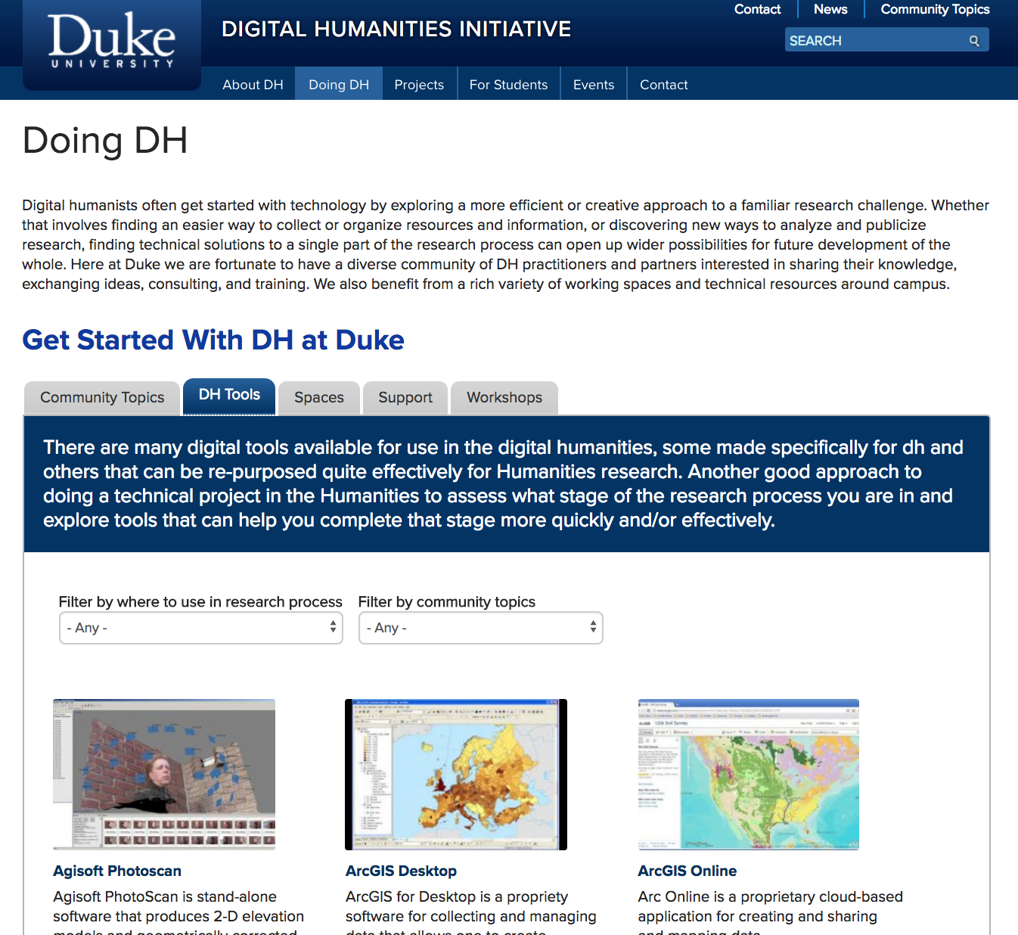
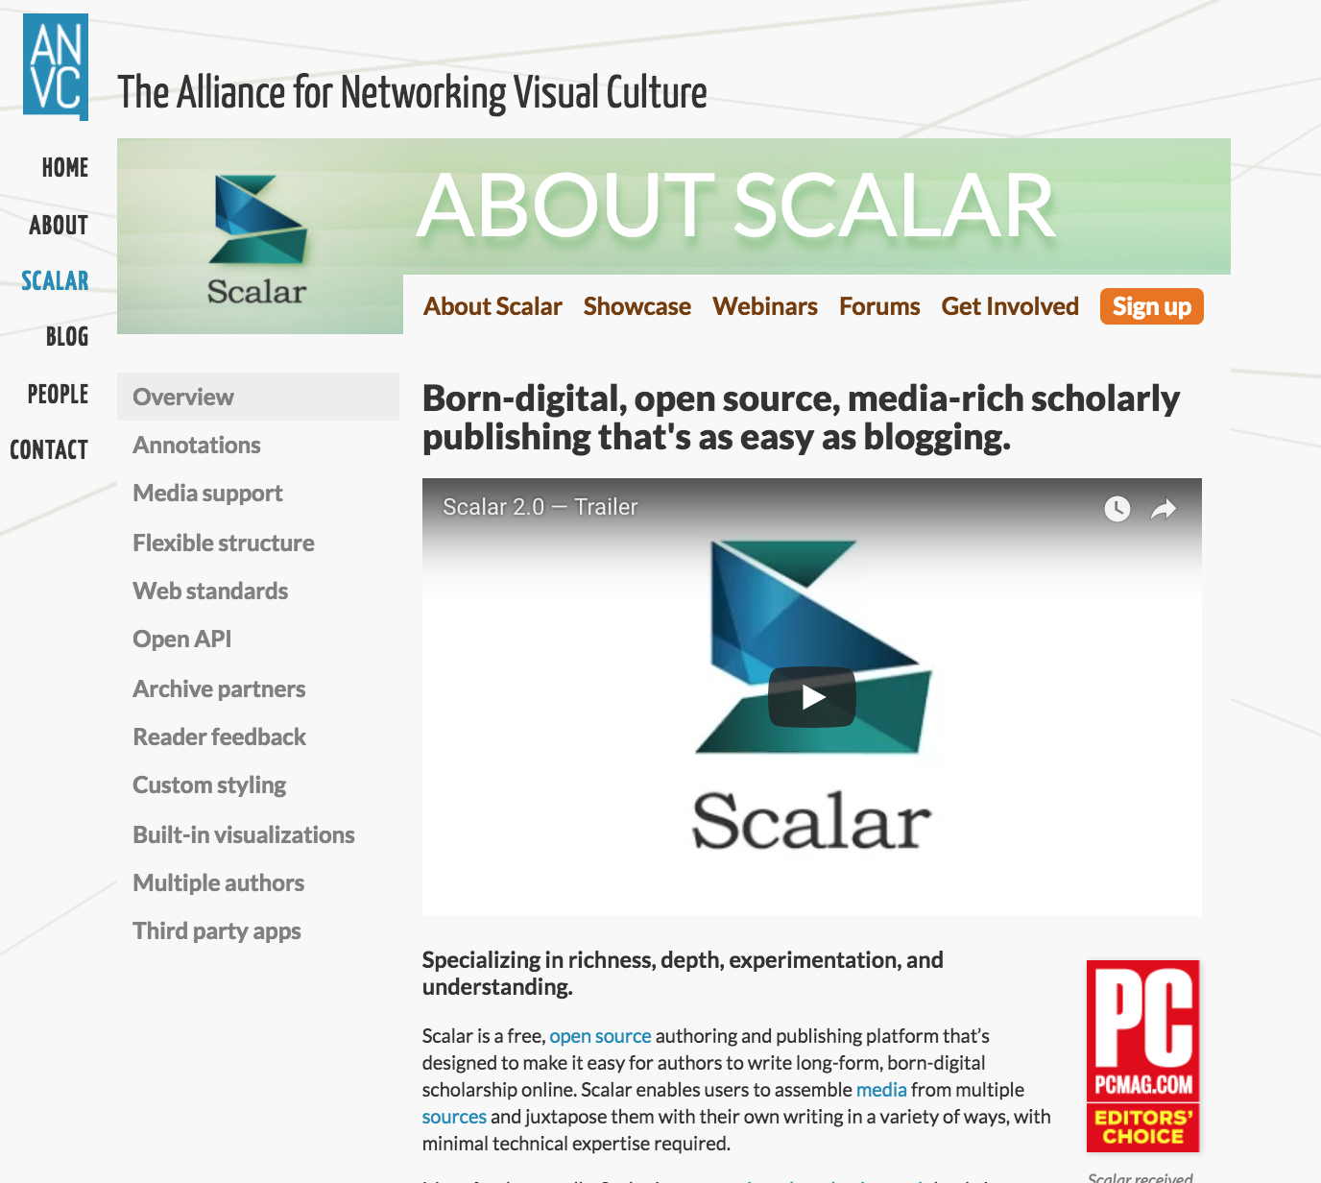

Slide 25
Text and Data Mining Services
Digital Humanities Toolkits
Linked Data
JSTOR Labs Text Analyzer
Leveraging technology

Slide 26
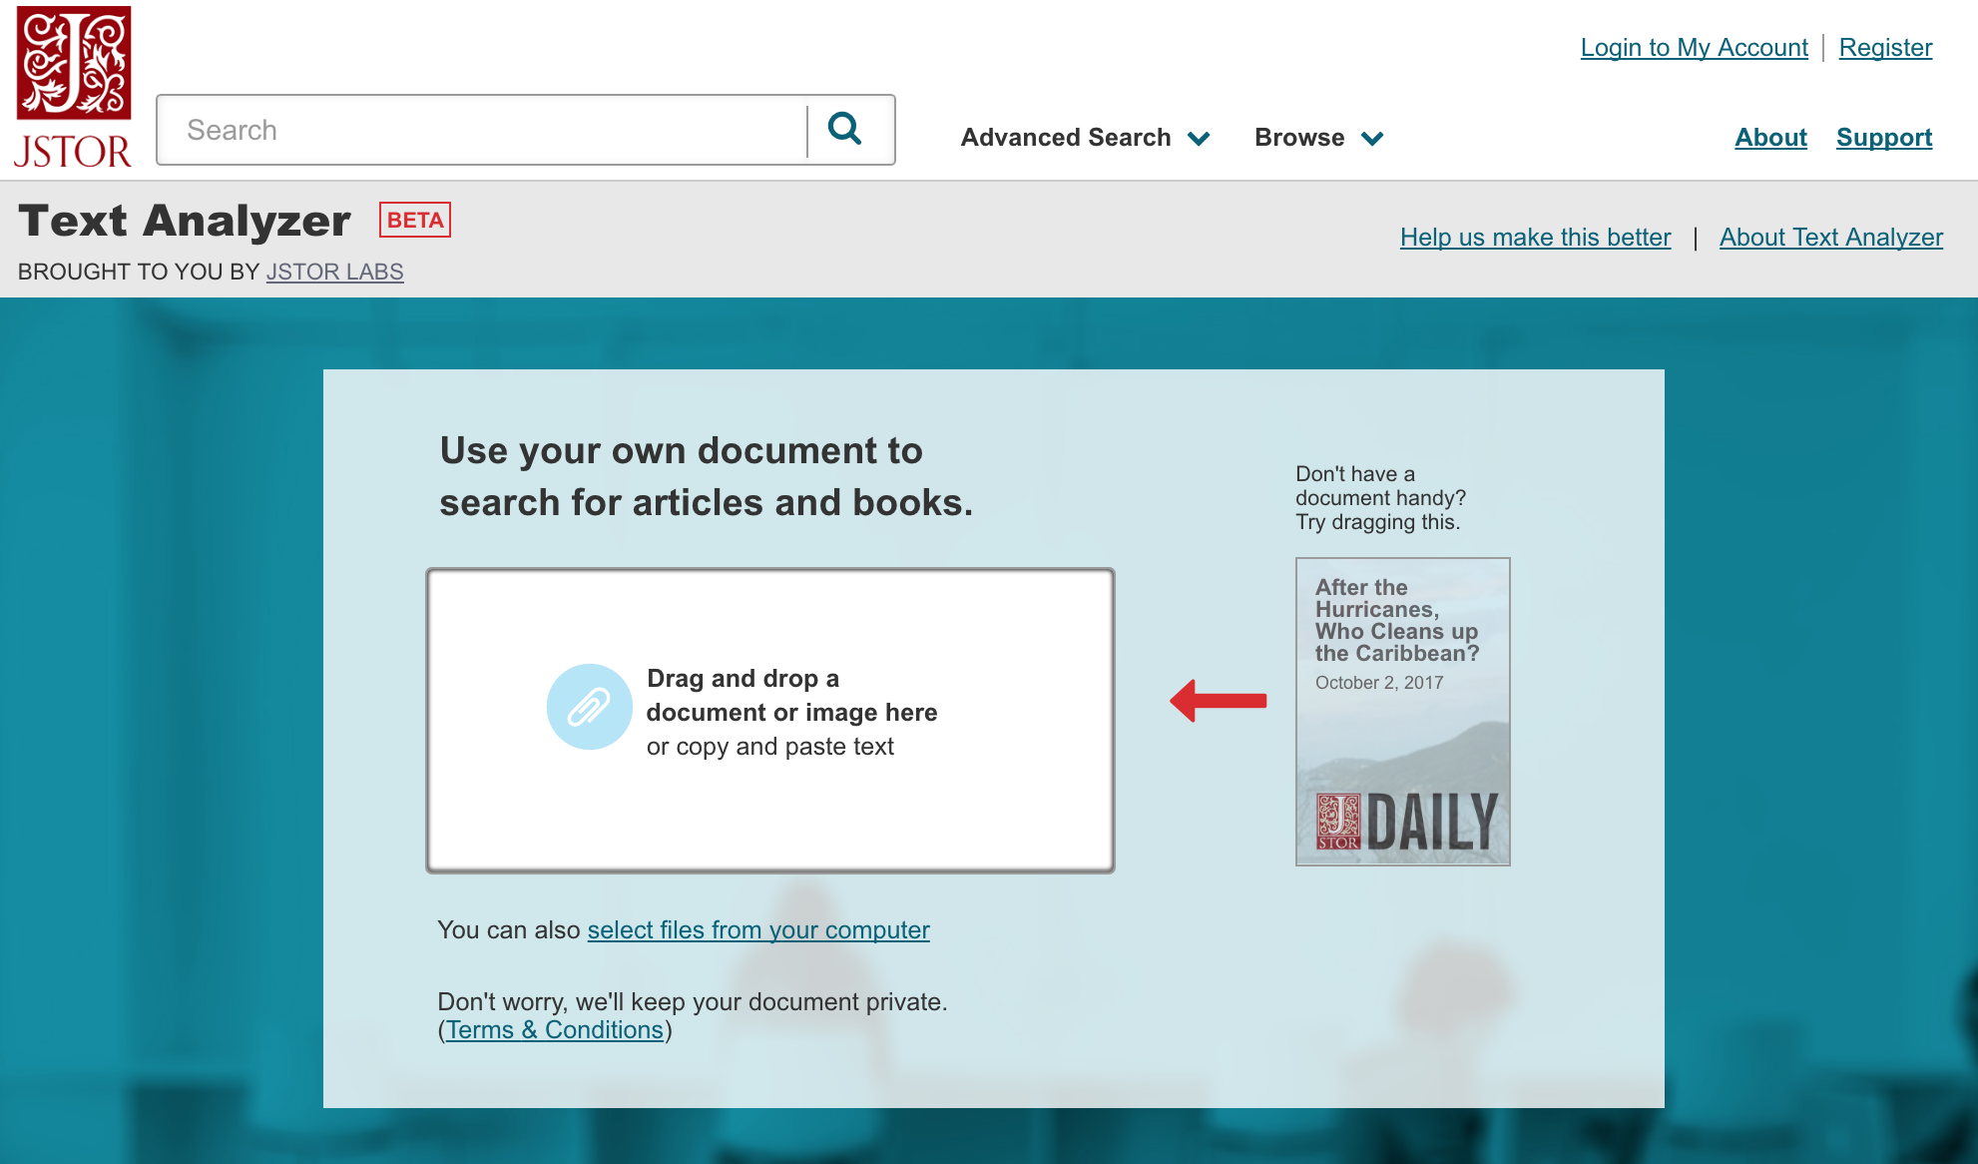
Notes:
Getting to recommended articles is a multi-step process involving a number of different technologies. First, Text Analyzer extracts the text from the document or image. For Word or PDF documents (for example), it just pulls out the existing text. For images without embedded text (for example, a picture of a page of text), it performs Optical Character Recognition (OCR) to find the text. Next, the tool analyzes the text to find topics (e.g. subjects) and entities (people, places and organizations) within it. The topics are found by using a "topic model," a tool used in natural language processing. In a topic model, a topic is composed of many individual terms that suggest the topic is being discussed. The higher the density of those terms in the document, the more likely that a particular topic is being discussed. For example: if the terms "carrots," "seed," "harvest," and "backyard" are used a lot, the topic model might suggest that the topic being discussed is "Gardening," even if the term itself is never used. The topic model used in Text Analyzer was created by analyzing all the scholarship in JSTOR. In doing so, we were able to leverage JSTOR Thesaurus, a controlled vocabulary of over 50,000 terms describing the content within JSTOR, for help in both naming the topics and in "training the content model." Entities are identified using multiple entity recognition services and tools, including Alchemy (from IBM), OpenCalais (from Thompson Reuters), the Stanford Named Entity Recognizer, and Apache OpenNLP. Last, the tool uses what it "thinks” are the most relevant topics and entities to find similar content in JSTOR. This similar content is presented on the results screen along with the topics and entities it found.

Slide 27
Text and Data Mining Services
Digital Humanities Toolkits
Linked Data
JSTOR Labs Text Analyzer
Meta.com
Leveraging technology
Notes:
As of September 2016, Meta has analyzed over 26 million papers and profiled 14 million researchers.^{[9]} The company has struck deals with publishers in science, technology and mathematics fields, which give the company access to full-text versions of more than 18,000 journals. Using natural language processing, Meta scans articles - as well as the millions of articles stored in open-access repositories - collecting information about authors, citations and topics. Participating publishers receive exposure for their journals in return.^{[10]} These include the American Medical Association, BioMed Central, Elsevier, Karger, Sage Publishing, Taylor & Francis, Wolters Kluwer, and the Royal Society.^{[11][12]}

Slide 28
Digital Preservation Network
Portico
DuraSpace
JISC Research Data Shared Services
demanding long-term preservation

Slide 29
Push vs. Pull
Ability to invest in experimentation across the sector
Threat of incrementalism
Strategic Alignment
summary

Slide 30
THAnk You
謝謝
Bruce Heterick Vice President Institutional Participation & Strategic Partnerships JSTOR |Artstor |Portico bruce.heterick@ithaka.org

