Slide 1
當科技大軍全面進攻,
圖書館該如何反擊?
徐惠玲
ies Consulting, iGroup

Slide 2
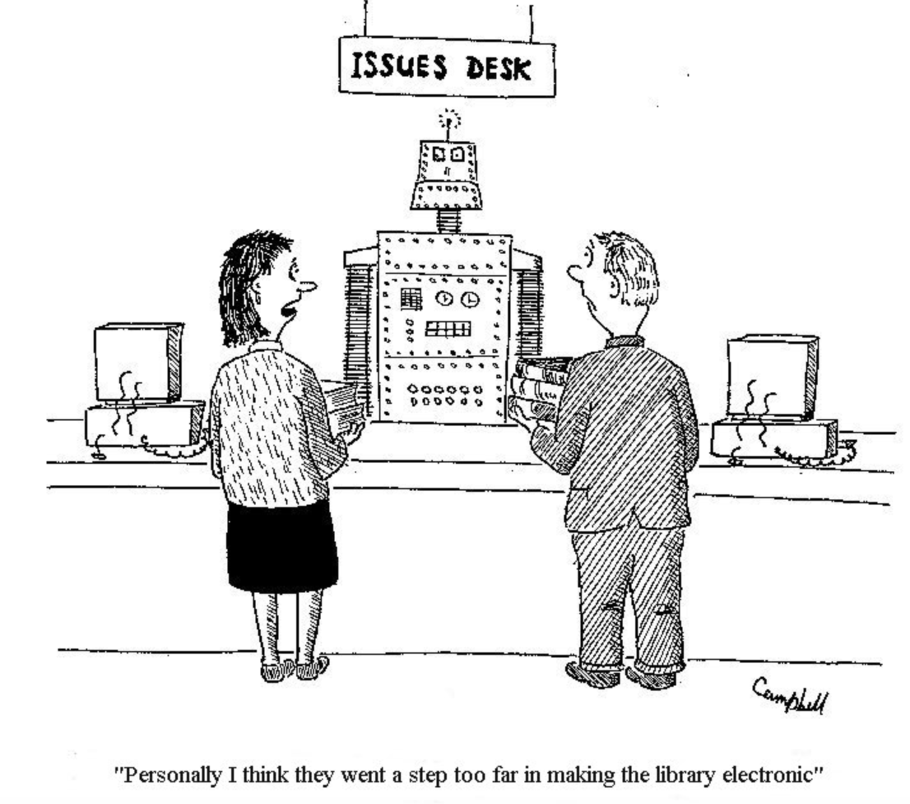
科技應用早已深入圖書館服務…
但它會帶我們走向哪裡?
ies
“Personally I think they went a step too far in making the library electronic!”
Notes:
機器與人工智慧, 早已在許多方面改變圖書館的服務. 機器如自助借還書機, 人工智慧如搜尋引擎, 到個人化資訊服務, 到 data mining, 推薦閱讀, 這些人工智慧的應用早已是圖書館服務的一部份, 與圖書館密不可分了.

Slide 3
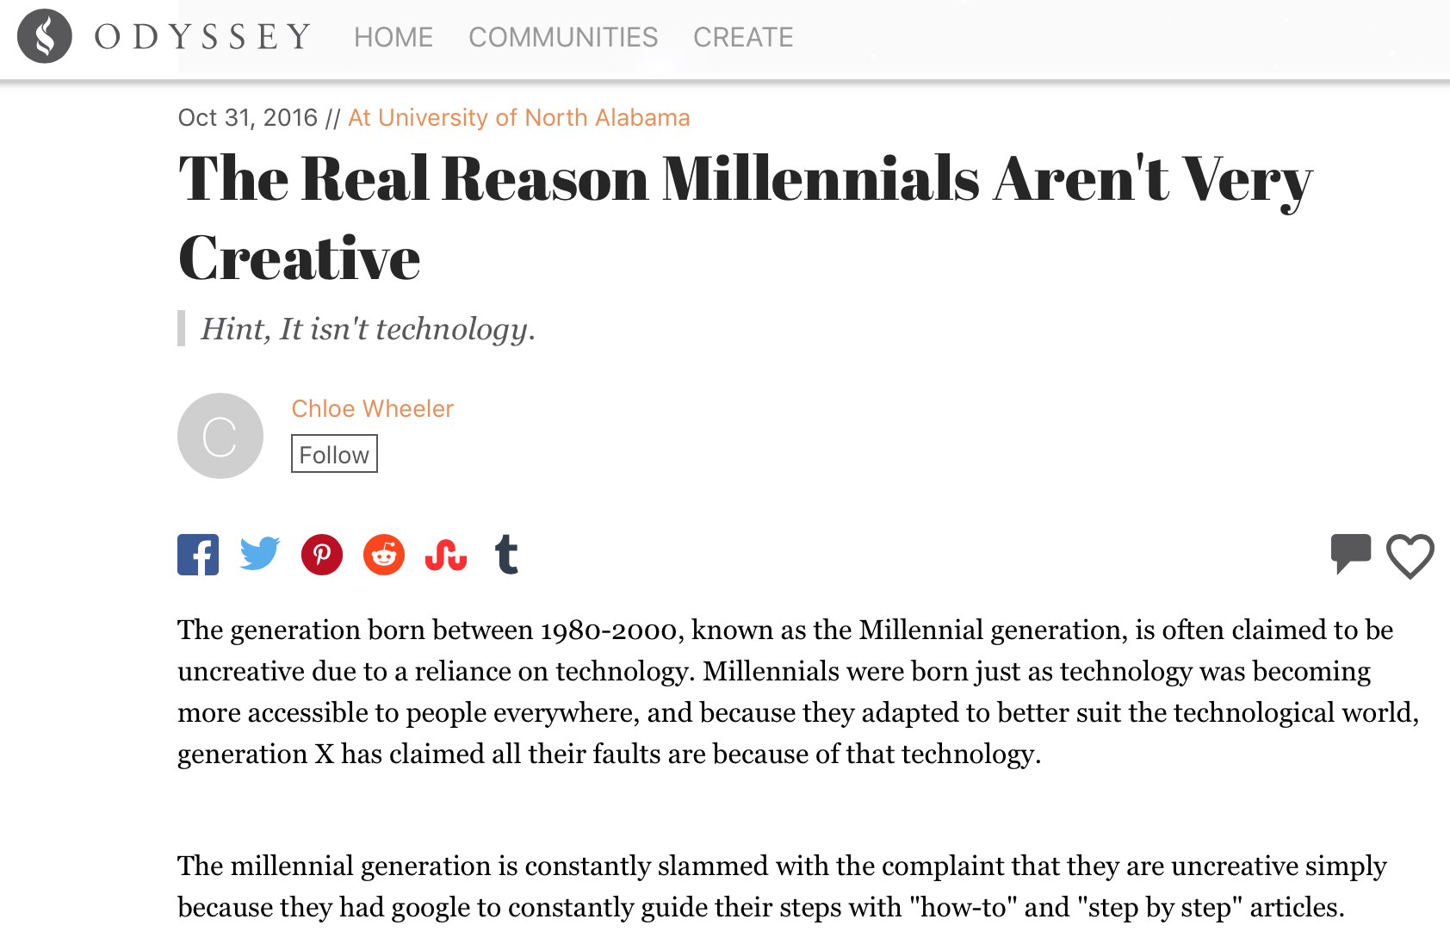
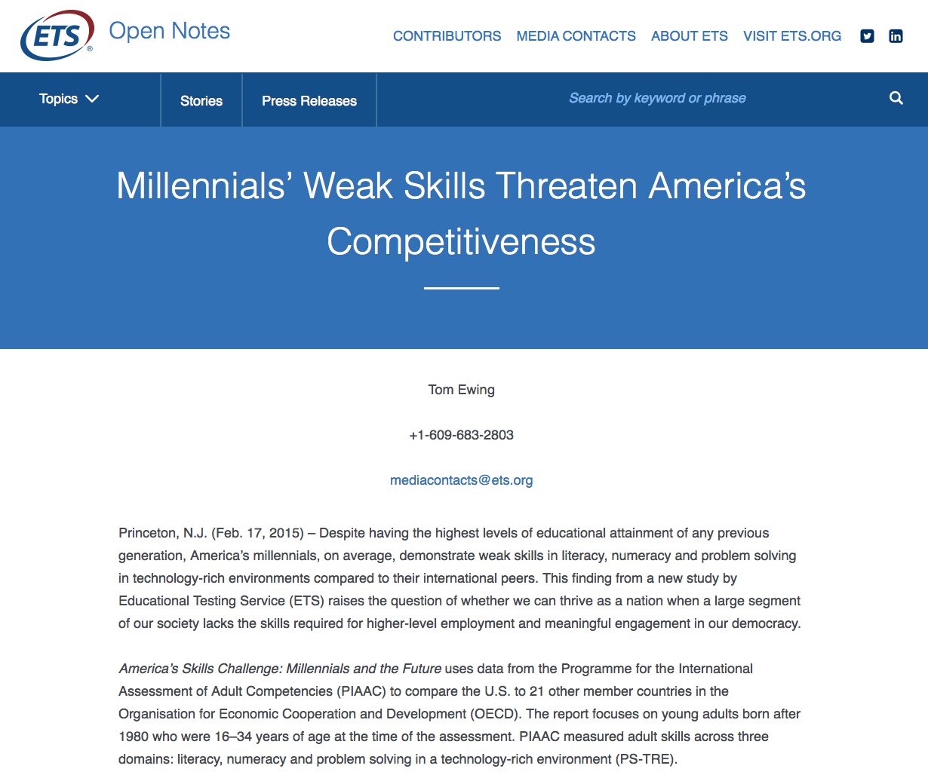
和以往不同的讀者
“… demonstrate weak skills in literacy, numeracy and problem solving in technology-rich environments compared to their international peers.”
Lack of Proficiency in Communication & Creativity
ies

Slide 4
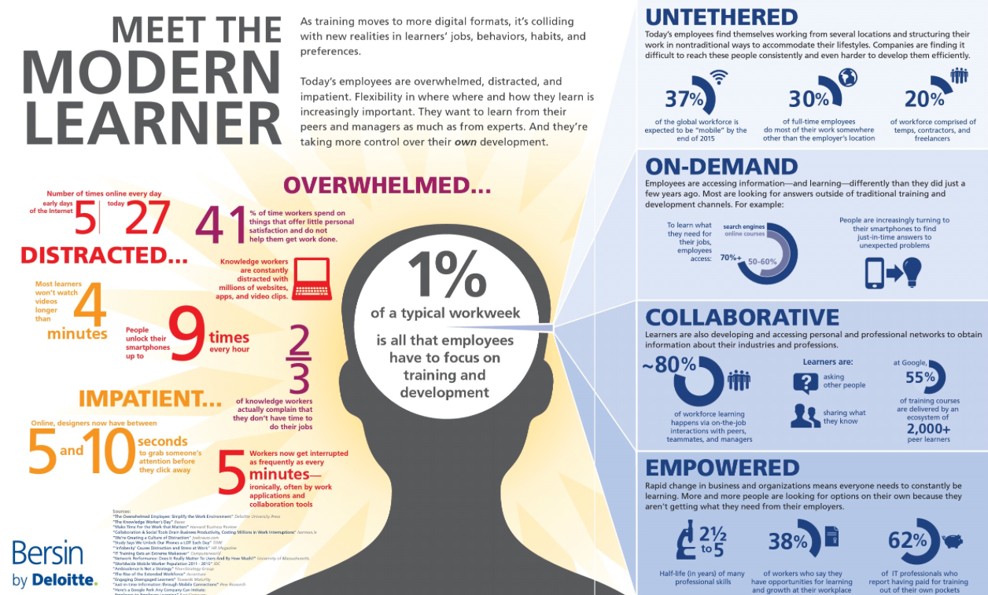
和以往不同的學習方式

Slide 5
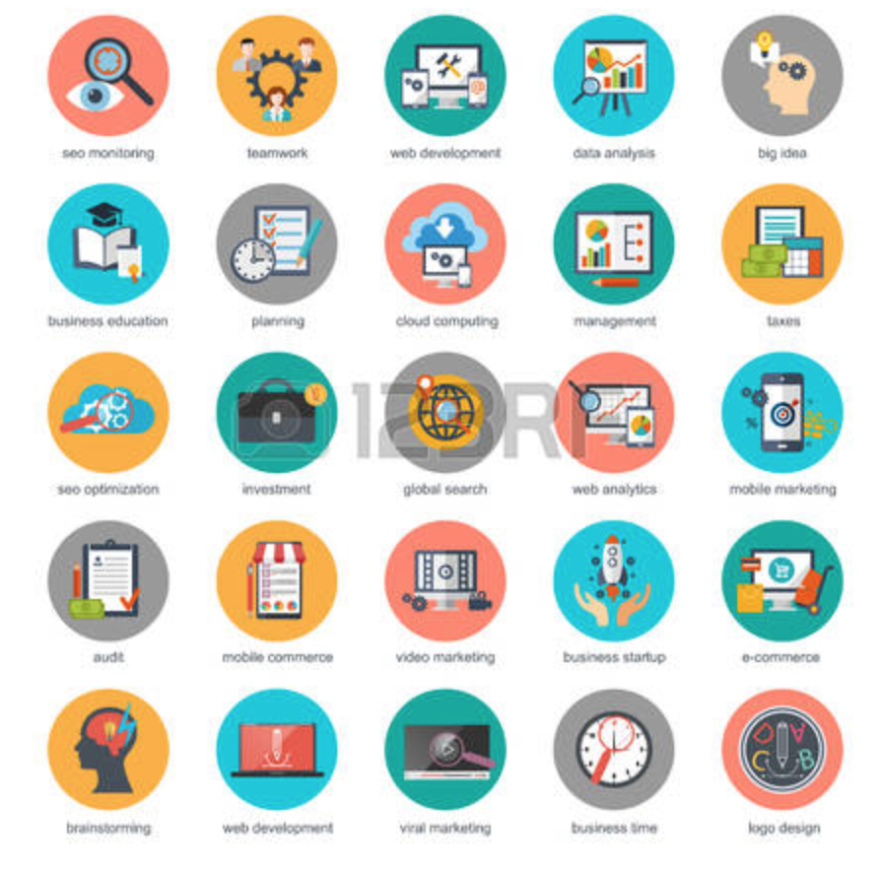
和以往不同的知識傳遞方式
Push Information
Immersive Technology
Bite-size
Multi-media
Word-of-mouth
Plain Language Summary
Container of Knowledge
Streams of Knowledge
Audience

Slide 6
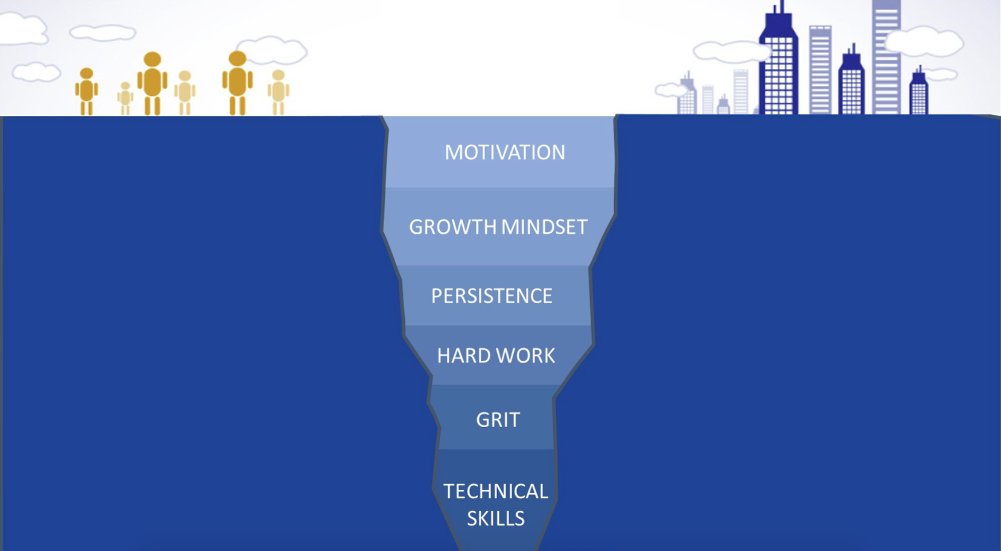
和以往不同的技能類型
Technical Skills vs. Soft Skills
Non-cognitive Skill

Slide 7
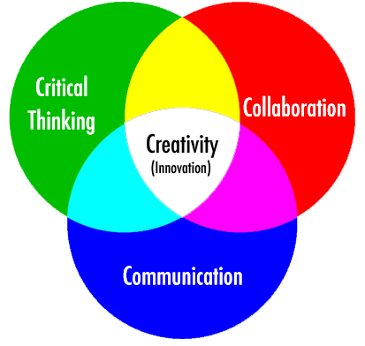
未來已經是現在進行式 –
圖書館如何面對?
虛擬環境的運用?
資源與知識的整合與利用?
以工作流程為設計理念的軟硬體?
+
Soft Skill
Technology Skill

Slide 8
資源與知識的整合、利用、與呈現
Librarian as Curator
Institutional
Repository
Curation
ies

Slide 9
虛擬環境的應用帶來無限的可能
Strategic
Research
Immersive
Learning
Innovative
Ideas
VR/AR
Blended
Learning
Project
Management
Crowd-funding
Management
Collaboration
Management
Institutional
Repository
AI
ies
Cyber Security

Slide 10
把工作流程概念帶入軟硬體設計與服務
Resources
versus
Workflows

Slide 12
“SkillVision Forum for Librarians”
Resources versus workflow
Research workflow
Innovation workflow
Collaboration workflow
Project workflow
Research support
Citation versus influence
Research integrity
Research asset management
Technology-enabled learning
Inquiry learning
Lifelong learning
Fundraising
Strategic
“Capture the imagination”
ies

Slide 13
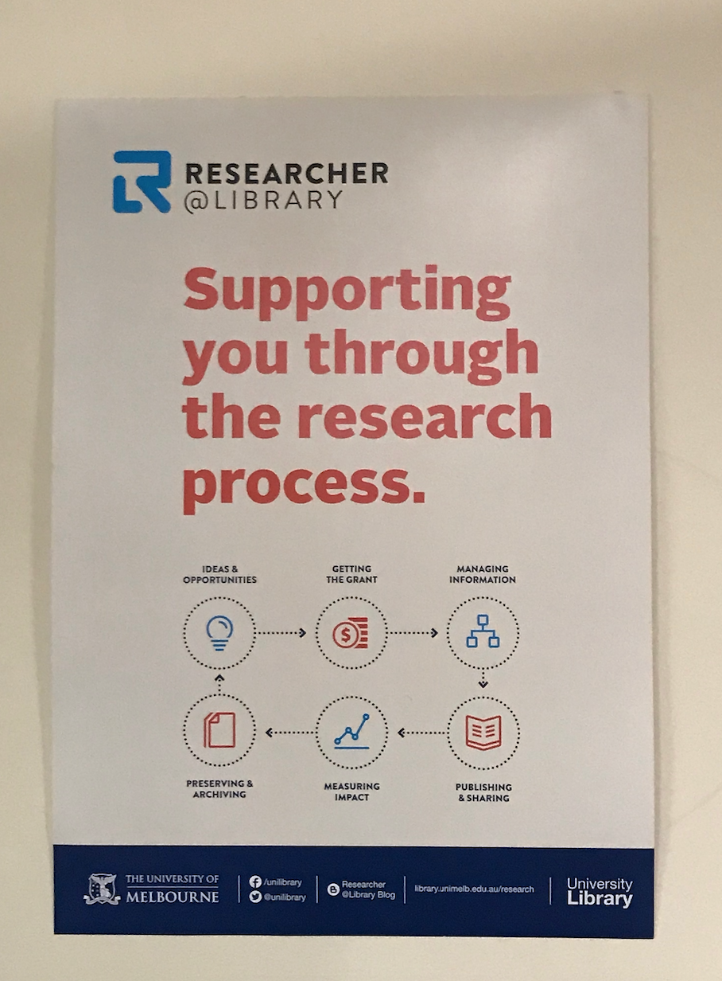
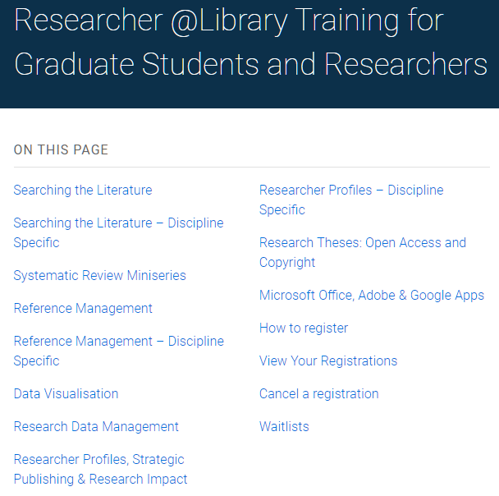
墨爾本大學 –
針對不同研究階段, 設計資源與課程
Source: http://library.unimelb.edu.au/services/workshops-and-tours/researcher-@library-training-for-graduate-students-and-researchers
ies
Source: Baillieu Library of The University of Melbourne

Slide 14
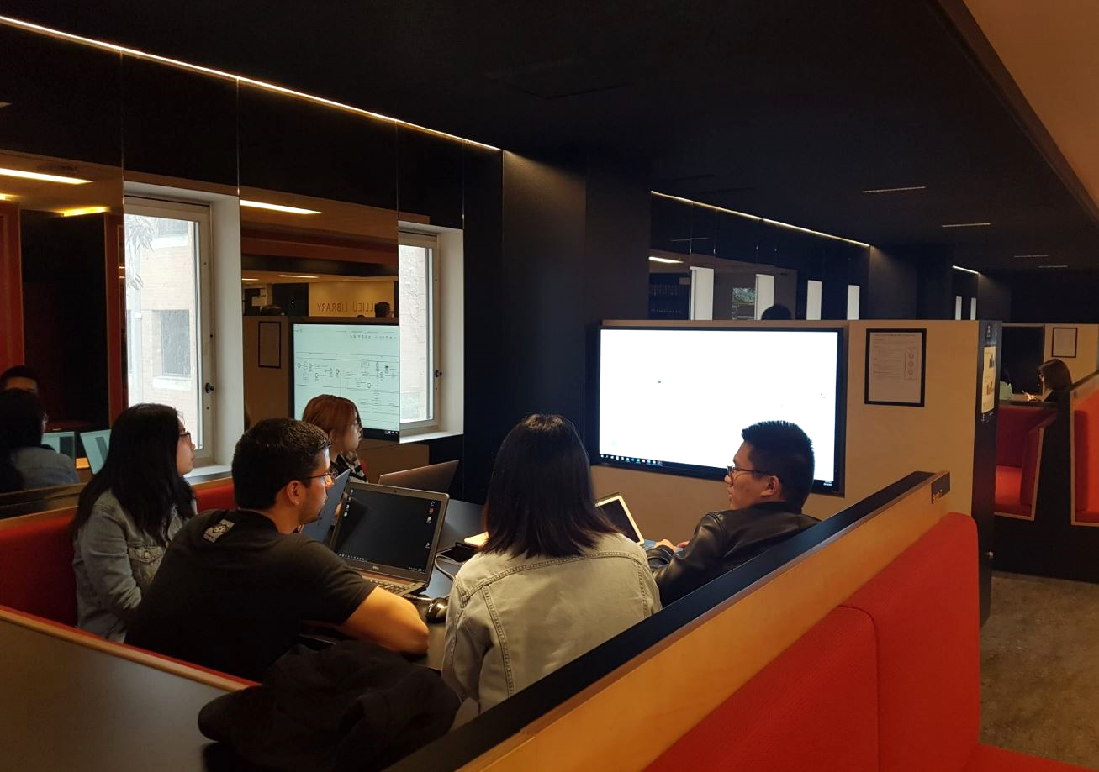
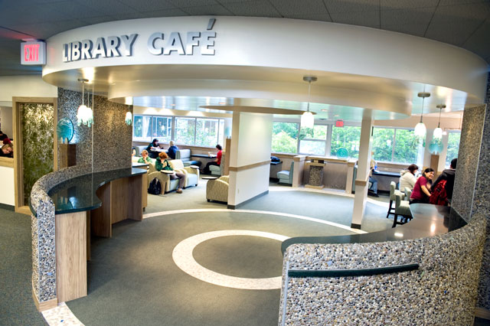
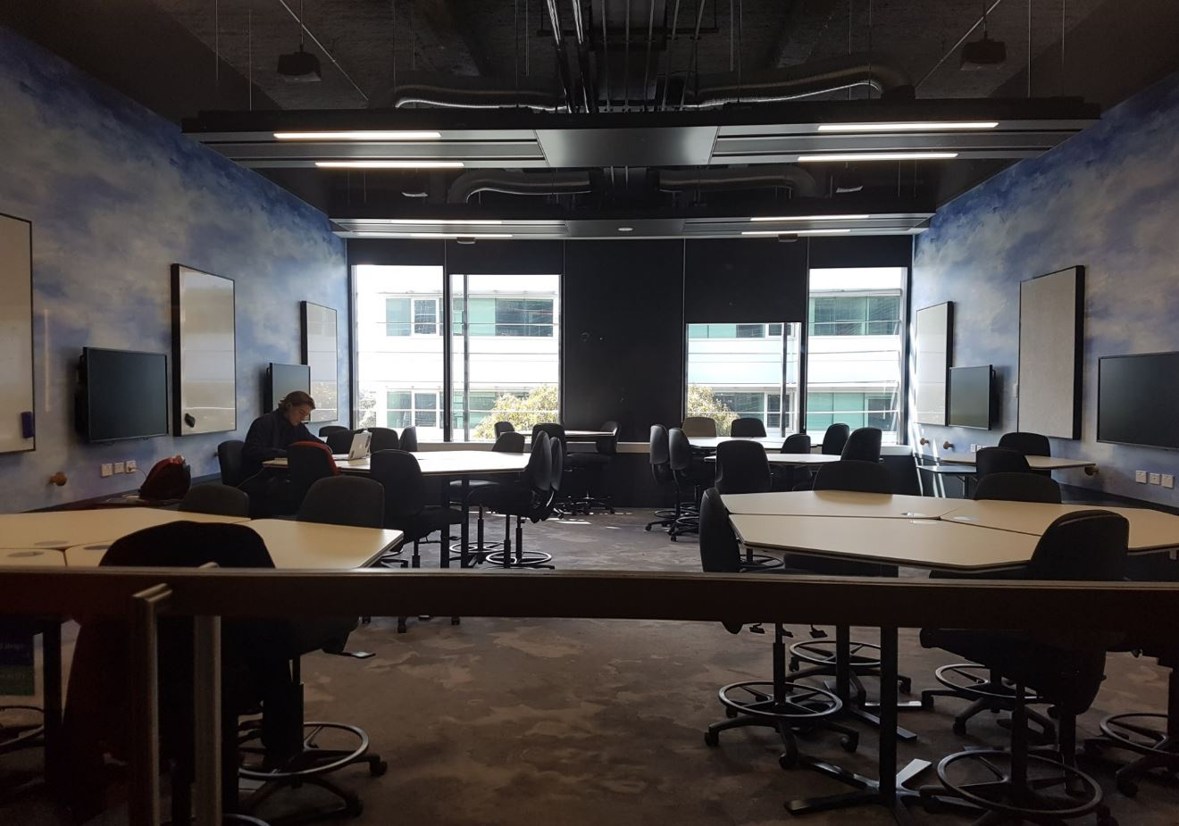
墨爾本大學 –
開放、功能式的空間設計鼓勵利用, 促進協作
ies
Source: Baillieu Library of
The University of Melbourne

Slide 15
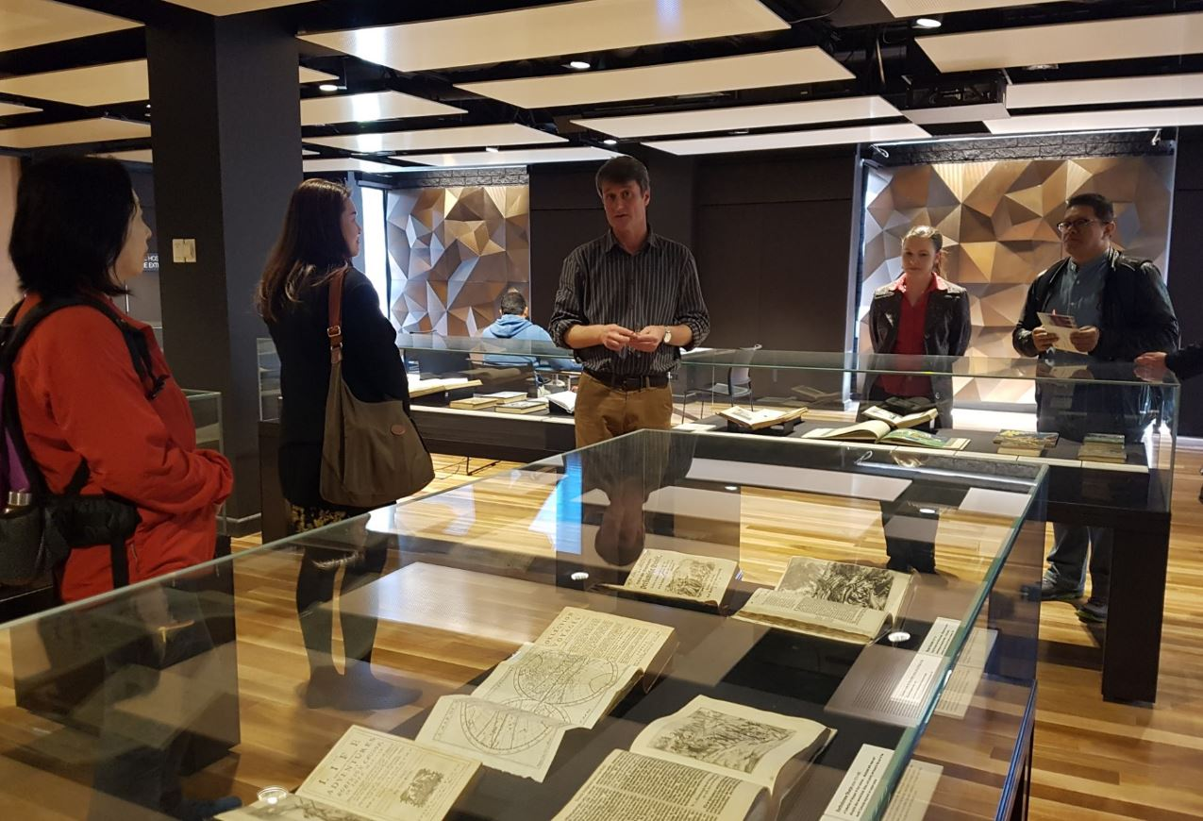
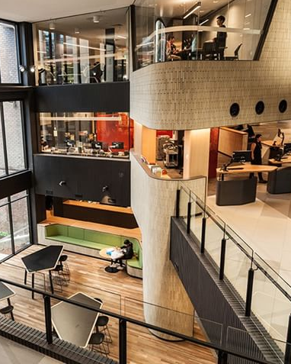
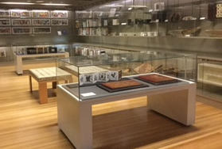
Monash University - 圖書館是知識中心, 也是社區中心
ies
Source: Matheson Library of Monash University

Slide 16
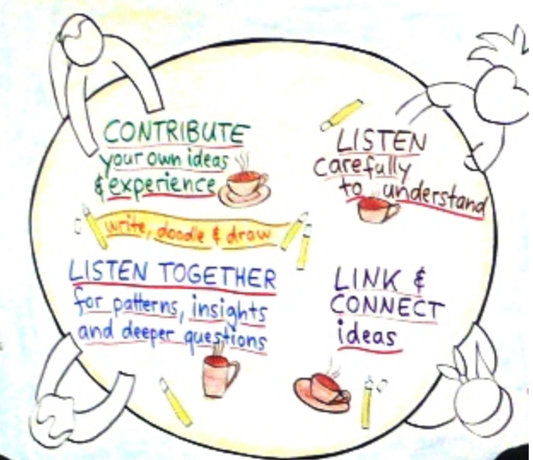
The World Café – 世界咖啡館
Contribute
Listen
Listen
Link
Topic:
Library Transformation
ies

Slide 17
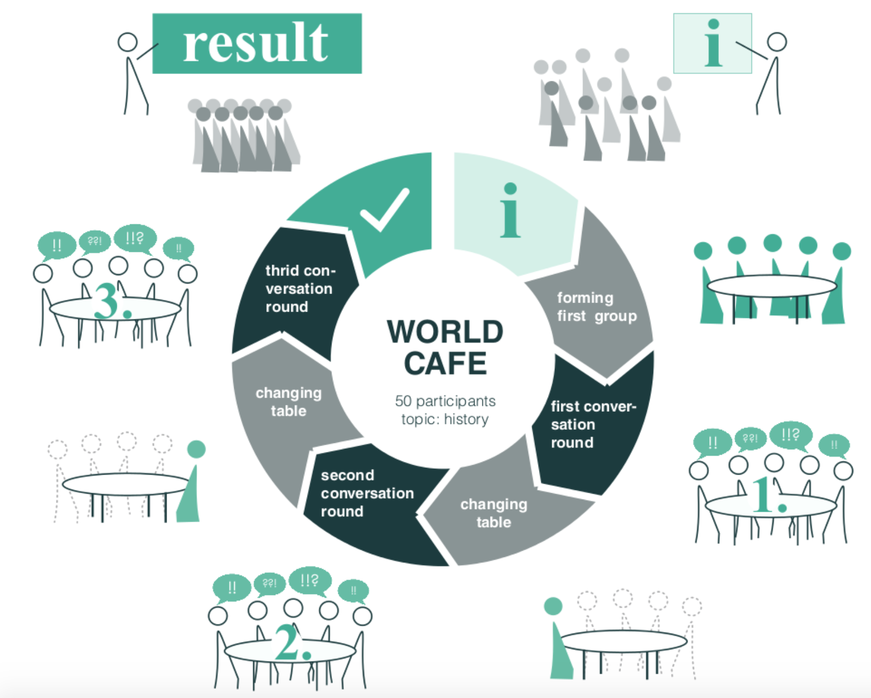
針對特定主題, 藉由討論來演進想法, 並設立具體行動目標
“Sharing and other matters”, 15 min, Wong WF
Sharing, 45 min
“Outline SMART KPIs”, 40 min
Grouping, 5 min
Debrief, 15 min
“Define the Future of Library Services”, 40 min
ies
“Identify the Competencies”, 40 min
Debrief, 15 min

Slide 18
ies

Slide 19
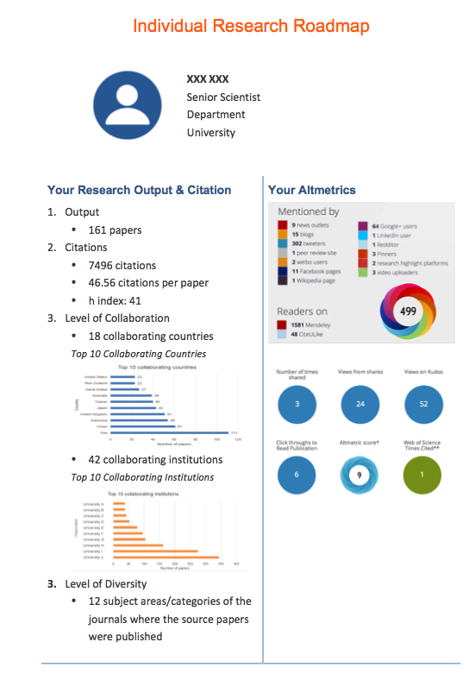
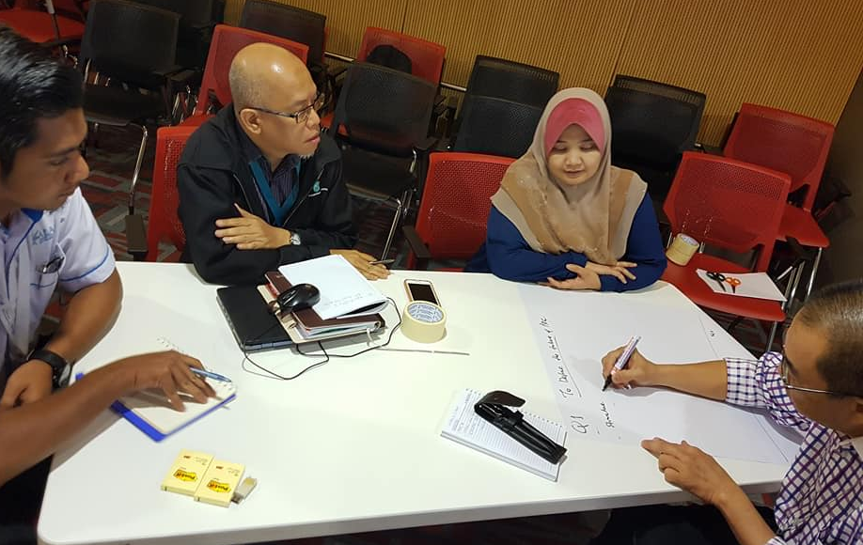
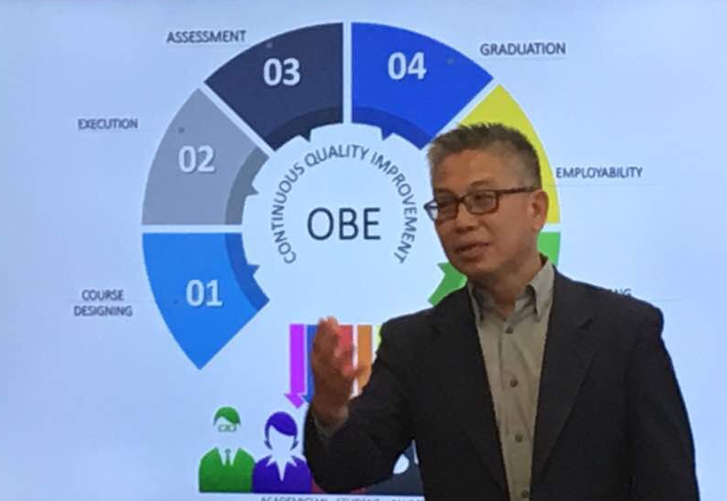
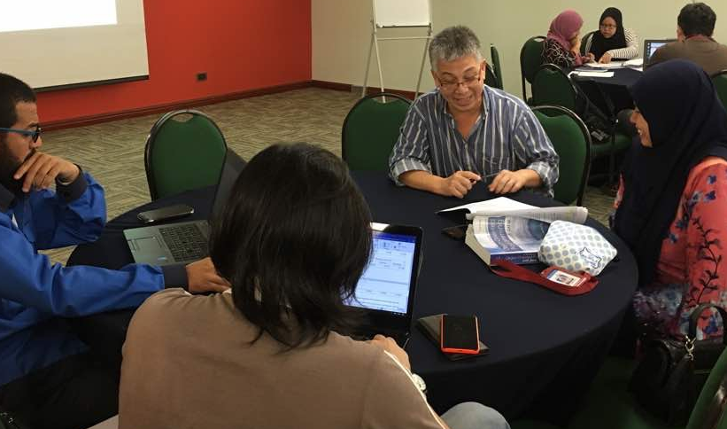
ies 諮詢團隊協助圖書館嘗試不同的可能性
ies

Slide 20
ies

Slide 21
THANK
YOU
iris.hsu@igrouptaiwan.com
ies

