Slide 1
The sustainability of Academic Libraries in a global network: collaboration and community
Dr. Ingrid Parent
University of British Columbia
CONCERT, Taiwan, November 8, 2017

Slide 2
About IFLA
Global Voice of the Library and Information Profession
>1400 Members (Associations, Institutions, Individuals), from 142 Countries, HQ in the Hague, The Netherlands
44 Thematic Sections, 15 Special Interest Groups
3 Regional Offices – Argentina, South Africa, Singapore, 4 Language Centres – Senegal, Argentina, Egypt, Russia
Motivated by the belief that free and effective access to information builds stronger, fairer and more participatory societies

Slide 3
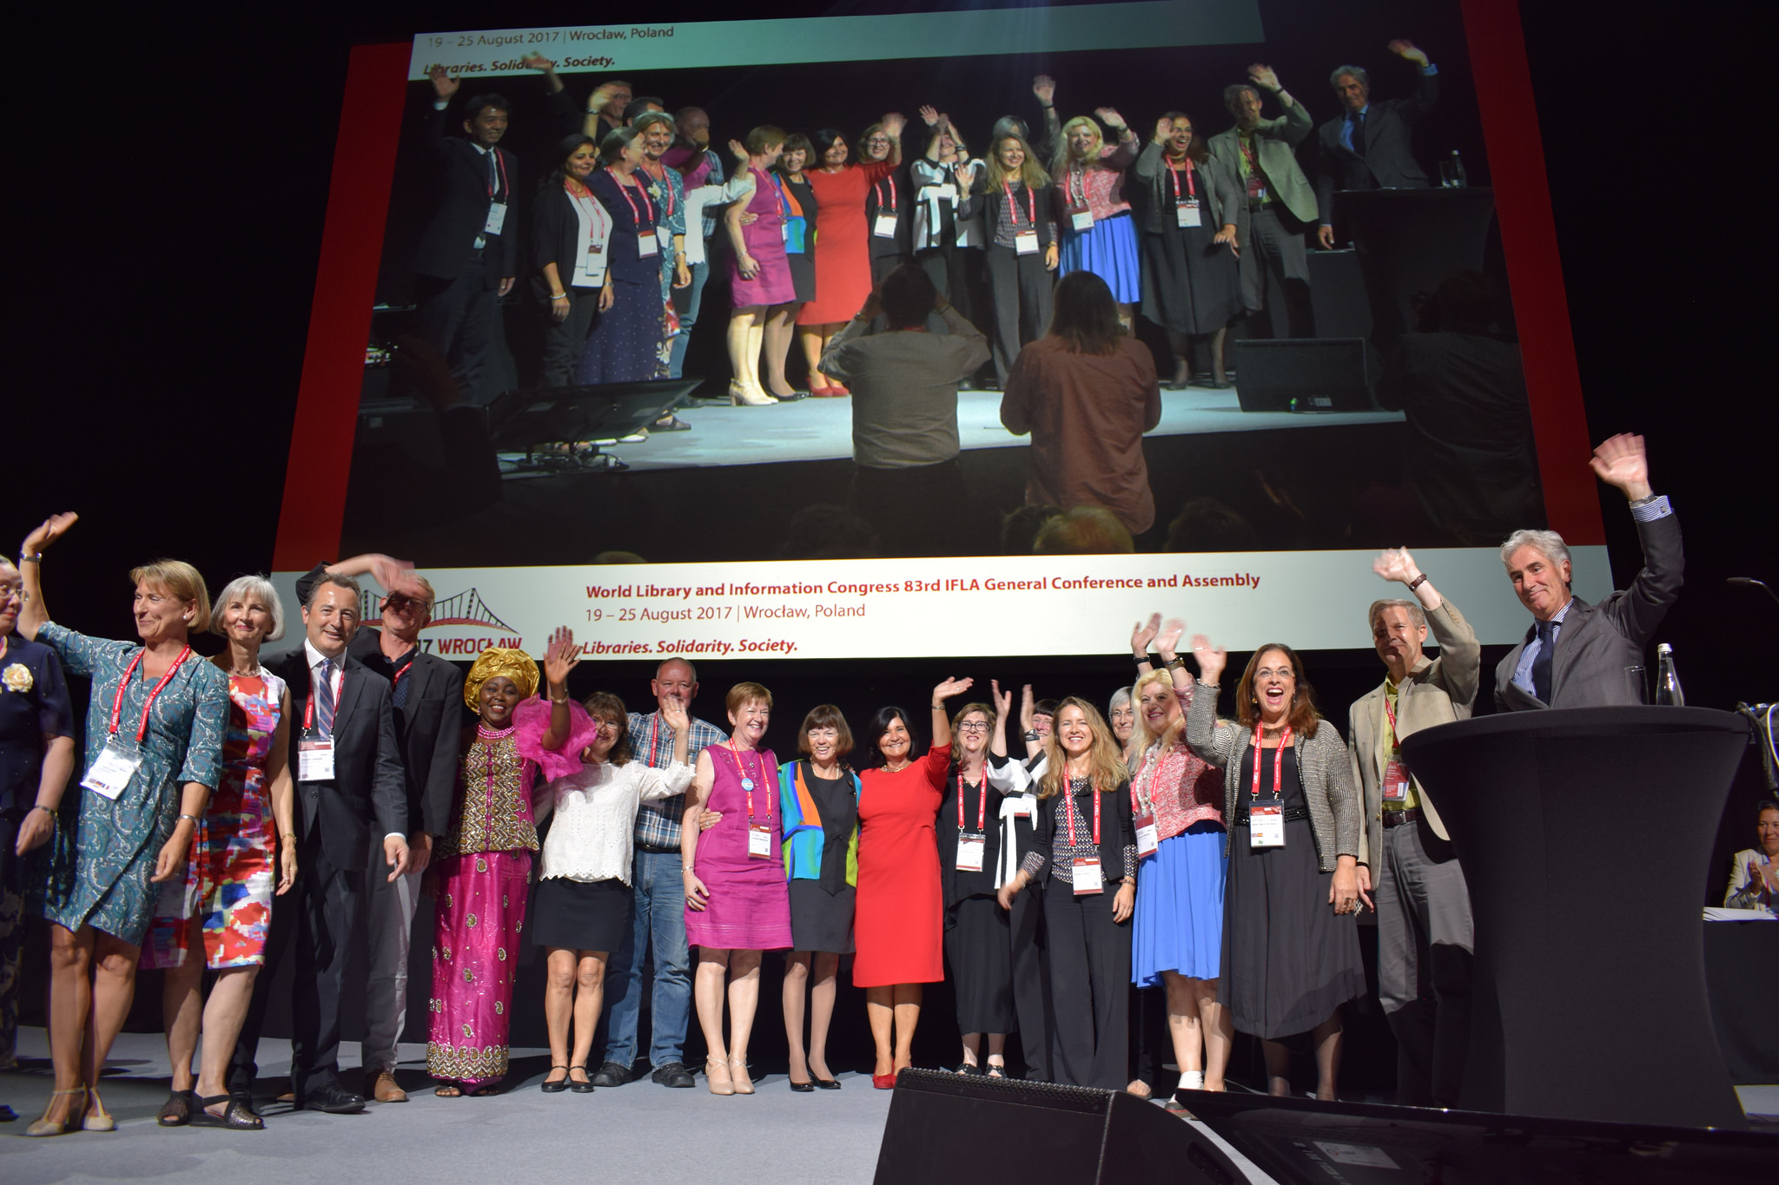
IFLA’s Objectives
Support the profession to improve services and practices
Advocate for libraries and their users in international fora (copyright, cultural heritage, freedom of access to information, Internet governance)
Support library associations to maximise effectiveness
Current Priority: develop a Global Vision of a United Library Field

Slide 4
Number of people—7 Billion
Number of fish--??
Number of Internet users—3 Billion
Amount of data--??
istock photo, credit: Ig0rZh

Slide 5
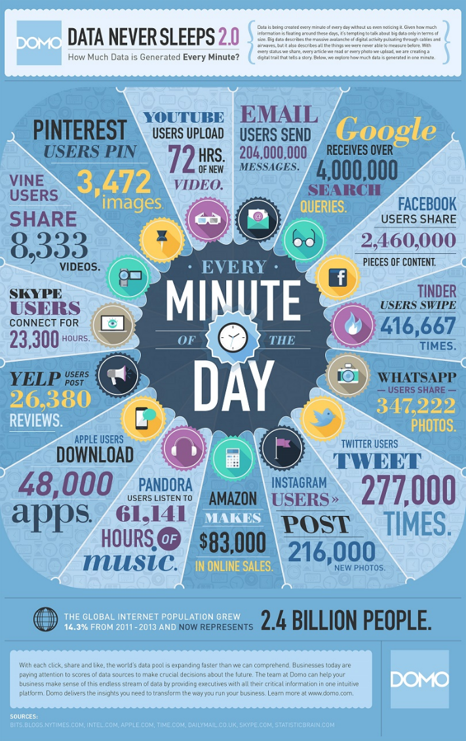
Source: https://www.businessinsider.com.au/infographic-heres-how-much-data-is-created-on-the-web-every-minute-2015-8

Slide 6
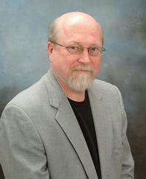
We are at the incunabula period of the digital age
T. Scott Plutchak
University of Alabama

Slide 7
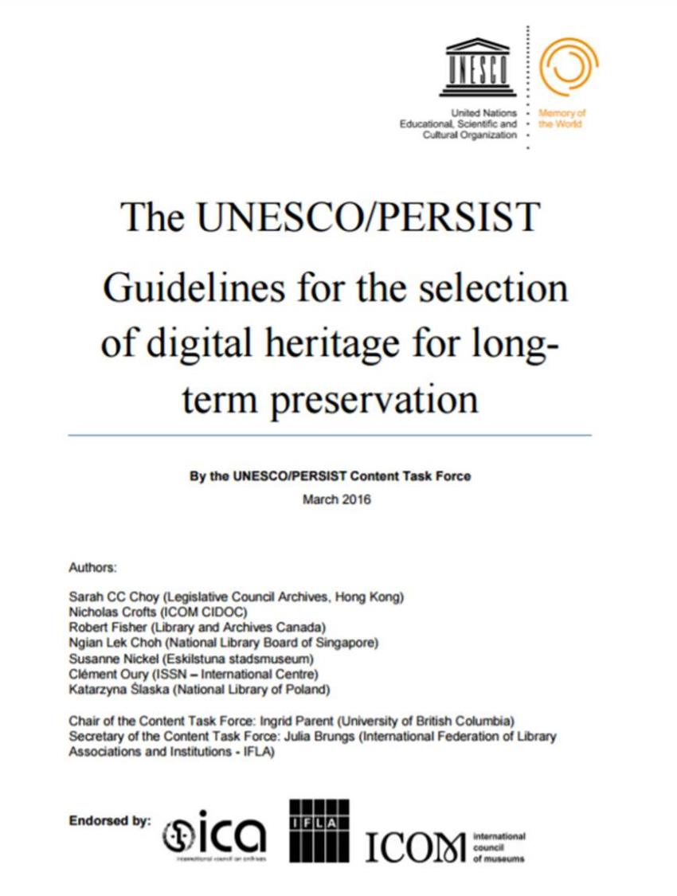

Slide 8
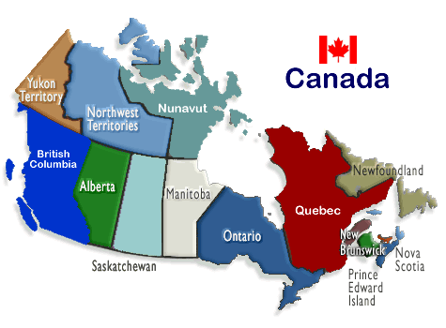
MISSION
CRKN is a partnership of Canadian universities, dedicated to expanding access to digital content for the academic research enterprise in Canada.
75 members
Serving over 1.2 million students & researchers

Slide 9
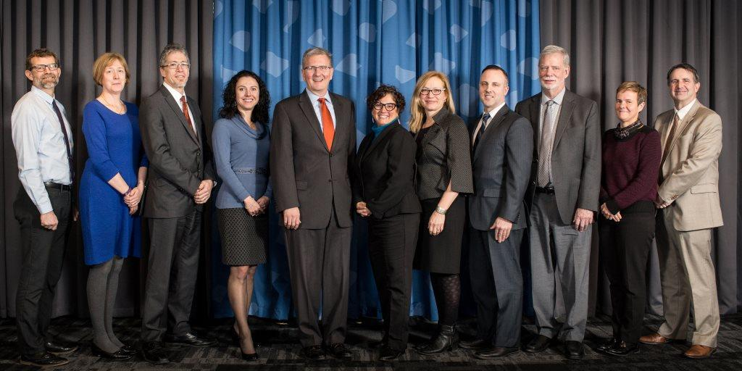
MISSION
Through the coordinated leadership of librarians, researchers, administrators, and other stakeholders in the research community, CRKN undertakes large-scale content acquisition & licensing initiatives in order to build knowledge infrastructure and research and teaching capacity in Canada’s universities.

Slide 10
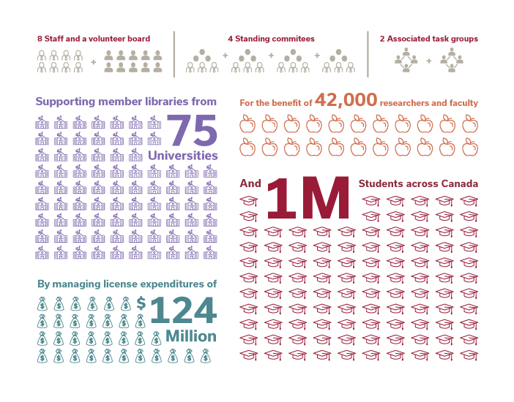
CRKN TODAY
Notes:
Today CRKN:
has 75 members, including 21 Universities in Ontario, and serves over 1.2 million researchers, faculty and students
With a staff of 9, provide access, through 64 licenses from key academic publishers, to over 3000 journals and databases at an annual value of roughly $124M
continue to add high-impact collections of journals and backfiles to the content portfolio, including significant humanities and social sciences content as well as STM content
Fully self-funded by members through annual membership fees
The majority of CRKN licenses are negotiated and settled in USD with the accompanying potential foreign exchange risk for our members, offset by foreign exchange project
CRKN provides access to thousands of journals that would have been outside the financial reach of many Canadian Universities if not for the collaborative purchasing arrangement.

Slide 11
NEGOTIATION PROCESS

Slide 12
CRKN Initiatives 2016-2017
Open Access
Partnership with Érudit towards Canadian OA content
Participation and leadership in SCOAP³
Supporting Content and Big Deal analysis
Journal Usage Project (JUP) – a national study of journal usage, citations and faculty perception of journal value to evaluate big deal value
Journal Value Analytics (JVA) for major publishers to assist in collection analysis and big deal value
Deployed an Institutional Mobilization toolkit for member use in knowledge mobilization on campus around the Scholarly Communication sustainability challenges
Supporting Research and Teaching
Participating in the Canadian Scholarly Publishing Working Group to move towards a sustainable publishing environment in Canada
Development and expansion of the Canadian National Digital Heritage Index (CNDHI) to facilitate access to digital Heritage content collections
ORCID-CA a national consortial approach to institutional ORCID membership

Slide 14
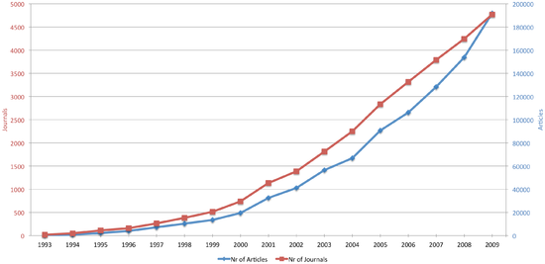
OPEN ACCESS – A BRIEF HISTORY
Growing interest in open access in the 90s, linked to the technical possibilities created by the Internet, concern about rising serials prices, and a belief in supporting openness in science
Key Statements
Budapest Open Access Initiative (2002)
Bethesda Statement on Open Access Publishing (2003)
Berlin Declaration on Open Access to Knowledge in the Sciences and Humanities (2003)
IFLA Statement on Open Access (2011)
Hague Declaration on Knowledge Discovery (2015)
EU Council of Ministers Conclusions on OA (2016)
Development of open access
*Laakso M, Welling P, Bukvova H, Nyman L, Björk B-C, et al.

Slide 15
Defining open 2.1
Open (License or Status): The work must be in the public domain or provided under an open license.
Access: Physical copies must be provided as a whole and at no more than a reasonable one-time reproduction cost. Digital copies should be downloadable without charge.
Machine Readability. The work must be provided in a form readily processable by a computer.
Open Format. The work must be provided in a format that places no restrictions, monetary or otherwise, upon its use and can be fully processed with at least one free/libre/open-source software tool.
Open Access Models
Green open access. Open Access publication following an embargo period, or publication of a ‘pre-print’ in an OA repository
Gold open access. Immediate Open Access publication, usually following payment by an author (Article Processing Charge - APC)
Diamond/Platinum open access. Immediate Open Access Publication with no payment of article processing charges (external funding).
‘Bronze’ Open access: Publication of articles for free on publisher websites (not in a repository)

Slide 16
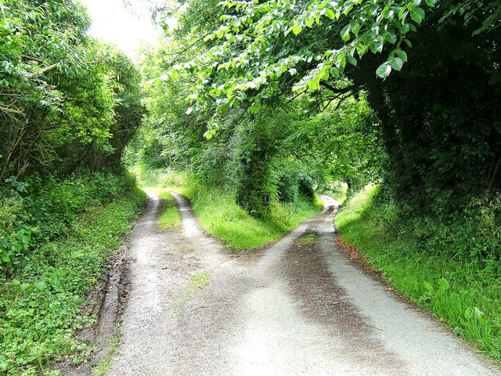
TRENDS AND ISSUES
What Business Model? The financing of Open Access policies in future remains uncertain. Who pays? How can we ensure that publishing is not the preserve of the wealthiest institutions? Are the Article Processing Charges (APCs) levied by the top journals sustainable, fair or accessible?
What Infrastructure? Knowledge discovery depends on an effective and operational infrastructure, but how can this be paid for? Should we worry about services such as repositories, sharing services, metrics providers, or databanks being owned by major publishers?
Mixed ‘Big Deals’: contracts signed between libraries and major publishers increasingly include APCs, alongside access to subscription journals. How can we ensure libraries have the expertise and support to negotiate these deals?
Trust and Recognition: there are doubtless many deliberately fraudulent, or low-quality open access journals. How can we enable researchers, students, and librarians to spot the fakes, rather than just condemn all OA journals as dubious?
Risks to Safe Harbour Provisions: legal action against ResearchGate for hosting infringing content (i.e. versions of record, rather than pre-print copies of articles, uploaded by the authors) poses challenges to all repositories who could find themselves liable for mistakes made by researchers?
The regionalisation of Open Access: Elsevier has proposed that OA could be regionalised, with one model followed in one part of the world, and another elsewhere. This has led to extensive criticism, but the idea should be taken seriously.

Slide 17
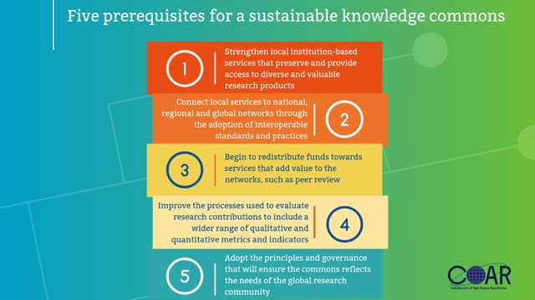
BEYOND OPEN ACCESS (BOA)

Slide 18
THE 2.5% COMMITMENT
Every academic library should commit to dedicate 2.5% of its total budget to organizations and projects that contribute to the common digital infrastructure needed to create and support the open scholarly commons.
A “Movement” begun by David W. Lewis, Dean of the IUPUI University Library in Indianapolis USA
Why?
The current scholarly communication model is dysfunctional.
The commercial sector, with ample funds mainly from academic institutions, is buying control of digital infrastructure.
Libraries have a disjointed approach to sustaining digital infrastructure and are often unaware of what others are doing.

Slide 19
THE 2.5% COMMITMENT - 2
Next steps: wider discussion with SPARC and COAR members at CNI meeting in December 2017.
“In the Internet era information will be free, the only question remaining is who pays for that freedom”. – Kalev Leetaru, Forbes, July 31, 2017.

Slide 20
SIMON FRASER UNIVERSITY COMMUNITY SCHOLARS PROGRAM
Scholarly research and electronic resources are generally inaccessible to anyone outside the university; non-profit and charitable organizations cannot have access to research in their fields: health, poverty alleviation, the environment, human rights, arts and culture.
SFU, in cooperation with the United Way and the Mindset Social Innovation Foundation, extends existing licenses for databases and e-journals from 6 publishers to 500 community scholars—currently a wait list.
The Program provides access to the latest research and knowledge to help community scholars find answers to societal problems and improve the lives of our citizens.

Slide 21
SOME FINAL THOUGHTS
Knowledge is the greatest asset in the 21st century
Libraries have a crucial role to play in the digital environment, and are more powerful when they collaborate and connect
Change is challenging; stay the course!
Implementing positive change will require TRUST and COURAGE

Slide 22
Thank you!
Xie xie!
Ingrid.parent@ubc.ca

