Slide 1
JULAC CONCERT Conference November 2018

Slide 2
Mission Through its collaborative efforts, JULAC creates an environment where scholarly resources are collected, managed and shared through the delivery of innovative services that enhance the academic endeavors of the UGC funded institutions.
Vision
JULAC is the premier body for deep collaborations related to scholarly information resources and services in Hong Kong academia.

Slide 3
JULAC Top Strategic Directions 2017-2020
Goal 1: Ensure Access to a Rich and Diverse Collection Collaboratively
Fully establish JURA (Joint Universities Research Archive) to reduce duplication of print and guarantee access to retained copies (Explore a joint temporary storage)
Joint consortia purchasing
Collect research data
Explore a common platform for research output
Digitization initiatives
Preservation and conservation issues

Slide 4
JULAC Top Strategic Directions 2017-2020
Goal 2: Deliver Innovative Services and Operations Together
Implement a shared ILS system
Explore collaborative opportunities through the shared ILS
Embed Information Literacy MOOCs and other project outcomes into curriculum
Promote Open Access
Establish a JULAC research support group
Review common operations to maximize efficiency
Review and enhance JULAC statistics
Goal 3: Shared Staff development
Establish JULAC Deputies Group

Slide 5
Shared Integrated Library System (ILS) (2/2)
Date | JULAC Shared ILS Milestone
May 2016 | Project organization and governance structure approved
Jul 2016 | Official project kick-off
Sep 2016 | Implementation Manager assumed duty for 1 year (served as the single contact between JULAC and the vendor)
Aug – Oct 2016 | 1st round of test data migration
Oct – Nov 2016 | Alma and Primo production environment delivered, workflow testing started
Nov 2016 | Change Manager assumed duty for 2 years (Supports libraries in Change Management and Process Re-engineering at both JULAC and institutional levels)
Jan – Mar 2017 | 2nd round of test data migration
May – 16 July 2017 | Cutover data migration and freeze of technical services
17 Jul 2017 | Shared ILS launched

Slide 6
Shared ILS Governance
The Shared ILS Steering Committee first met in May 2018.
The Committee shall
provide the oversight and leadership of the Shared ILS on behalf of the JULAC Directors;
make operational and policy decisions taking into account the recommendations made by JULAC or its sub-committees;
escalate and/or report to the JULAC Directors as needed;
liaise between JULAC and Ex Libris.
On behalf of the Committee, the JULAC Manager is
the gatekeeper of requests on creation/deletion of user accounts and configuration changes on the Shared ILS;
the single point of contact between JULAC and Ex LIbris.

Slide 7
JULAC Technology Committee
Set up since September 2017 to take the place of JULAC Systems Committee
Discusses systems issues relating to Shared ILS
Provides IT-related advice and recommendations to JULAC Directors and other sub-committees.
Shares knowledge and arranges sharing sessions on IT-related issues and development
Long term system administration of Shared ILS
Two JTECH members have started sharing the system administration work since May 2018 and will rotate among eight JULAC libraries every two years
Explores with HKAF (HK Authentication Federation) on how it can be implemented in Library services and applications

Slide 8
JULAC Access Services Committee
Library Access - JULAC Card
Undergraduate degree students: reader access to JULAC libraries
Library Borrowing & Inter Library Loans
Postgraduate & Staff: access to and borrowing from JULAC libraries
HKALL (Hong Kong Academic Library Link) Local unmediated book request and delivery service
HKALL courier service
Document Delivery & RAPID
Overseas and local unmediated article level request and delivery service

Slide 9
Bibliographic Services Committee
Survey on cataloguing practice
BSC sub-groups on cataloguing standards and authority control
Guidelines for common practices for cataloguing under a shared ILS
HKCAN (Hong Kong Chinese Authority Name)

Slide 10
JULAC Consortiall
Consortial electronic resources acquisitions
Consortial monograph acquisitions– HKMAC (HK Mono Acquisitions)
Perpetual Access and Escrow-CLOCKSS
International Memberships:
ICOLC (International Coalition of Library Consortia)
CNI (Coalition of Networked Information)
SCOAP3 (Sponsoring Consortium for OA Publishing in Particle Physic)

Slide 11
Learning Strategies Committee
JULAC Information Literacy Project
Entitled “Enhancing Students’ Information Literacy through the Development and Implementation of Shared Interactive Multimedia Courseware”
UGC’s funded project for “Teaching and Learning Related Proposals”
Project duration - 2015 to 2018

Slide 12
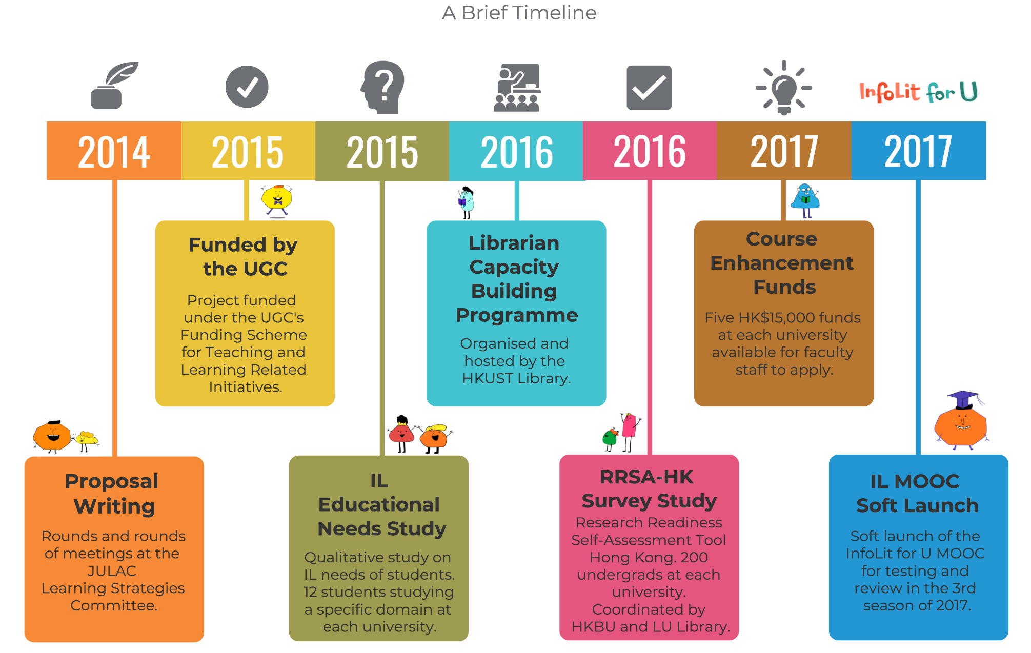
Notes:
Also, each participating institution plays very important roles in these sub-projects. At the poster session in the latter half of this morning you will have plenty of time to understand each of them more in details.

Slide 13
Potential New Initiatives
Research Support Committee
Senior staff development
Collaboration with Hong Kong Public Library
Shared remote storage?

