Slide 1
Using eLearning to Support Remote Instruction
Babak D. Beheshti, PhD
Professor and Dean of the College of Engineering and Computing Sciences (CoECS), New York Institute of Technology
Jennifer Fong
Director, Education Product, Sales and Marketing, IEEE

Slide 2
Our New Normal
Our New Reality

Slide 3
Some of the Challenges of Remote Instruction
Reimagining lectures
Student engagement
Finding effective teaching resources/content
Hands-on labs
Effective and reliable assessment
Data privacy
Multiple time zones
Language barriers
Internet connectivity
Synchronous vs asynchronous instruction

Slide 4
How NYIT Has Approached Remote Instruction

Slide 5
New York Tech’s Approach to Remote Instruction
Blended Course
Hybrid Course
Face-to-face class sessions accompanied by online materials and activities
Online materials are not intended to “replace” face-to-face class time but instead supplement and build upon the content discussed in the classroom
Online components replace a portion of face-to-face class time
Online interactions can be synchronous (i.e. Zoom) or asynchronous (i.e. online discussion forums, VoiceThread)
College of Engineering went 20% in-person, 80% of classes hybrid (Hybrid Remote Instruction – HRI)
Labs and first-year classes held in-person – but with HRI options available.
Extensive investment in technology
Notes:
A Blended course involves face-to-face class sessions that are accompanied by online materials and activities--essentially a “blend” of both live and online learning. A fundamental component of a blended course is that these online materials are not intended to “replace” face-to-face class time; rather, they are meant to supplement and build upon the content discussed in the classroom.
Hybrid courses differ in that their online components are intended to replace a portion of face-to-face class time. Online interactions can either be synchronous, meaning that students are interacting online in real time, such as through class sessions conducted via Zoom, or asynchronous, meaning that students interact online at different times, such as through online discussions or VoiceThread.
College of Engineering went 20% in-person, 80% of classes hybrid (Hybrid Remote Instruction – HRI)
Labs and first-year classes were designated as in-person – but with HRI options available.
Extensive investment in technology: enhanced audio-visual equipment in classrooms, software licenses for off-campus access, equipment for faculty, parking-lot WIFI access, hot-spot loaners, lab-kit loaners, faculty training in technology and methodology, redesign of classrooms and labs, …

Slide 6
Online Education CAN be Very Effective…
Online education, including online teaching and learning, has been studied for decades. Numerous research studies, theories, models, standards, and evaluation criteria focus on quality online learning, online teaching, and online course design.
What we know from research is that effective online learning results from careful instructional design and planning, using a systematic model for design and development.
Typical planning, preparation, and development time for a fully online university course is several months before the course is delivered. Faculty are usually more comfortable teaching online by the second or third iteration of their online courses.
https://ep.jhu.edu/faculty/learning-roadmap-for-new-online-instructors/comparing-face-to-face-and-online-teaching

Slide 7
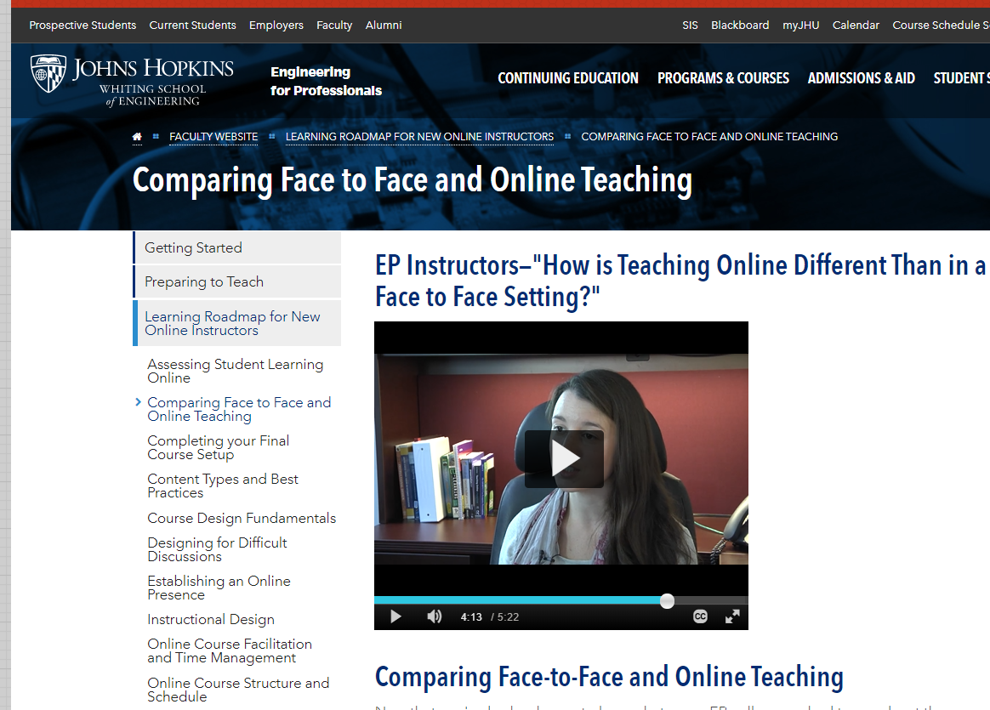
Teaching Face-to-Face vs. Online
Types of Differences | Teaching Face-to-Face | Teaching Online
Pedagogical* | Mostly synchronous interaction, content presented as lectures, hands-on, pencil-and-paper assessments, content can be planned session-by-session | Mostly asynchronous interaction, discussion forums, various means of content presentation, alternative assessments (e.g., collaborative/research projects, presentations), content must be planned out in advance of development
Operational | Held in the same geographic location at the same time—regularly scheduled sessions | Class is in session 24/7
Students | Often live in close proximity to campus, schedule allows for classroom sessions | Often working professionals, can be globally dispersed, personal availability can vary widely
Role of Instructor | Lecturer, sage on the stage that transfers knowledge to students | Facilitator, helps the students construct knowledge by guiding discussions
Watch this video:
https://ep.jhu.edu/faculty/learning-roadmap-for-new-online-instructors/comparing-face-to-face-and-online-teaching

Slide 8
General Hints for an Online Engineering Course (1)
Set Clear Expectations and Rubrics
Segment Your Content
Curate Content
Communication is Critical
Notes:
Set clear expectations and rubrics. Be organized much more so than in a face to face class, the spontaneity of the face to face class is not there - so students need to know very clearly what to expect and what is expected of them!
Remember to segment the contents. For example, a 50-page chapter need to be broken into modules.
Remember a wealth of resources is already available. You should consider your course to be a collection of curated content!
Course communication announcements are critical.
Post the announcements in multiple locations such as in the announcement section, the discussion area, and send emails.
Be cognizant of the fact that unlike the face to face classes that students deal with one or two input channels, now they may have to deal with 12 different input channels from their instructors in multiple online courses.

Slide 9
General Hints for an Online Engineering Course (2)
Assignments
Video
Quizzes
If you would normally have a single assignment with five questions, break it up into five small assignments that are dispersed in between relevant content.
If you use a lot of video, use Kaltura’s quizzing feature. This will stop the video at prescribed points and show your students questions you’ve created.
If you normally give a quiz at the end of the week, break it up into two or three small ones and position them after related content
Notes:
If you would normally have a single assignment with five questions, break it up into five small assignments that are dispersed in between relevant content.
If you use a lot of video, you can take advantage of Kaltura’s (https://corp.kaltura.com/solutions/education/) quizzing feature. This will stop the video at prescribed points and show your students questions you’ve created.
If you normally give a quiz at the end of the week, break it up into two or three small ones and position them after related content

Slide 10
Engagement
Connect students with one another. You may need to initially force this, as they are not in the same physical space, and the isolation can be overwhelming.
Don't lecture! eLearning and video content from publishers, your recorded videos and other content should be provided as on-demand basis.
Live (synchronous) sessions should be flipped: students do groupwork projects, have discussions, and Q&A.
Choreograph your module lesson plan sequence: (1) eLearning module, followed by (2) polling, followed by (3) quiz, followed by (4) video, etc.
“The one who does the work, does the learning.”
Notes:
Connect students with one another. You may need to initially force this, as they are not in the same physical space, and the isolation can be overwhelming.
Don't lecture! eLearning and video content from publishers, your recorded videos and other content should be provided as on-demand basis
Live (synchronous) sessions should be flipped, so that during this valuable time students do groupwork projects, have discussions, and Q&A.
Your module lesson plans should be a choreographed sequence: eLearning module followed by polling followed by quizzes followed by video etc.
The underlying principle should be “the one who does the work, does the learning”

Slide 11
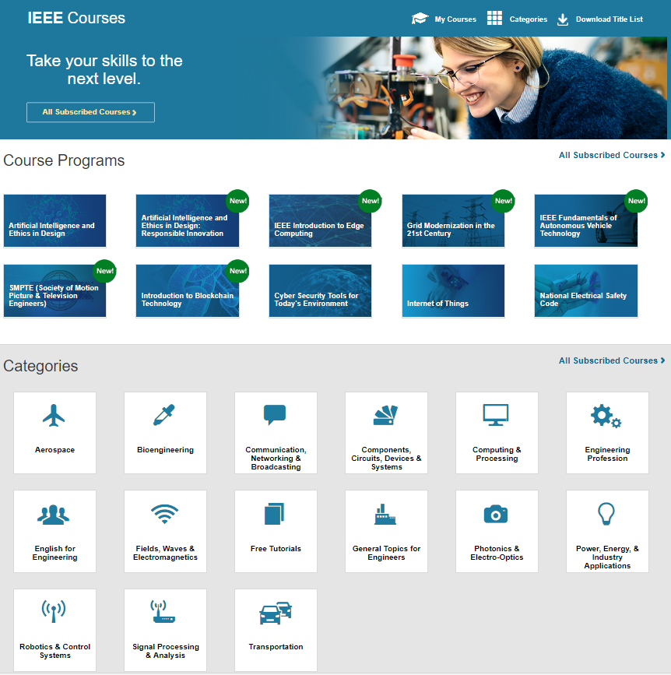
Use eLearning to Differentiate Instruction
In place of lectures
Create homework not from the textbook
Tutoring and supplemental instruction
Advising
Research
Projects
Notes:
To help with instruction, use vetted eLearning from publishers like IEEE to facilitate instruction, and allow synchronous time to be used for engagement.
As mentioned, use eLearning classes in place of lectures. Students can be presented with the content via the online course, and then discuss the topic during a live virtual meeting or answer questions in a discussion forum.
It’s also important to keep things interesting for students, and eLearning can help with this. Using an eLearning class can be more interesting for some students that reading a textbook. The online class is more interactive, and includes knowledge checks.
You can also send the classes to students who are having trouble with specific topics and need extra help. Let the eLearning course provide the supplemental instruction.
Have a student that is still trying to determine engineering/technology topics of interest? You don’t have to be the expert on every technology. Instead, use eLearning courses to provide an introduction to various technologies, to help students make informed decisions.
These courses can also be an alternative research source. When assigning courses presented by leading experts, that are peer reviewed, students can gain insights and content that can be used for a variety of research projects.

Slide 12
Group Work
Select online groups of four to six people, no larger groups
If possible don't let groups to be randomized - allow self-selection
Create a structure for each group:
Set time schedule to submit plans
Require basic team roles to be determined and submitted
Require scheduled internal team meetings as well as meetings with you
Set rubrics for team members’ contribution

Slide 13
Assignments
Use a rubric
Document your feedback
Add feedback responses for quiz questions
Continuously improve your course
Hold live sessions
Notes:
Use a rubric. It can make grading faster, communicate your expectations for assignments to students, and ensure your scores are more fair and consistent.
Some LMSs allow you to integrate a rubric into your assignments, which includes descriptors of criteria quality.
Document your feedback. As you go through a course, you will see patterns in student understanding. Keep a document where you collect the feedback you write to students so you can re-use it for duplicate cases.
Add feedback responses for quiz questions. Some LMS quiz tools allow you to add canned feedback to both correct and incorrect answers for each question. If students select an incorrect answer, you can have feedback that explains why the answer is wrong and direct students to resources to improve their understanding.
Continuously improve your course. Pay attention to the patterns you see in your students’ understanding. If they struggle with a topic, it may indicate that you need to enhance or replace parts of your content so that it does a better job presenting the topic.
Hold live sessions. For endemic misunderstandings in a content area, hold an optional live session using video conferencing software, e.g. Zoom. Be sure to record your session and post it to your LMS so students who can’t attend benefit from it as well!

Slide 14
Instructor Resources
IEEE eLearning Library (https://ieeexplore.ieee.org/courses/home)
Merlot Multimedia Resources (https://www.merlot.org/merlot/index.htm)
“within” Virtual Reality App (https://www.with.in/)
Examples of Available Lectures
Electronic and Electrical Engineering Lectures: https://www.youtube.com/channel/UCjALws4XTgfLyNnvXnKPj-g/playlists
200 on-line lectures covering all subjects of Digital Electronics on YouTube at: http://youtube.com/user/billkleitz
VHDL Basics and FPGA Impementation (Intel, Altera and Xilinx): https://www.youtube.com/playlist?list=PLBOhtamYB1hj8CJiOhz2F9kCQwcY6t5af
Introduction to Cryptography by Christof Paar: https://www.youtube.com/channel/UC1usFRN4LCMcfIV7UjHNuQg/videos

Slide 15
Online Labs
Example Vendor - Emona Multi-User, Remotely Controlled Experiments in Electronics and Telecoms
Emona offers a range of hardware experiments (NOT SIMULATIONS) which classes of students use a single equipment to carry out experiments in real time.
Easy student access: From anywhere on web browser, log on with USERNAME/PASSWORD
Many students can run independent experiments simultaneously due to very fast time-share technology

Slide 16
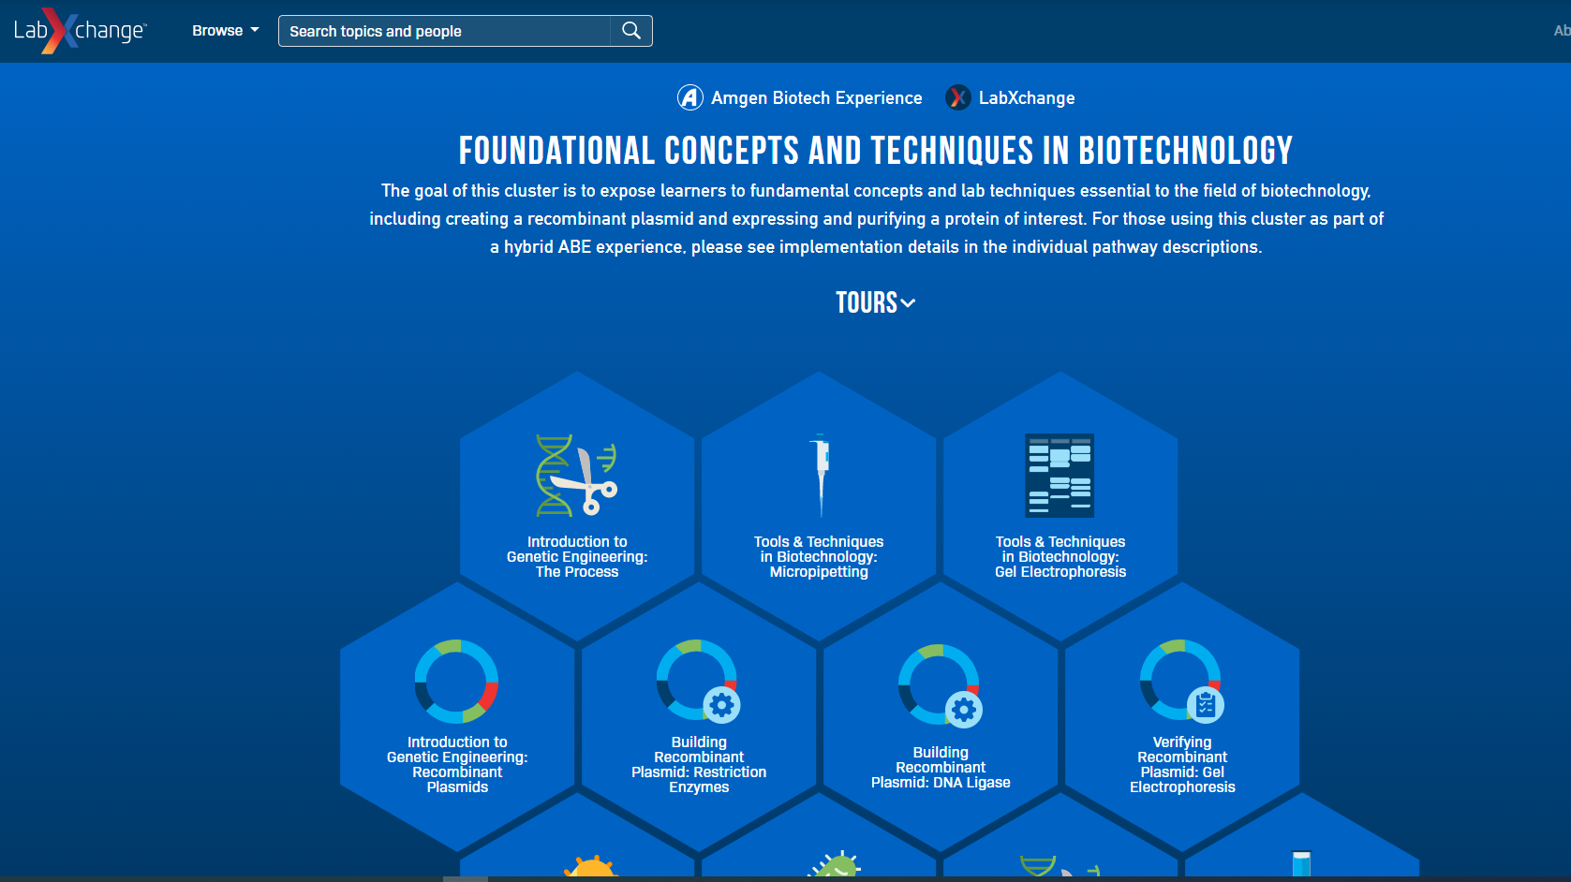
Online Labs
Example Vendor - Harvard’s LabXchange has just released a suite of lab simulations with assessments that focus on basic molecular biology techniques

Slide 17
Faculty Need Vetted Online Content
Publishers are the ideal source for peer-reviewed content that every student can access online
Faculty say they’re working up to 60% more
Finding and vetting content that all students can access takes a lot of time
Engineering libraries can help by providing vetted resources
Online instructional resources that are peer-reviewed and globally relevant allow instructors to focus on student support while still meeting accreditation criteria
Notes:
We’ve been talking to engineering faculty at institutions around the world, and universally the switch to distance learning has been really hard. Anecdotally, faculty tell us they are working 60% more than before. That makes it really hard to find good online content to support students that’s available no matter where students may be (and some may be in other countries where certain content isn’t accessible!)
Vetting resources is time consuming, but so is creating your own from scratch. That’s where engineering libraries can play a huge role. By offering online engineering instructional content that is peer-reviewed and globally relevant, professors can focus on supporting students in this unprecedented time.

Slide 18
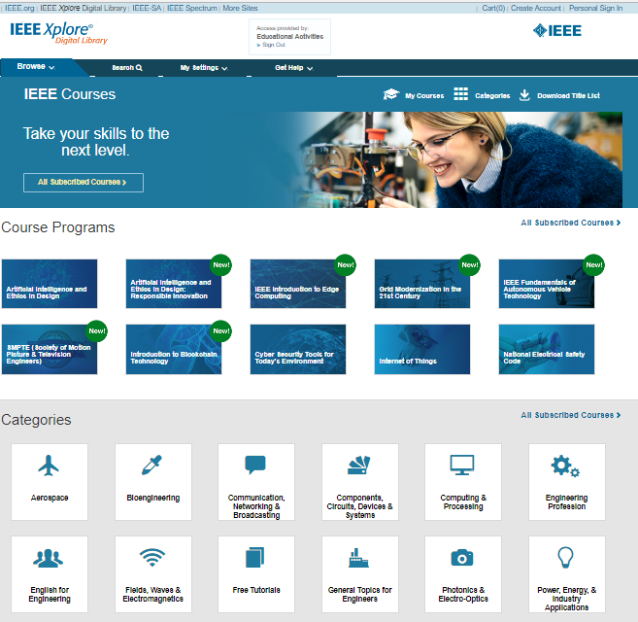
IEEE eLearning Library: Peer-Reviewed Online Library Resource
Hundreds of engaging, multimedia courses developed by leading experts from around the world
Entire library of online courses are peer reviewed
Online courses are available 24/7 and can be accessed from anywhere in the world on the IEEE Xplore Digital Library
Content supports a variety of engineering curriculum areas as well as Career Preparation topics
Notes:
eLearning Library online courses from IEEE helps with this. The content is developed by global leading experts in their fields. Their global perpectives on engineering help to meet the ABET accreditation requirement of global relevance in an engineering curriculum.
Unlike most free resources available online, the entire online collection of IEEE courses is peer-reviewed, making them a trusted resource to support the curriculum.
If you’re like most universities, you likely have international students who are now learning from different countries. Another feature of the IEEE eLearning library is that the courses are available online 24/7, and can be accessed from anywhere in the world, just like the IEEE Xplore Digital Library. This means that learning doesn’t stop simply because someone lives in a different time zone.
And let’s also be honest, many students now have many other things going on around them, from childcare responsibilities to shared technology to crowded living arrangements and more. Students may be better able to actually get the instruction from an online resource available 24/7 than from one that requires them to be online at a specific time.
What’s exciting is that the sheer breadth of the library…hundreds of hours of courses in a variety of engineering, technology, and even career preparation topics…means that there are very likely resources that many of your faculty can use no matter what engineering topic they teach.

Slide 19
Essential eLearning Topics for Engineering Education
Aerospace | Bioengineering | Career Development | Communications
Components, Circuits, Devices & Systems | Computing | Emerging Technologies | Fields, Waves, & Electromagnetics
IEEE Standards | Photonics & Electro-Optics | Power & Energy | Robotics
Signal Processing & Analysis | Telecommunications | Transportation

Slide 20
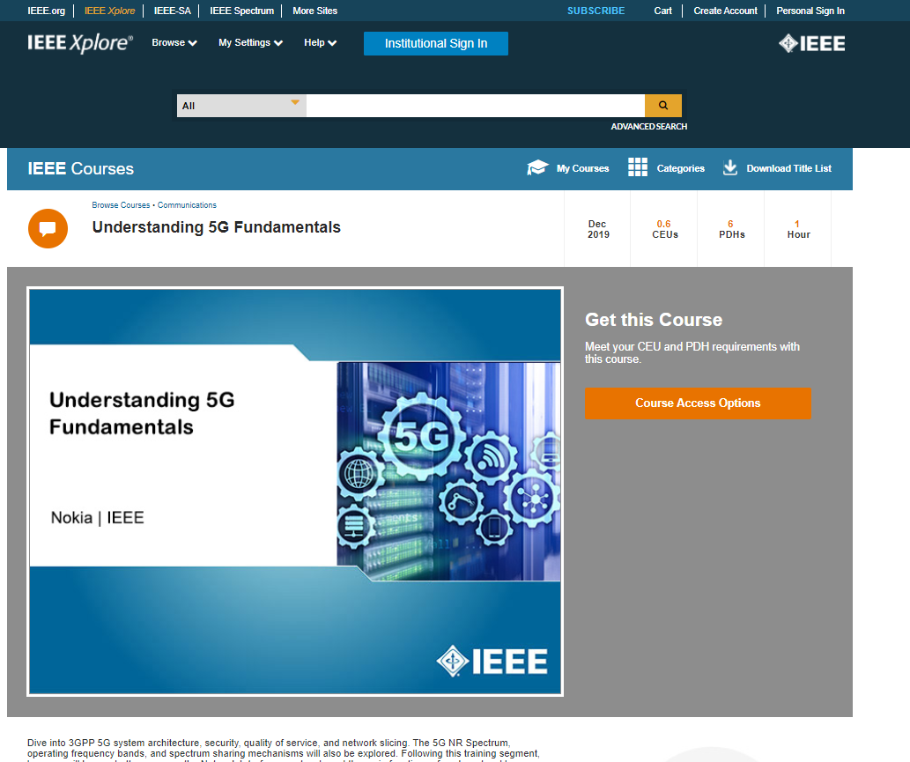
New York Tech’s Experience with IEEE eLearning Courses
Graduate level ECE course “Silicon IC Fabrication”
Selected two eLearning courses:
Interconnect Technology for 32 NM and Beyond
Dealing with Issues in VLSI Interconnect Scaling
Students are given about 3 weeks to complete the course
25 students in the course
Graduate level ECE course “Digital Communication”
Selected two eLearning courses:
Understanding 5G Fundamentals
Green Radio Techniques for Improved Wireless Basestation Design
Notes:
Include faculty experiences here

Slide 21
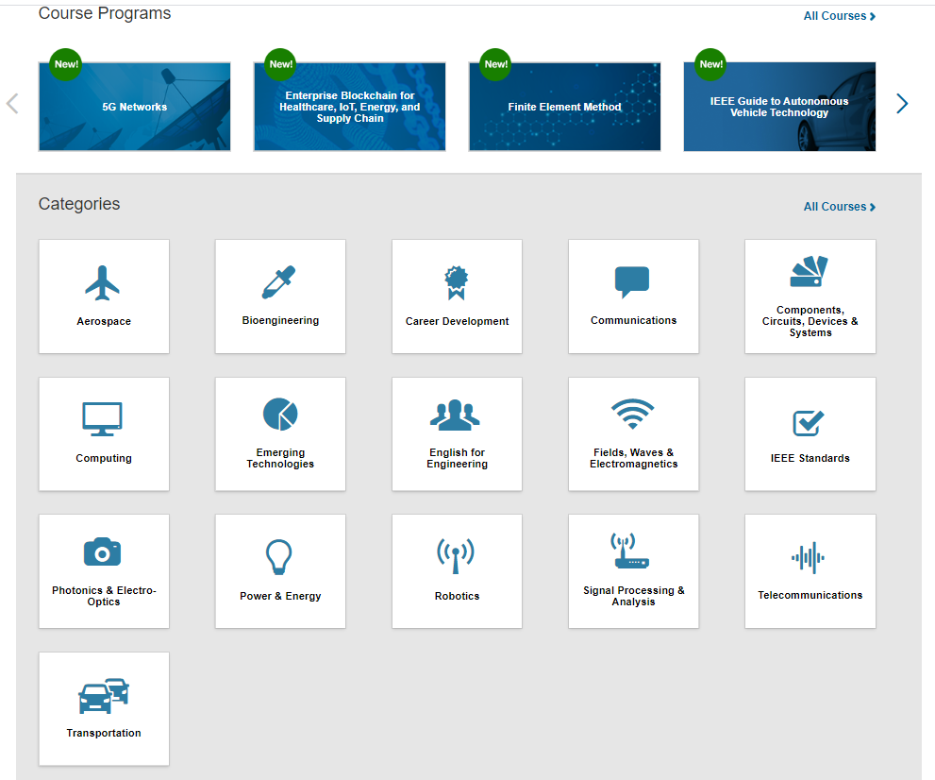
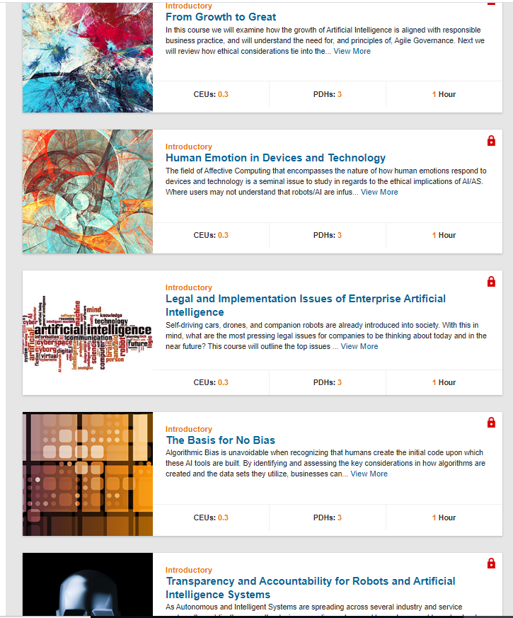
IEEE eLearning Content Can Supplement Many Engineering Classes
Notes:
Engineering and technology categories are vast in the eLearning Library, including courses in:
Telecommunications
Computing
Power & Energy
Standards
Aerospace
Bioengineering
Photonics
And so much more.
Some of our latest courses include course programs on:
The Ethics of Artificial Intelligence
5G Networks
Edge Computing
The Internet of Things
This year we have programs coming out about:
Artificial Intelligence Standards on Data Privacy
Digital Transformation
Machine Learning
Automotive Cybersecurity
To see if your university currently has access to the IEEE eLearning Library, simply click the Browse button next to the Xplore logo, and then click Courses. You’ll be taken to the courses home page. Click on any topic to find courses in that category. Any course title that has a green lock next to it is one that is part of your university’s subscription.
If you don’t currently have access, talk to the person who is responsible for your Xplore subscription, often the engineering librarian, to find out about special access offers.

Slide 22
Technical English Challenges Complicate Remote Instruction
English is the international language of engineering, and a job requirement for graduating students
It is hard for international students who struggle with technical English to learn these subjects remotely
eLearning programs like IEEE English for Technical Professionals help students master technical English before attending graduate engineering classes

Slide 23
How NYIT Uses English for Technical Professionals

Slide 24
Supporting University Continuing Education Programs
Alumni and other working professionals are experiencing career displacement due to the pandemic
eLearning courses can be offered through the university:
Workforce retraining
Alumni services
Career services

Slide 25
Questions?

Slide 26
Thank you!

