Slide 1
Supporting remote access and online courses by libraries in the new normal
Jeremy Chou 周頡
Sales Director of Taiwan, Hong Kong and Macau
Notes:
OA: Mobile/Remote Access
Faculty Select: $

Slide 2
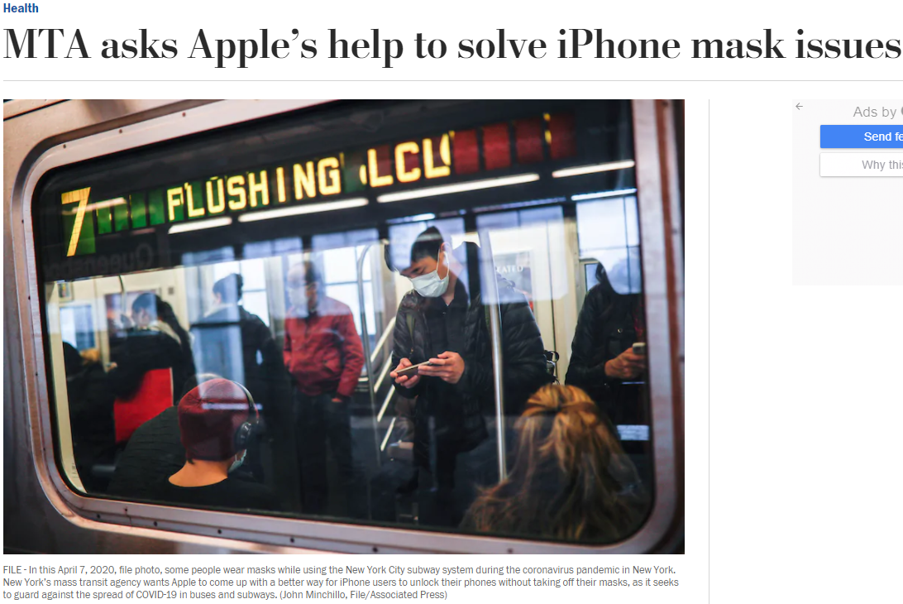
Notes:
Face ID vs Touch ID . 推 birdy590: 用 Touch ID 根本就無感... 真的是沒事找事做
[新聞] 紐約運輸署要求FaceID不用拿下口罩就能解
Metropolitan Transportation Authority，MTA）就向 Tim Cook 要求，希望蘋果能替 iPhone 更新 Face ID 功能，在不用脫下口罩的情況下也能解鎖手機。 MTA 發現不少乘坐地鐵或交通交通工具的民眾會拉下口罩進行 Face ID 解鎖，擔心這種 做法會增加病毒傳播的風險，故 MTA 主席 Patrick Foye 發信給 Tim Cook，要求蘋果改 善 iPhone 的 Face ID 口罩解鎖功能，讓市民可以不用拉下口罩也能解鎖 iPhone。
其實蘋果在推出 iOS 13.5 更新後，若 Face ID 辨識用戶配戴口罩會立即跳出密碼解鎖 ，但這方法並沒有從根本改善戴口罩解鎖 Face ID 問題，所以 MTA 才要求蘋果進一步努 力改善問題。

Slide 3
“ When the pandemic hit and all the students went home, we began to see e-resource usage decline. We suspect that our users, not understanding how off-campus library access works, simply gave up. ”
Notes:
the Society for Scholarly Publishing 學術出版協會讓成員們以及相關研究工作者交流的一個網站，很多所謂的guest post，來自館員的真實經驗與案例，可以讓大家參考與學習。
電子資源的校外連線與使用，對於某些使用者而言，或許沒有像前述談到的iphone認證/解鎖般來的重要，所以當校外的連線認證有問題的時候，往往可能直接放棄。
那我還是去用SCI-HUP或是Google Scholar好了。
On our highly residential campus, IP access works well. Or at least, it used to. When the pandemic hit and all the students went home, we began to see e-resource usage decline. We suspect that our users, not understanding how off-campus library access works, simply gave up.

Slide 4
Notes:
2018年11月一份來自OpenAthens (英國身分存取與管理, )
900館員
53% 學術圖書館 25%醫學圖書館

Slide 5
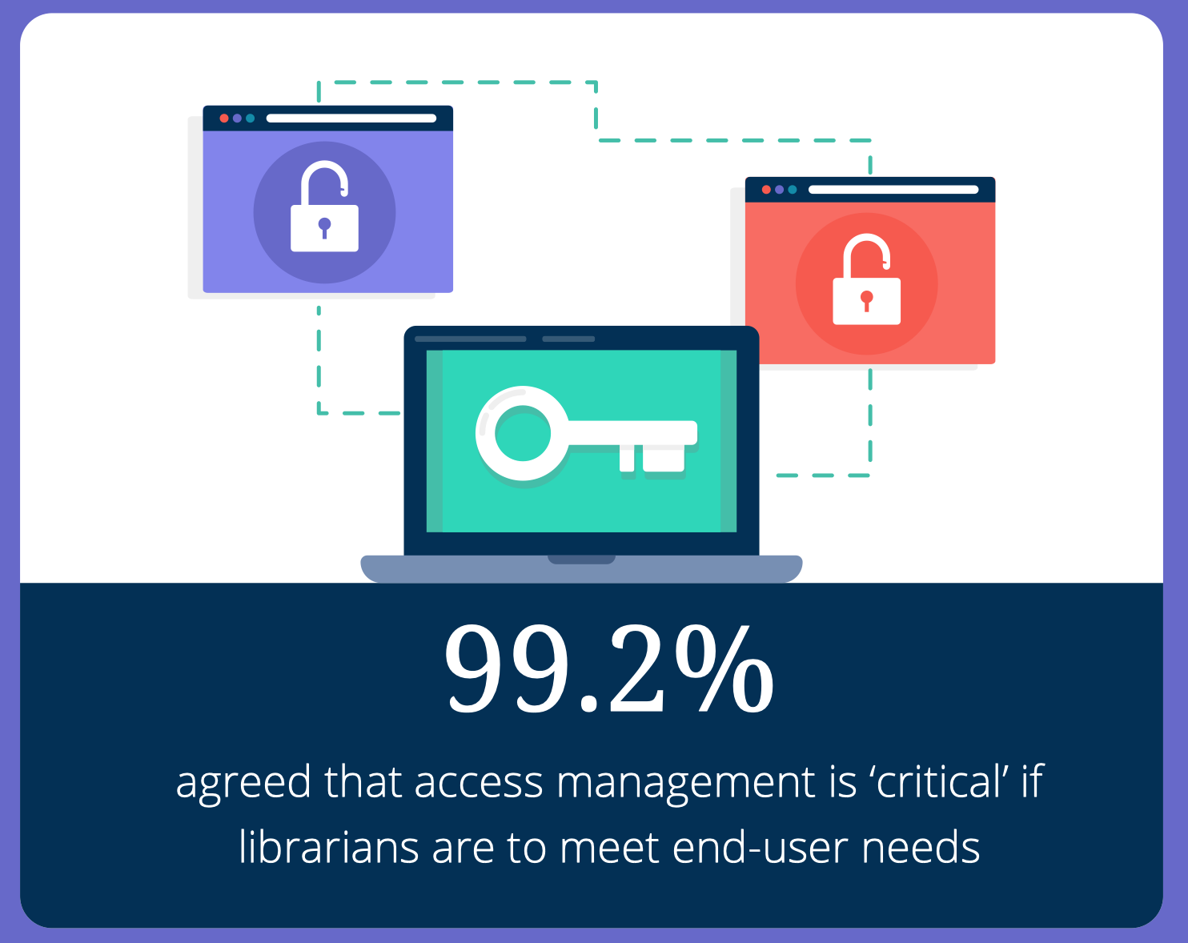
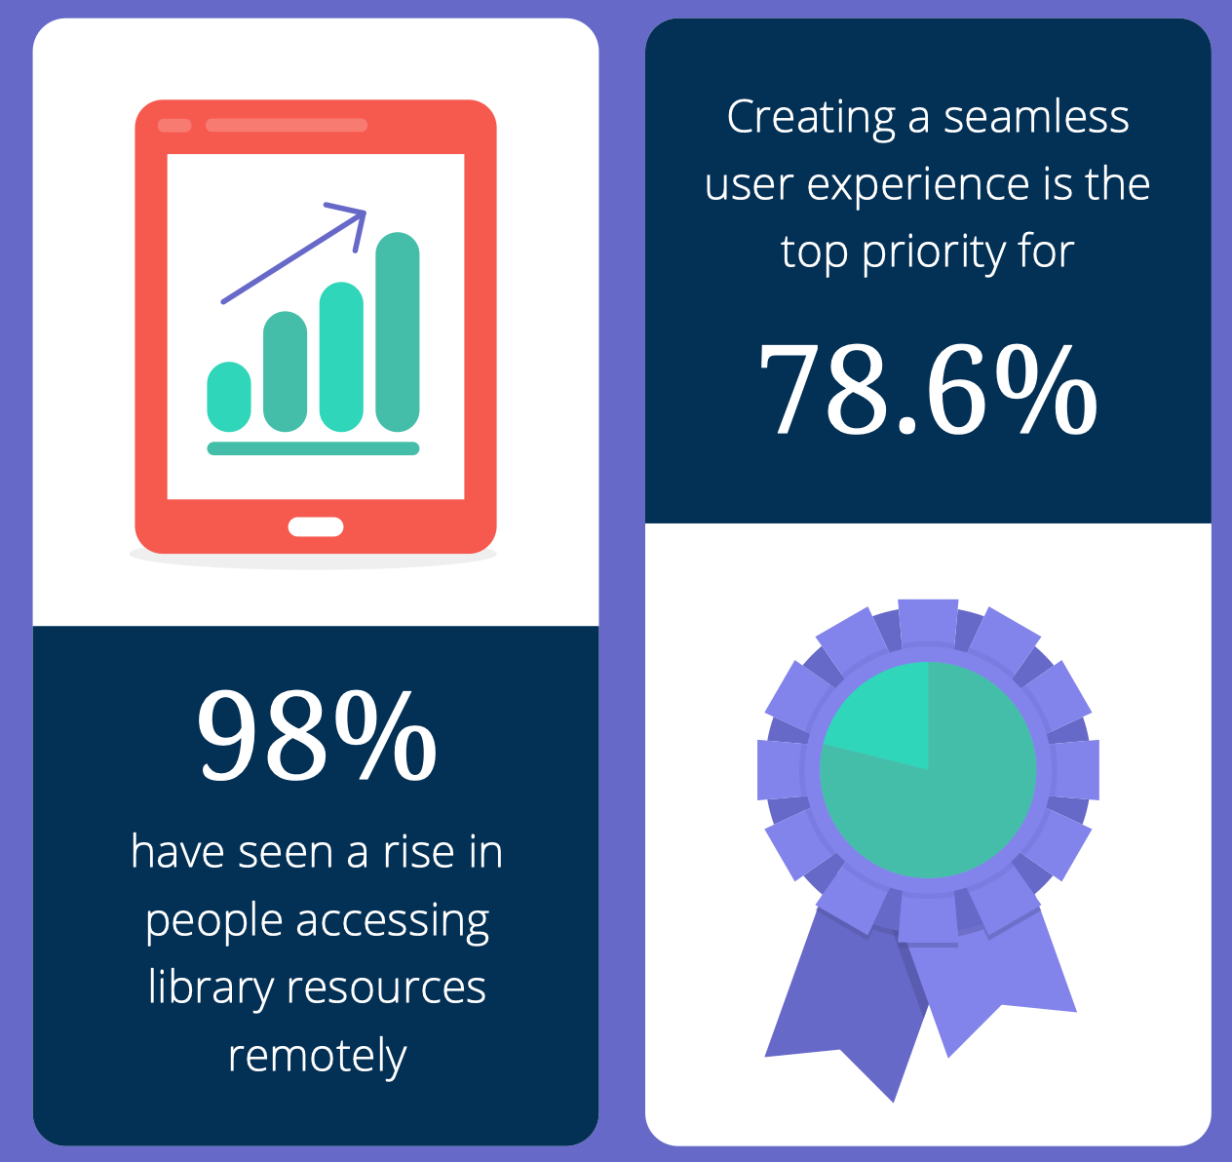
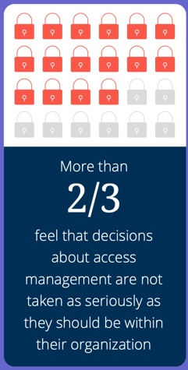
Top 3 Key takeaways
Notes:
99.2% 滿足使用者的需求 存取管理很關鍵
98% remote access 大幅度的成長
2/3館員 單位沒有認真看待電子資源的存取管理

Slide 6
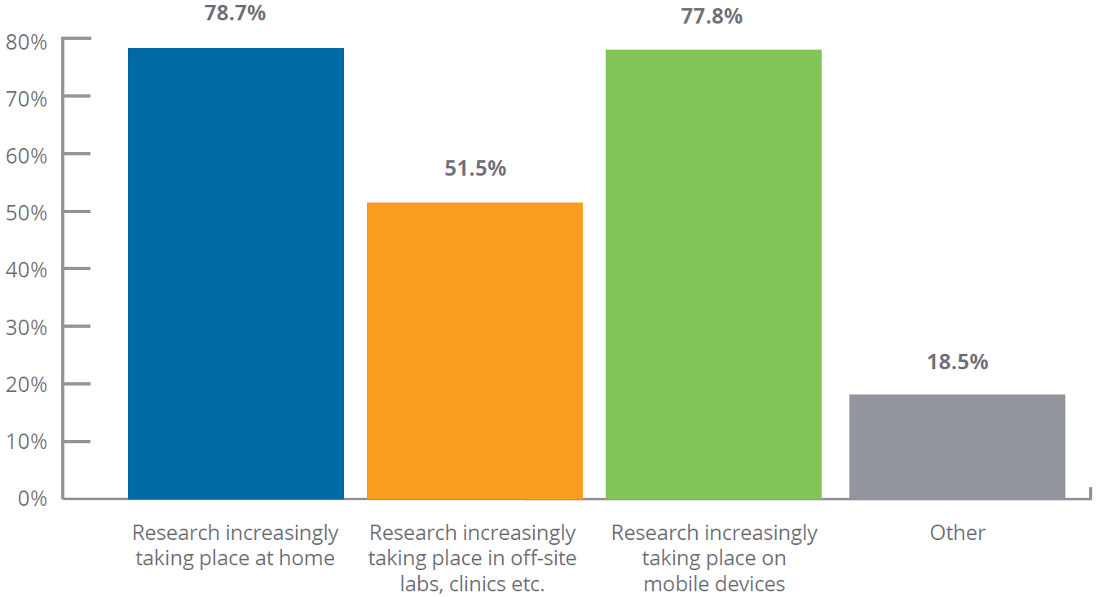
Why the remote access is rising?
Notes:
在家中進行研究
在校外/機構外的實驗室診所診間 進行研究
利用行動裝置進行研究
現在進行式

Slide 7
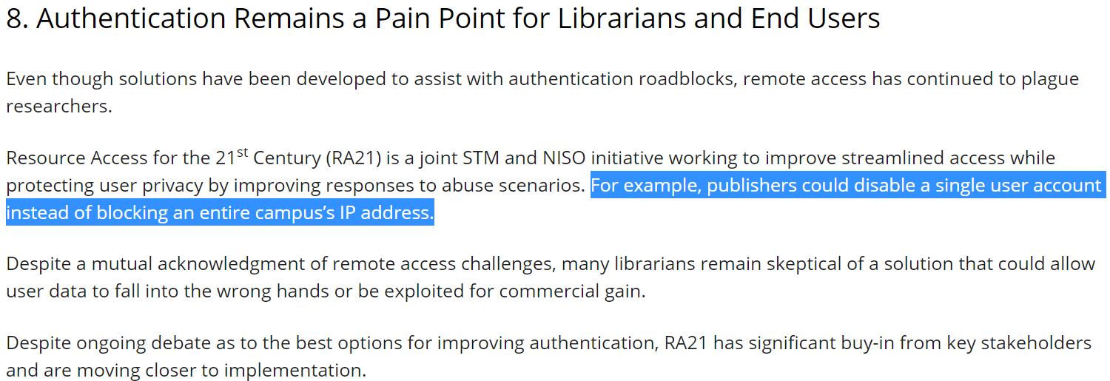
Notes:
對於使用者還有館員來說，認證依然是一個痛點。 遠端連線則是一直苦惱著研究者。
RA21由STM及NISO所提供的主張跟聲明
簡化資源認證與存取過程，保有使用者隱私以及降低資源的非法濫用
只需停用某個使用者帳戶 無須封鎖整個校園IP

Slide 8
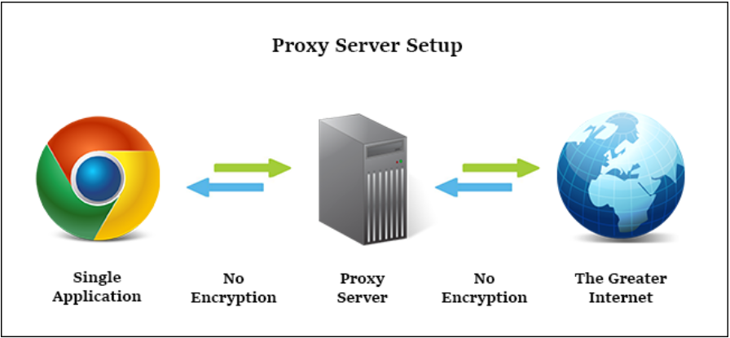
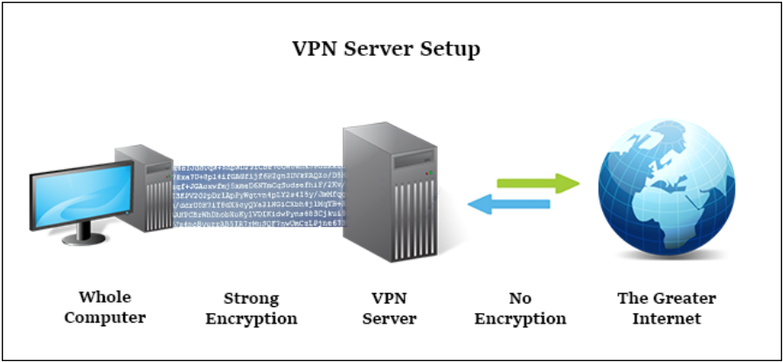
Remote Access / Off-Campus
Authentication based on IP address
Notes:
無論是行之有年的VPN或是PROXY SERVER 都是以IP為基礎的認證
對於圖書館以及資源提供商而言，都無法確切地知道，是誰在用什麼資源

Slide 9
或
Notes:
在這樣的背景下，以SAML認證為基礎的方式，以OpenAthens這個服務為例，自然也受到了資源提供商與圖書館的關注

Slide 10
Notes:
因此無論在校園ip內或是校園ip外
圖書館跟資源提供商 出版社 資料庫廠商都可以知道是誰在存取資源

Slide 11
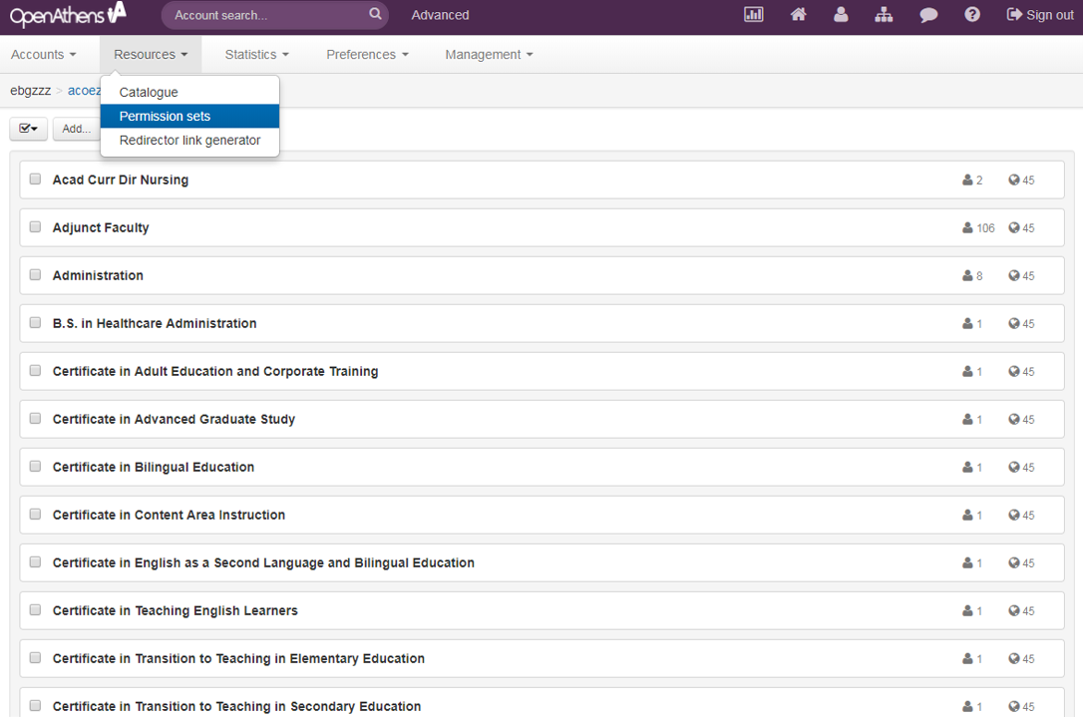
Customizable Permission Sets for Resource Allocation and Viewing Usage
Notes:
知道是誰在用後 可以控制誰可以使用什麼資源 以及那些資源可以給誰用
套用該permission的人數與資源數

Slide 12
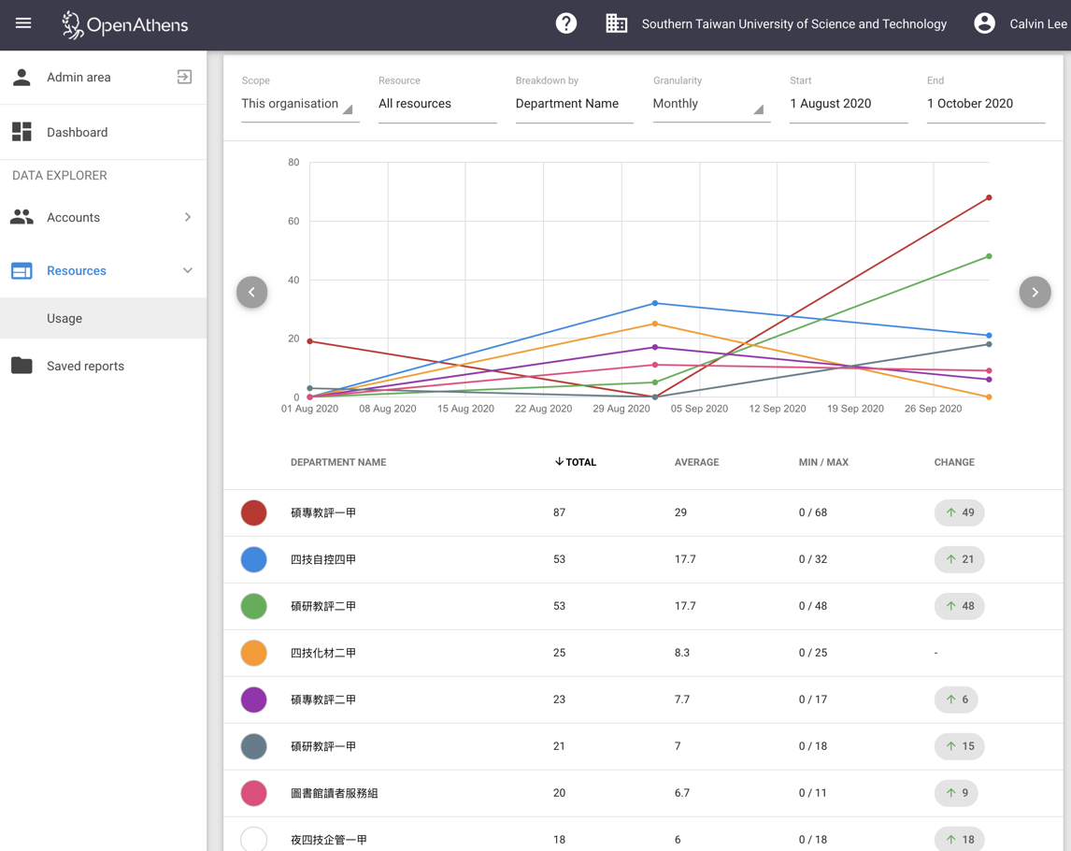
Notes:
相對應的在處理使用統計的時候 也能夠依據使用者的屬性 跑出不同族群的使用統計報告

Slide 13
Doing research or accessing content from the Mobile Devices
In 2015, research taking place on mobile devices was rated the most likely cause by 84.3% of respondents.
Research increasingly taking place on mobile devices (77.8%).
Higher education (HE) and healthcare both ranked research increasingly taking place on mobile devices as the number one cause of off-site access.
Limitations of current system prevent users from making best use of mobile devices (37.1%).
Notes:
前述由OpenAthens所進行的研究報告中，
將近八成的館員認為，透過行動裝置進行研究，是造成remote access大幅增加的主因之一。
來自高等教育以及醫療機構的館員們，甚至認為使用行動裝置進行研究，是造成remote access 增加的第一原因。
不過，這也反映出了一個現象，以當前認證系統或是遠端存取系統的侷限性，使用者無法最佳化地使用行動裝置達到做研究的需求。

Slide 14
Notes:
校園網路的wifi訊號有限制 尤其以醫療院所為例
讀者必須使用自己的4G網路進行IP的認證

Slide 15
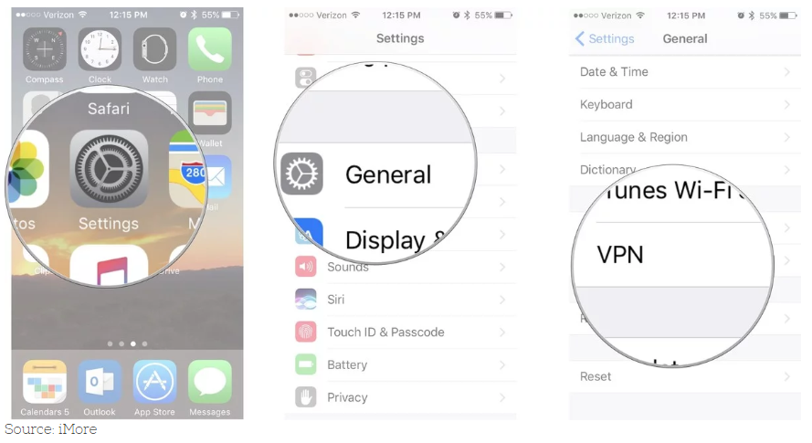
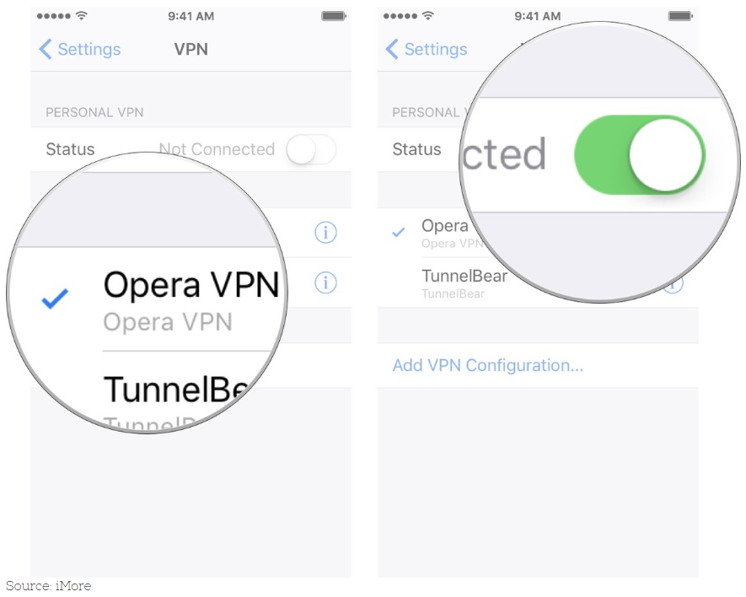
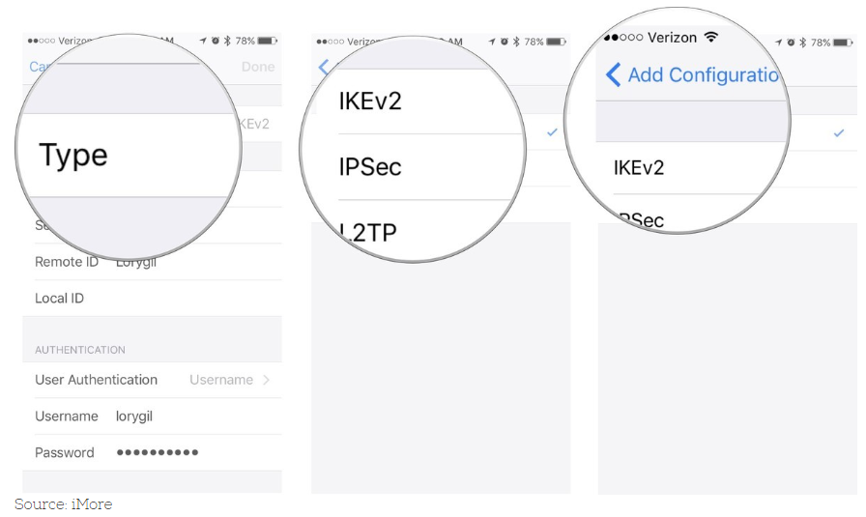
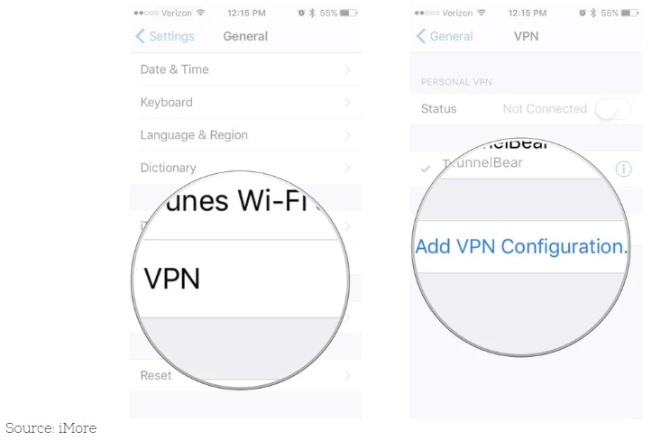
Notes:
因此必須在手機上設定VPN或是利用VPN軟體

Slide 16
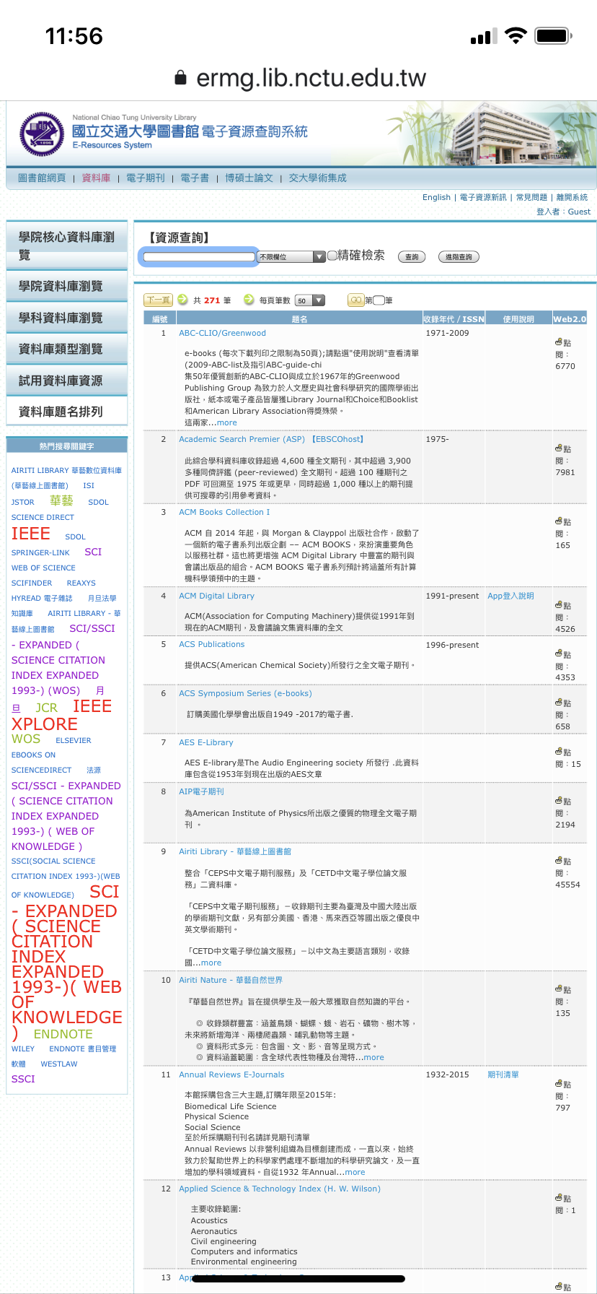
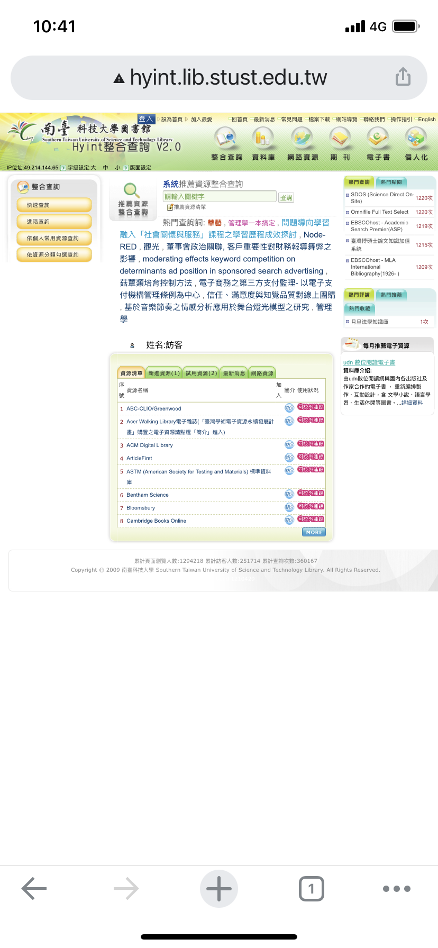
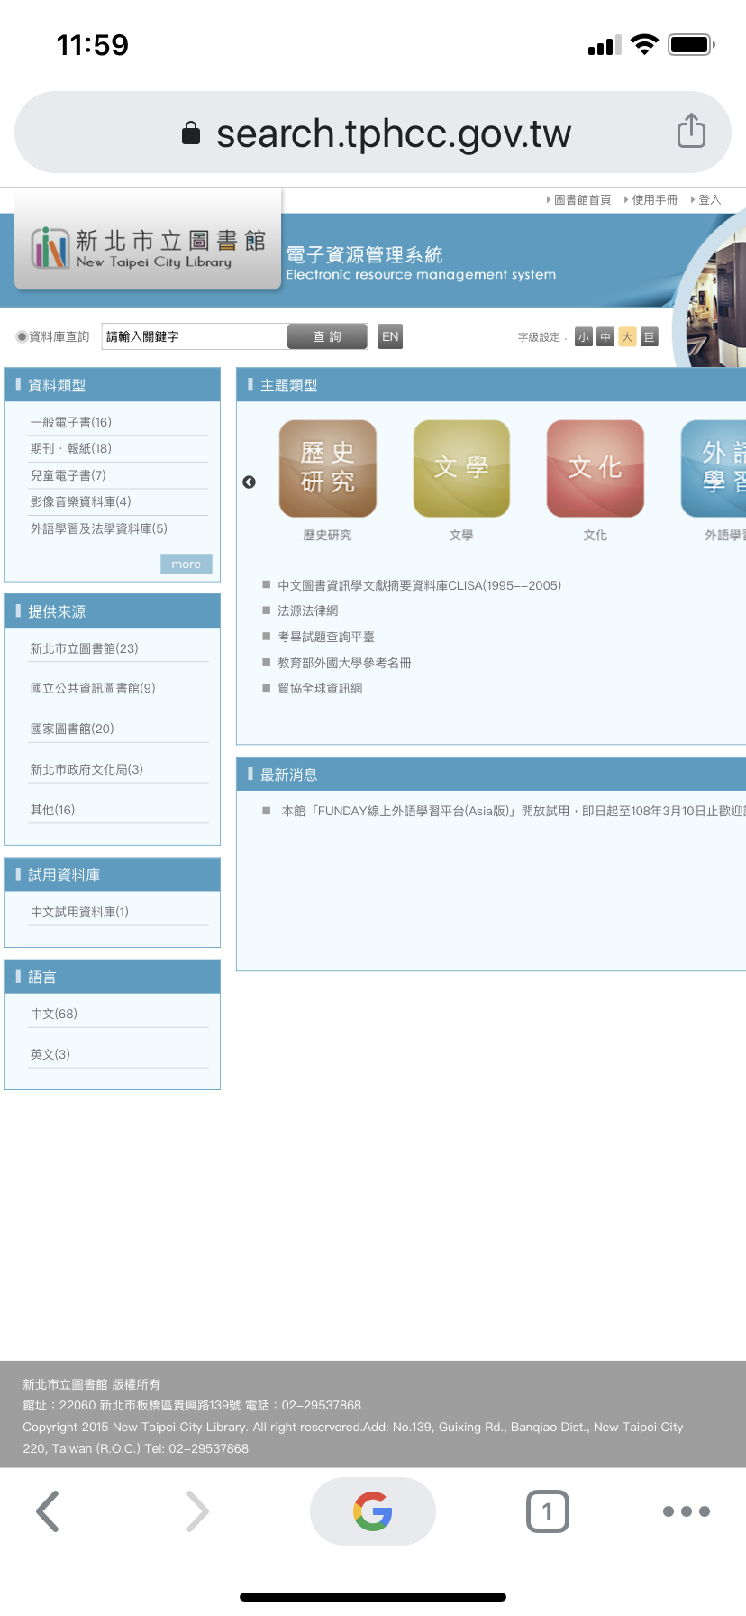
Notes:
抑或是回到圖書館的資源認證與登入系統進行操作

Slide 17
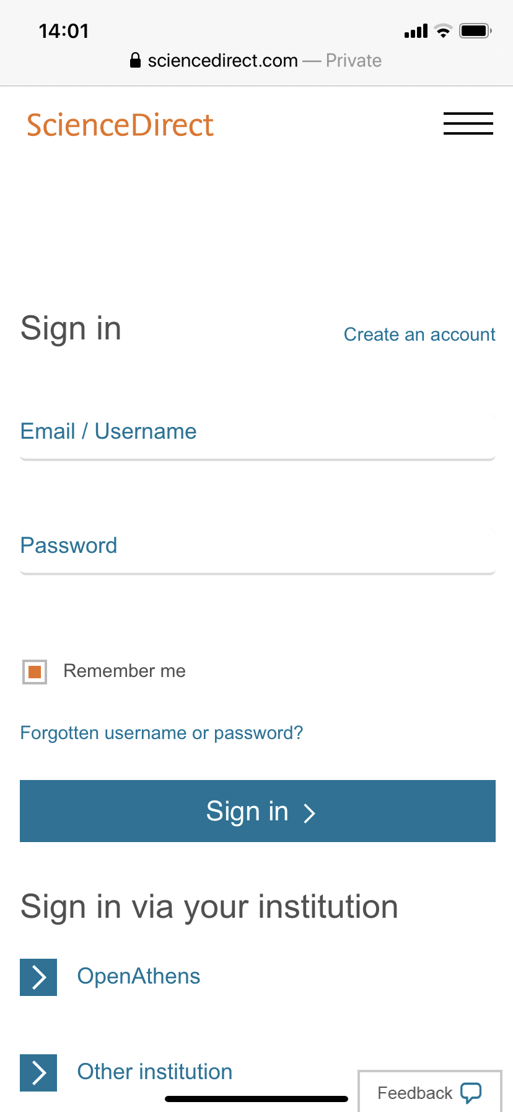
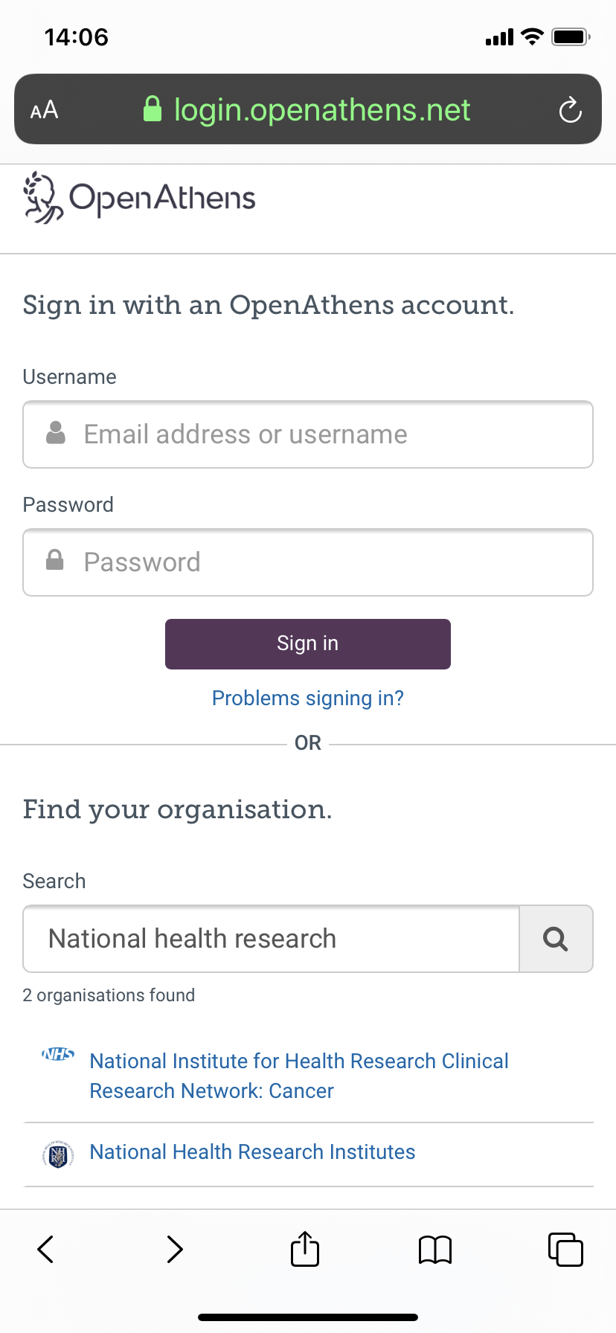
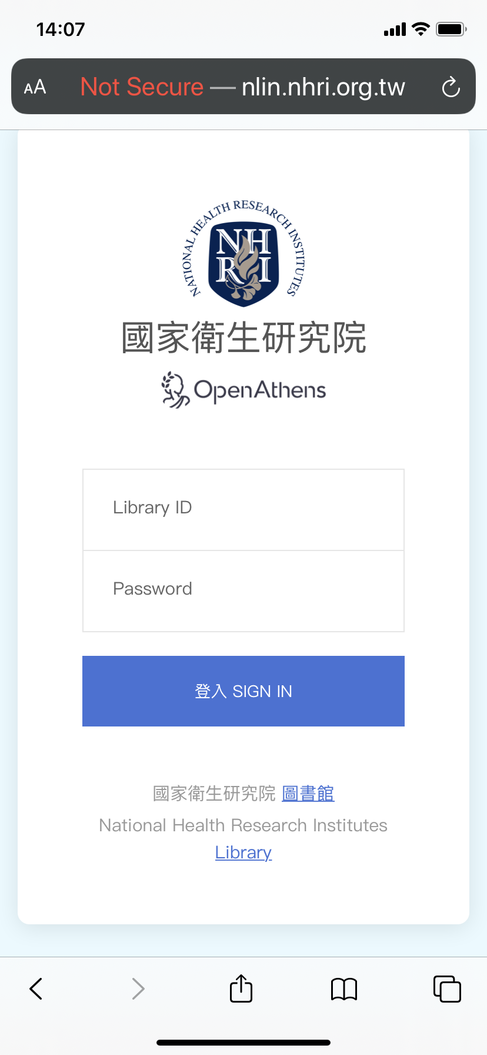
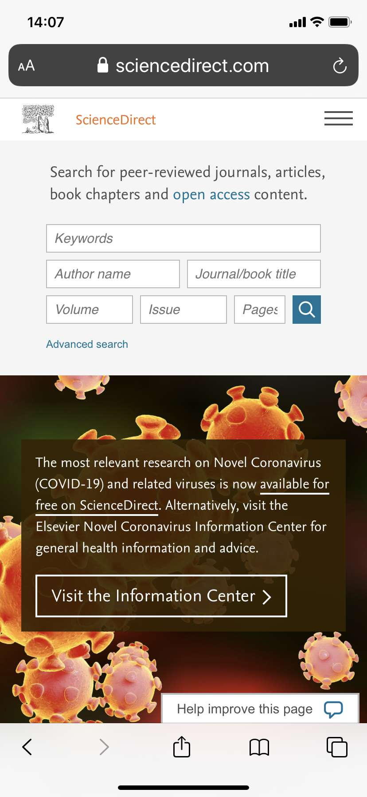
3
2
1

Slide 18
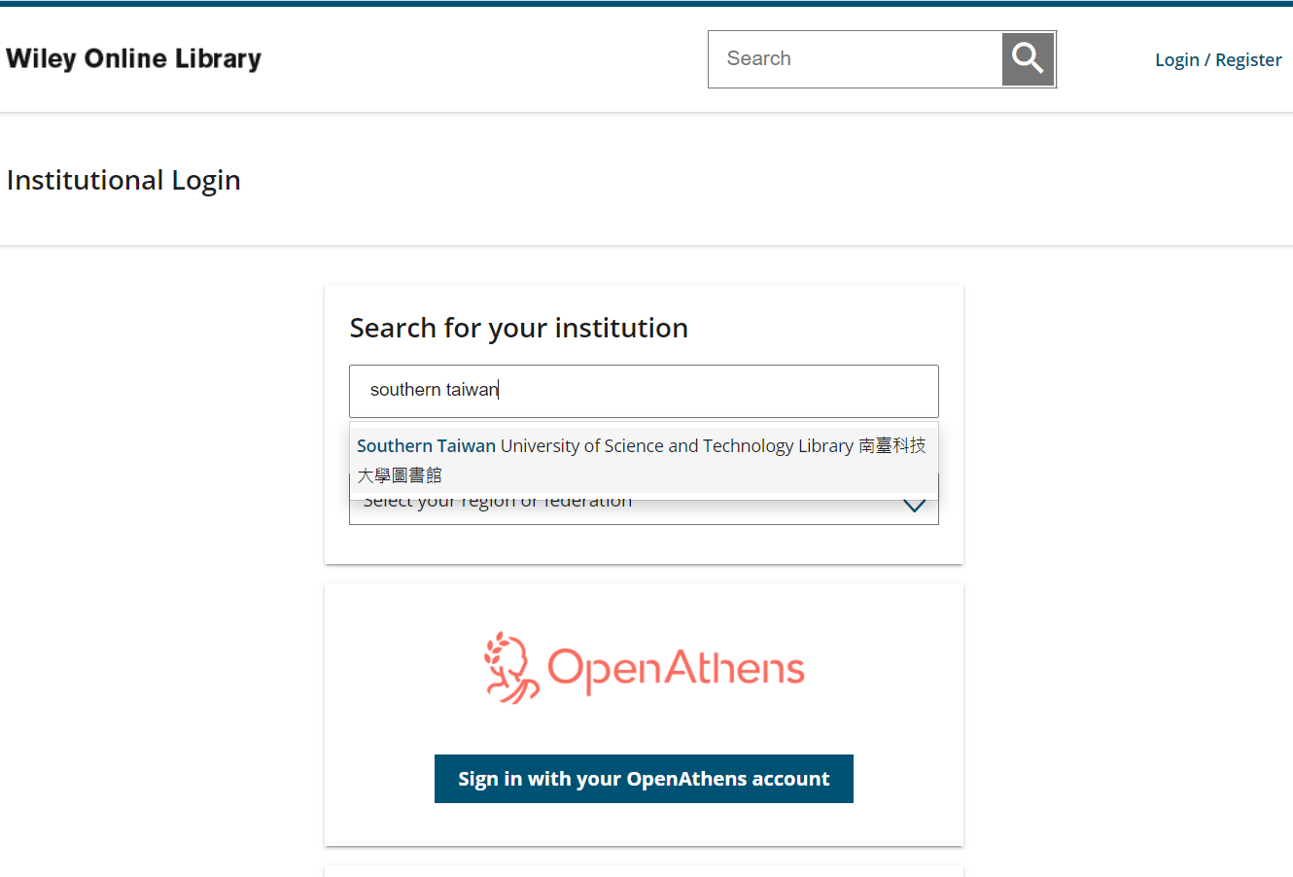
1
2

Slide 19
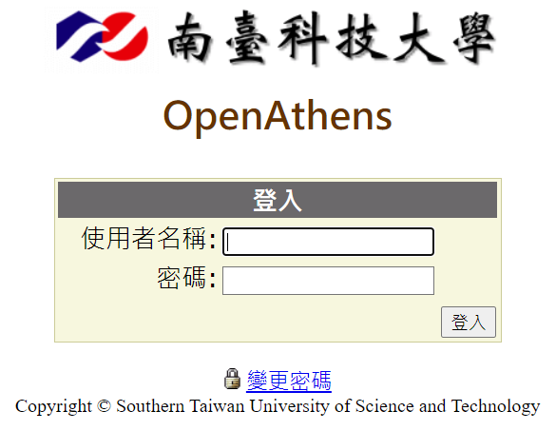
3

Slide 20
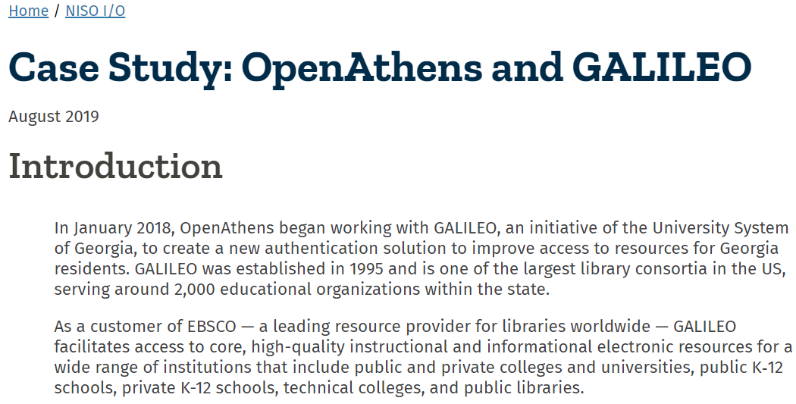
https://www.niso.org/niso-io/2019/08/case-study-openathens-and-galileo
Notes:
2,000個教育機構，包含大專院校學術圖書館、公共圖書館、以及K-12 也就是所謂的國小至高中圖書館。
服務對象涉及900萬位讀者/使用者

Slide 21
The GALILEO initiative also works on a number of additional projects beyond portal access to databases that are aimed at fulfilling the organization’s goal of promoting lifelong learning for the residents of Georgia.
One of the most notable is the Affordable Learning Georgia initiative that supports the implementation of affordable alternatives to expensive commercial textbooks. The project is saving students millions of dollars on textbooks each semester by facilitating access to open textbooks or to resources made available through GALILEO.
Notes:
除了前述提及的認認與資源存取服務，還有很多是針對整個喬治亞州的居民所服務的計畫。
其中一個最著名的專案，就是”可負擔的學習計畫”

Slide 22
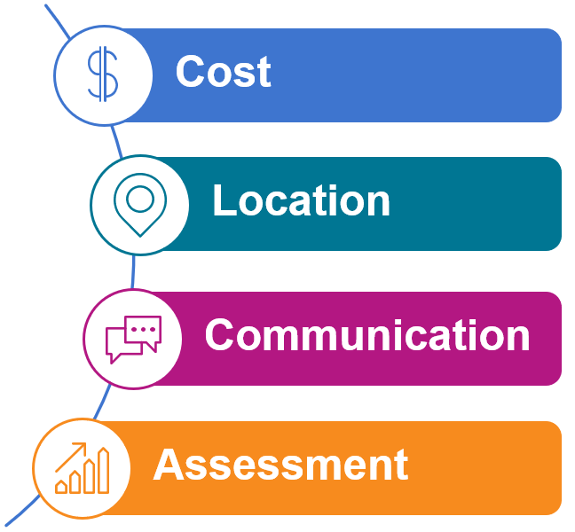
Notes:
Costs: 上漲 學生成績
Location: 統一入口/途徑 oer資源 不熟悉 youtube Google scholar
Communication 館員教師溝通有挑戰 老師不會主動找館員 館員也不清楚要提供那些OER給老師
Assessment:
Librarians are looking for ways to help drive usage and show value of library materials. Tracking usage of library resources is necessary to prove the value of those resources and materials.

Slide 23
2/3 of the libraries surveyed agreed that Textbook Affordability is a major concern for their institution, and nearly all 95% believe that it’s a major concern for students.
Some 64% of librarians reported helping faculty select appropriate OERs for their courses.
While faculty are very skilled at evaluating educational content, they are not as skilled at finding and using it online.
Frustrated by costs or digital rights management (DRM) restrictions.
https://www.libraryjournal.com/?detailStory=lj-textbook-affordability-survey-costs-still-a-concern-oer-an-opportunity
Notes:
2/3館員教科書的可負擔性 顧慮 學生的負擔
六成館員有在幫忙老師找OER
When discussing about the “Textbooks”, we have to understand the issues and problems so far.
12 thousand US dollar, is the annual textbook spending for a college student, this is from the college board.

Slide 24
“There is substantial interest in use of open educational resources for instructional practices, particularly from younger faculty members.”
“About six in ten respondents are very interested in using open educational resources (OER), and roughly half strongly agreed that they would like to adopt new instructional approaches with OER.”
https://sr.ithaka.org/publications/2018-us-faculty-survey/
Notes:
What is the attitude about the OER from the faculty members’ perspective?

Slide 25
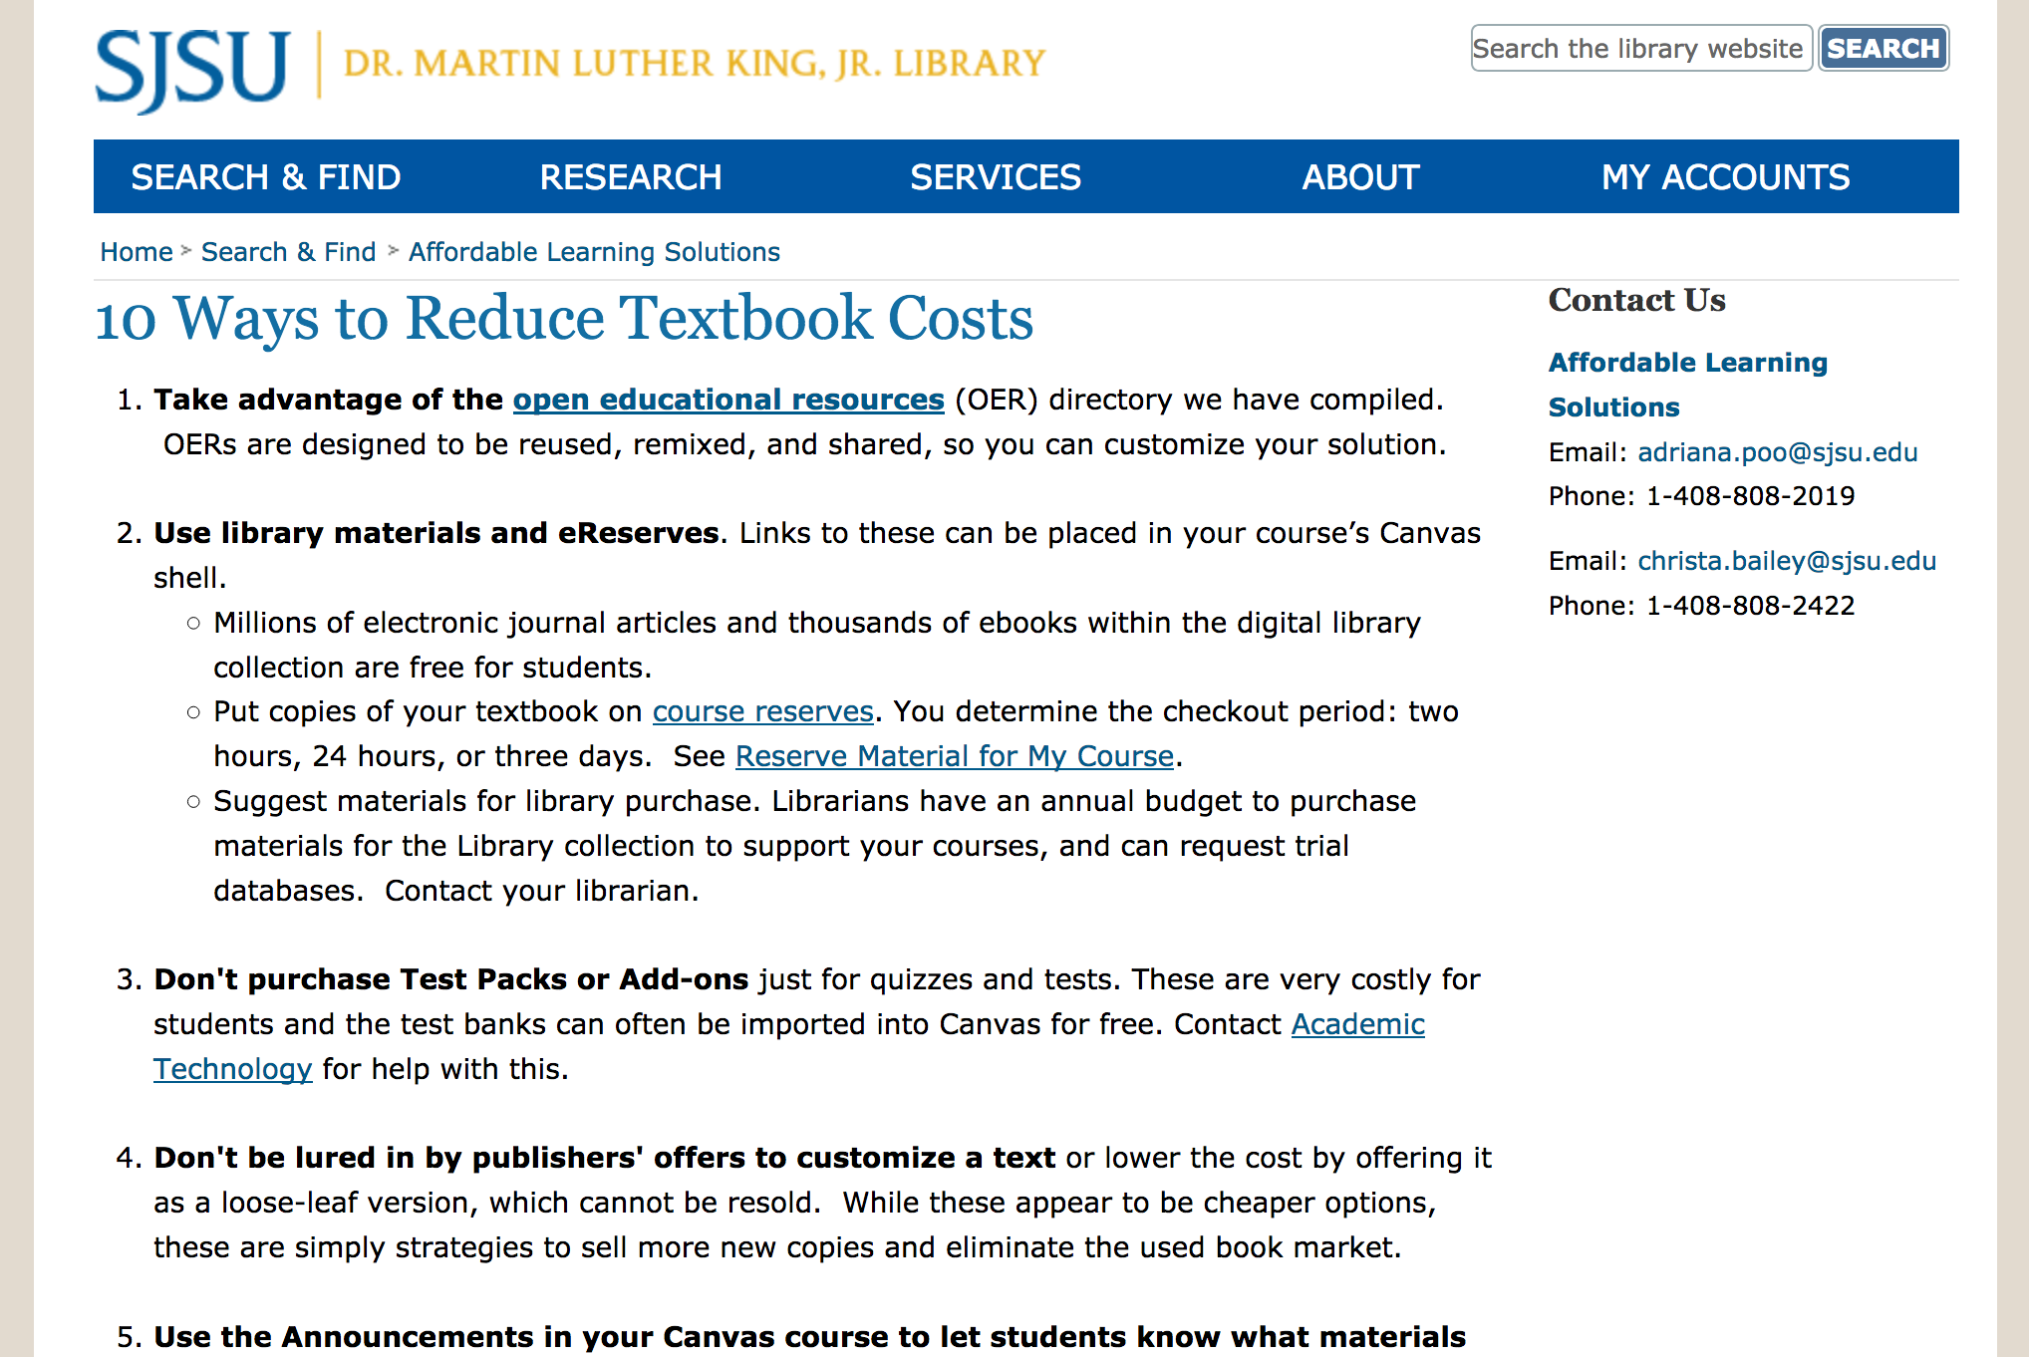
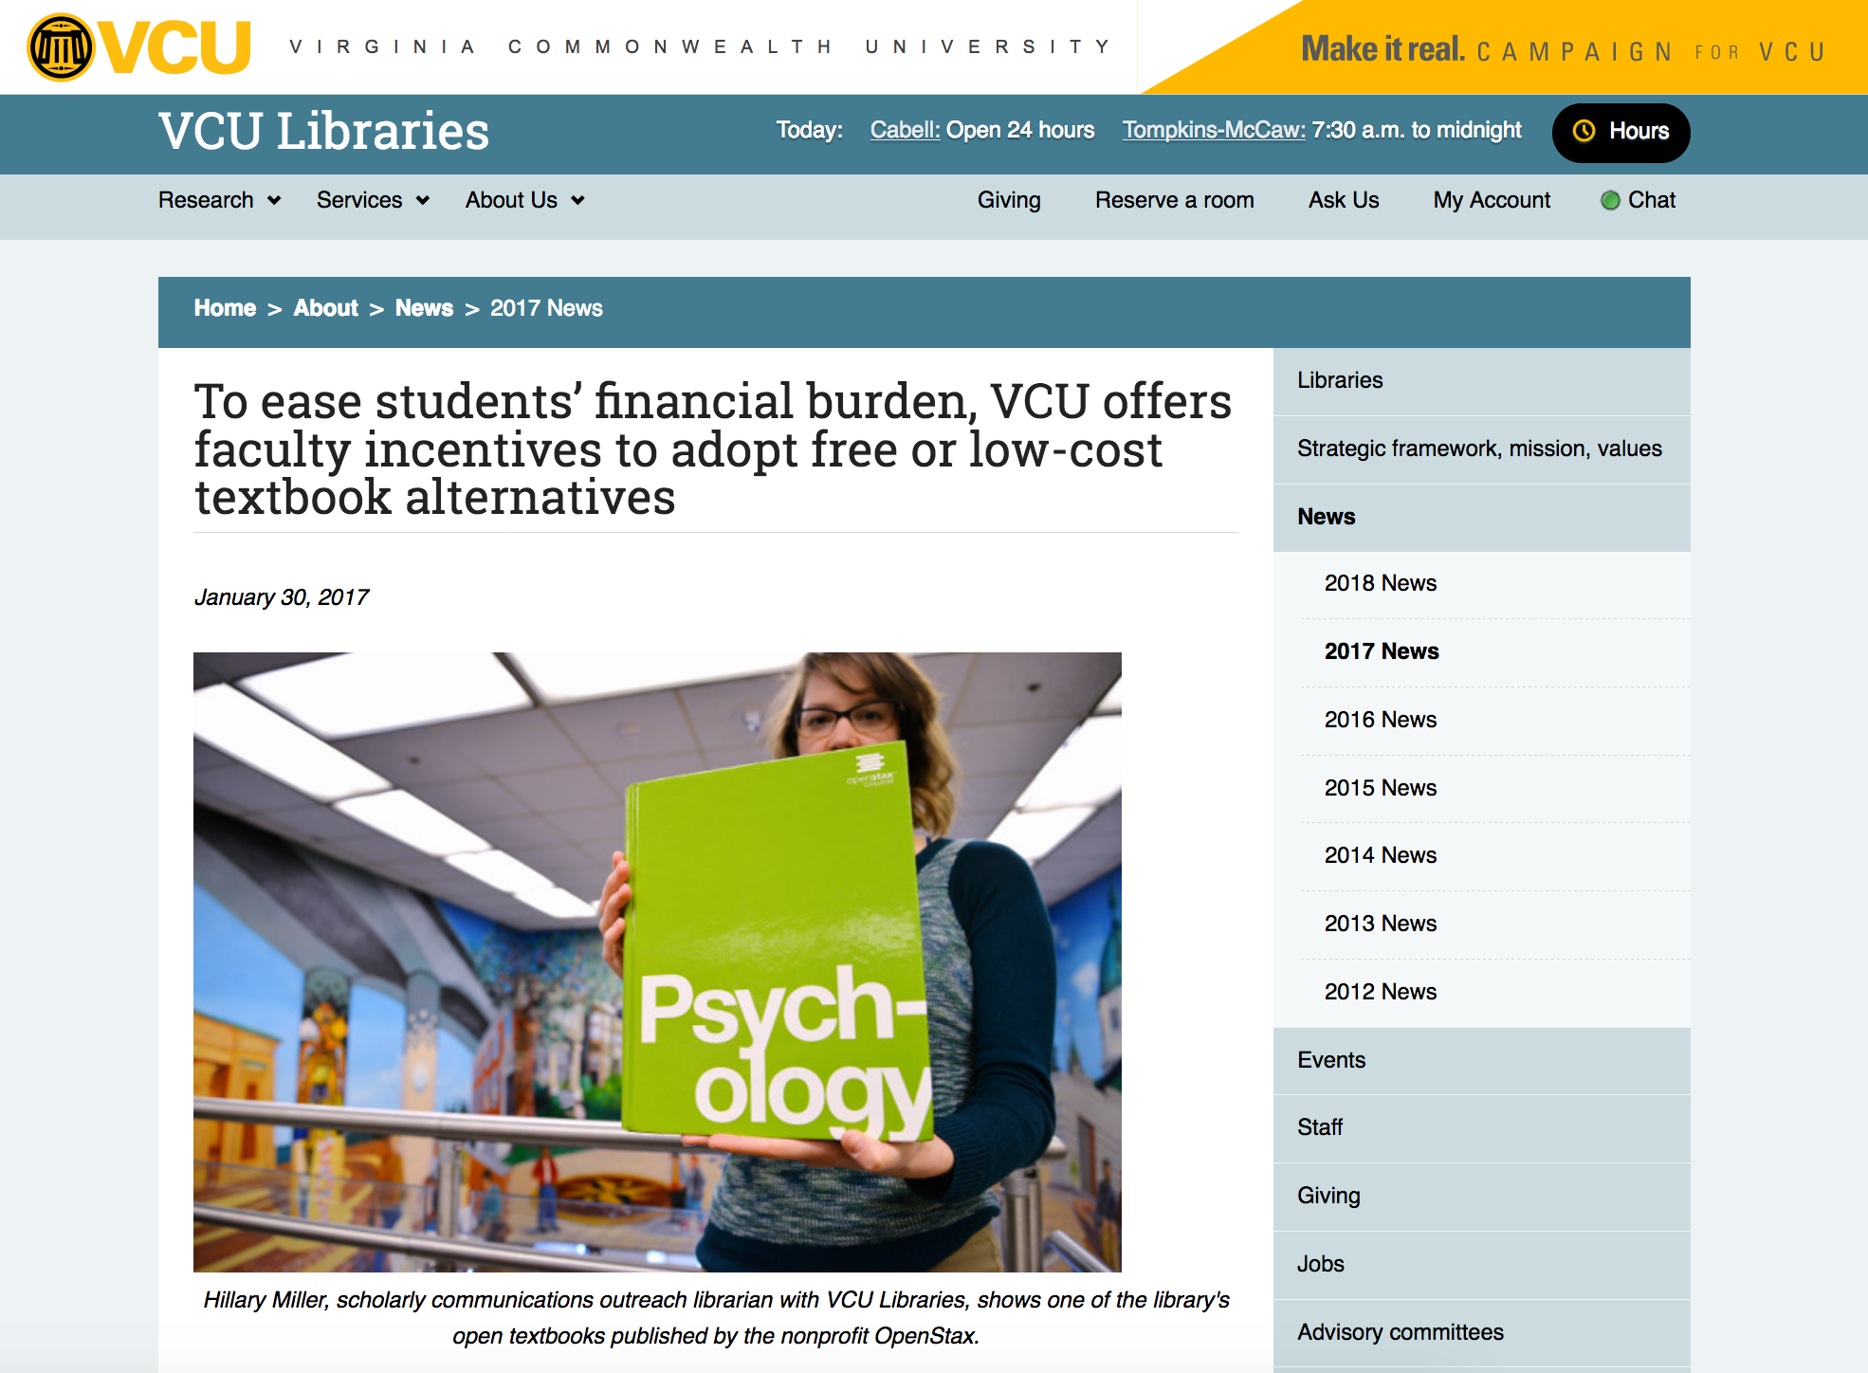
Libraries are trying to help through innovative approaches to material acquisition and faculty education
Notes:
Faculty members are invited to apply in two categories:
Adopt Awards: Redesign your course to incorporate existing low-cost or free educational resources. $500 per person, capped at $3,000 per course (though special considerations will be given to large departments and other special scenarios).
Author Awards: Create a substantially new open textbook or open course content when it is possible to demonstrate that quality resources are not currently available to meet learning objectives. $2,000 per person with a project cap of $6,000 per course.

Slide 26
Notes:
Some people think OER is one if the alternative solution to fix the issues about the textbooks.

Slide 27
‘Platforms like Faculty Select are the ‘go-to’ place for universities to obtain quality, free content which supports student access while also controlling the ever-rising cost of education.’
Notes:
No Shelf Required 一個聚焦在電子書與出版產業的blog website
What about the public review to Faculty Select?
This is from the notable website in the monograph field.

Slide 28
Value Proposition
Faculty Select enables an institution or a consortium to further drive textbook affordability, access, and usability for their faculty and students.
Through a single, easy-to-use interface faculty can:
easily find and access quality Open Educational Resources (OER) to support their courses
search/request access to relevant e-books from top academic publishers

Slide 29
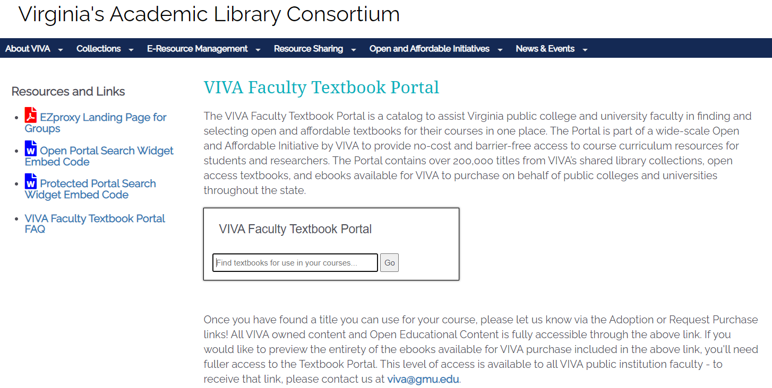

Slide 30
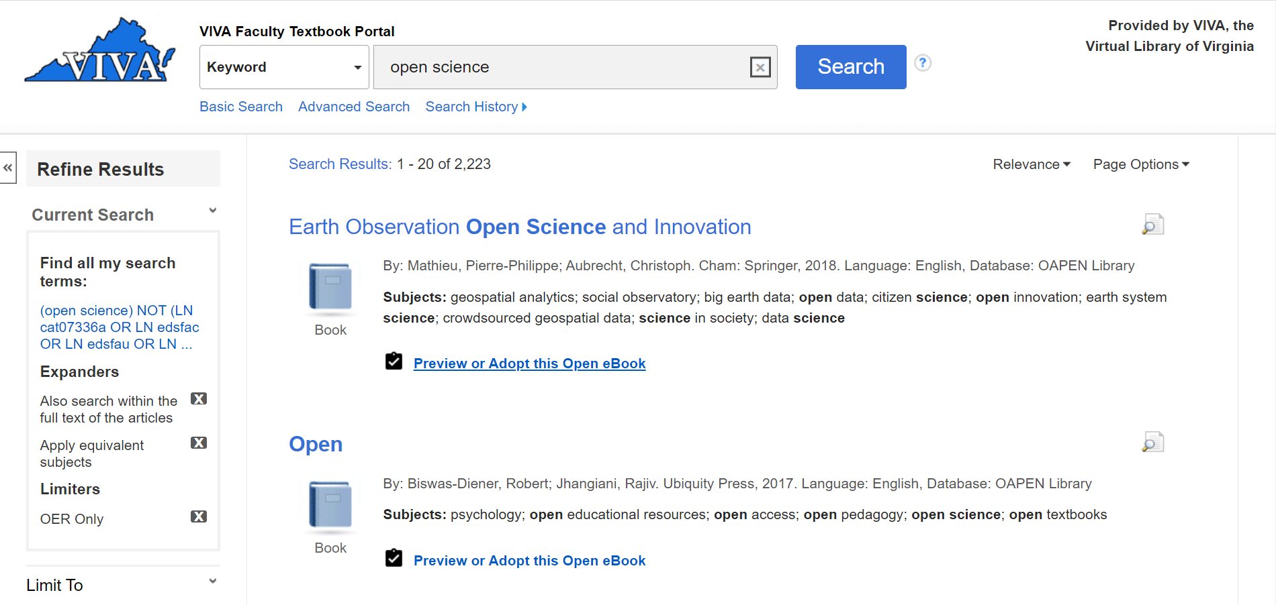

Slide 31
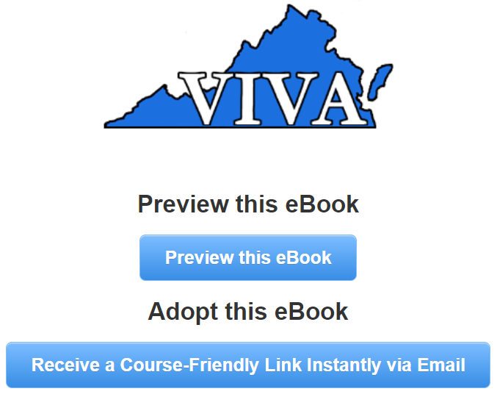

Slide 32
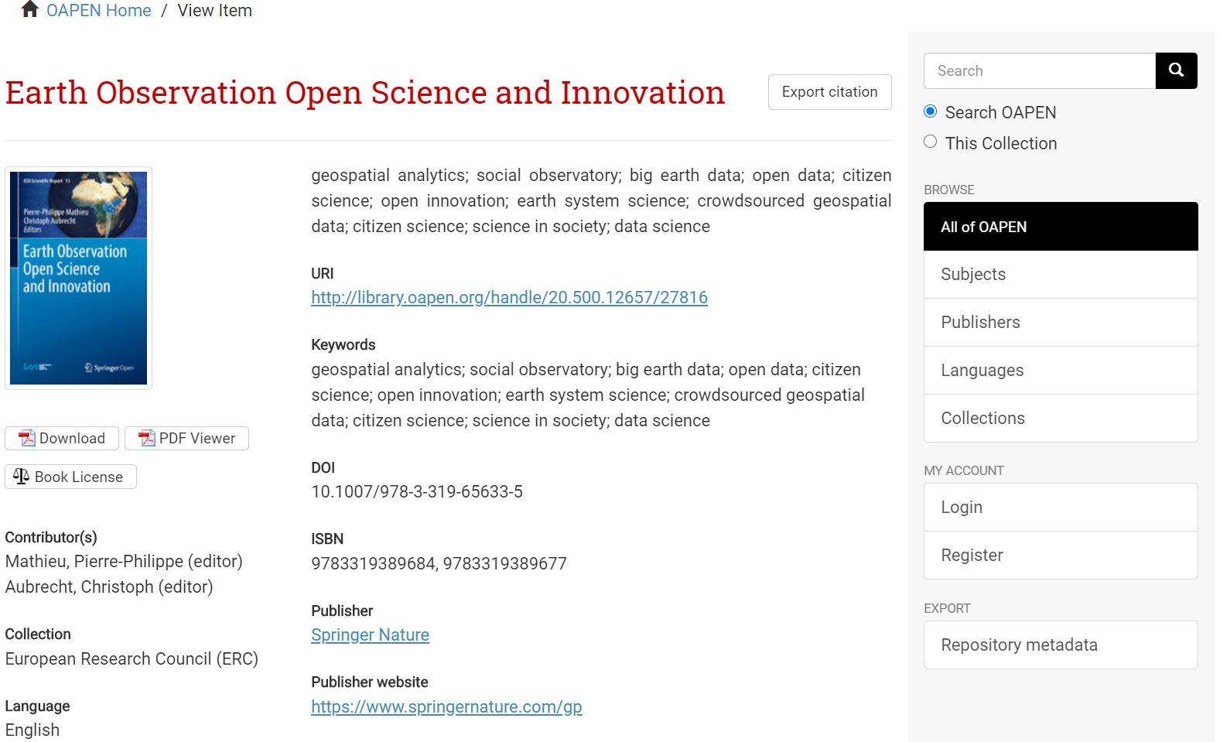

Slide 33
A quote from a university librarian in Massachusetts, USA
“…so far, every faculty member who has seen Faculty Select has agreed to adopt a free-to-students textbook. We’ve saved students well over $50K in the first week.”
Notes:
麻薩諸塞大學洛厄爾分校
Please NOTE:
This slide is NOT for public briefing, but you can mention this ORALLY.

Slide 34
Thank You
Jeremy Chou 周頡
jchou@ebsco.com

